Slide 1
APEX Accelerators
April 15, 2026
How APEX Can Help You!
Gina Corce
Procurement Counselor
gcorce@missouri.edu
MoAPEX.org + Connect with us on LinkedIn

Slide 2
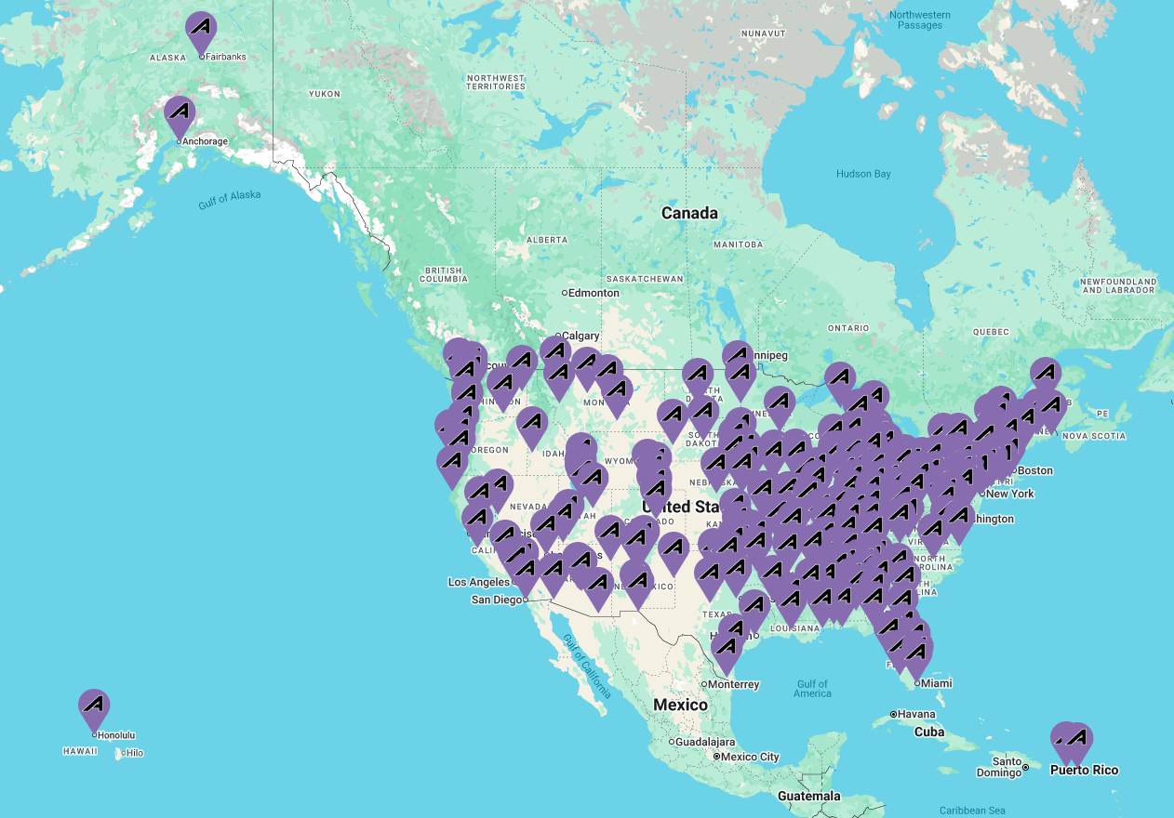
No Cost, Confidential GovCon Guidance
APEX Accelerators provide education and training to ensure that all businesses become capable of participating in federal, state, and local government contracts.
Missouri APEX Accelerator is funded in part through a cooperative agreement with the Department of Defense.
This program is hosted locally by the University of Missouri Extension’s Business Development Program.
moAPEX.org | moapex@missouri.edu
Slide 2

Slide 3
APEX Counseling Services
A nationwide network of procurement professionals that help local businesses compete successfully in the government marketplace.
Over 90+ Accelerators operate in 300+ offices as the bridge between buyer and supplier.
Services include:
Suitability Assessments
Registration Assistance
Market Research
Bid Opportunity Identification
Networking Opportunities
Contract Support
moAPEX.org | moapex@missouri.edu
Slide 3

Slide 4
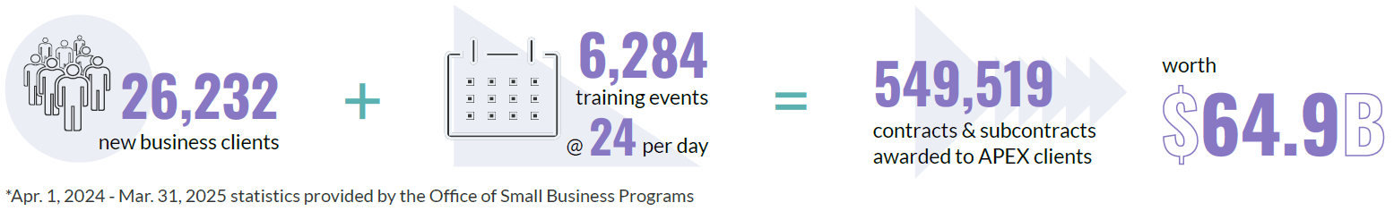
APEX Accelerators provide
a critical front door for industry
*Apr. 1, 2024 - Mar. 31, 2025 statistics provided by the Office of Small Business Programs.
moAPEX.org | moapex@missouri.edu
Slide 4

Slide 5
How Can APEX Help?
Small Businesses
Learn how to position your company as a responsible
& responsive offeror
Large Primes
Fill your supply chain & increase project capacity through
small business matchmaking
U.S. Agencies
Guide contractors through registrations
& compliance requirements
moAPEX.org | moapex@missouri.edu
Slide 5

Slide 6


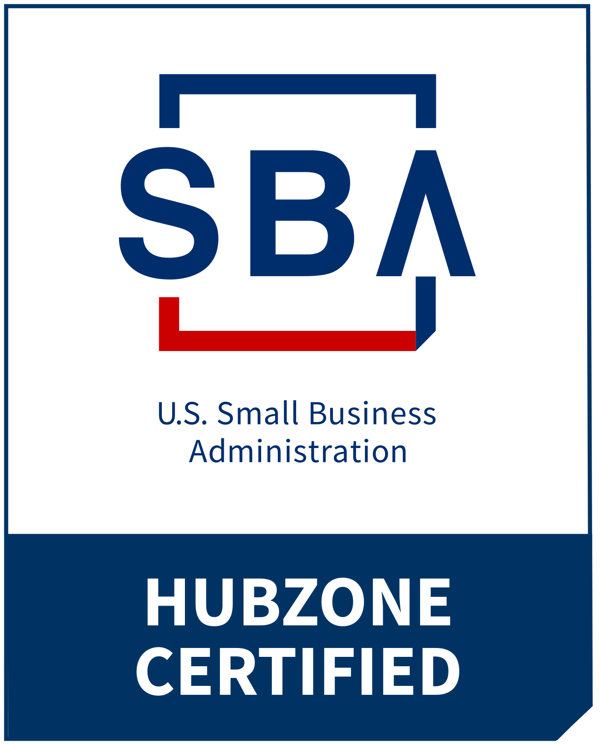
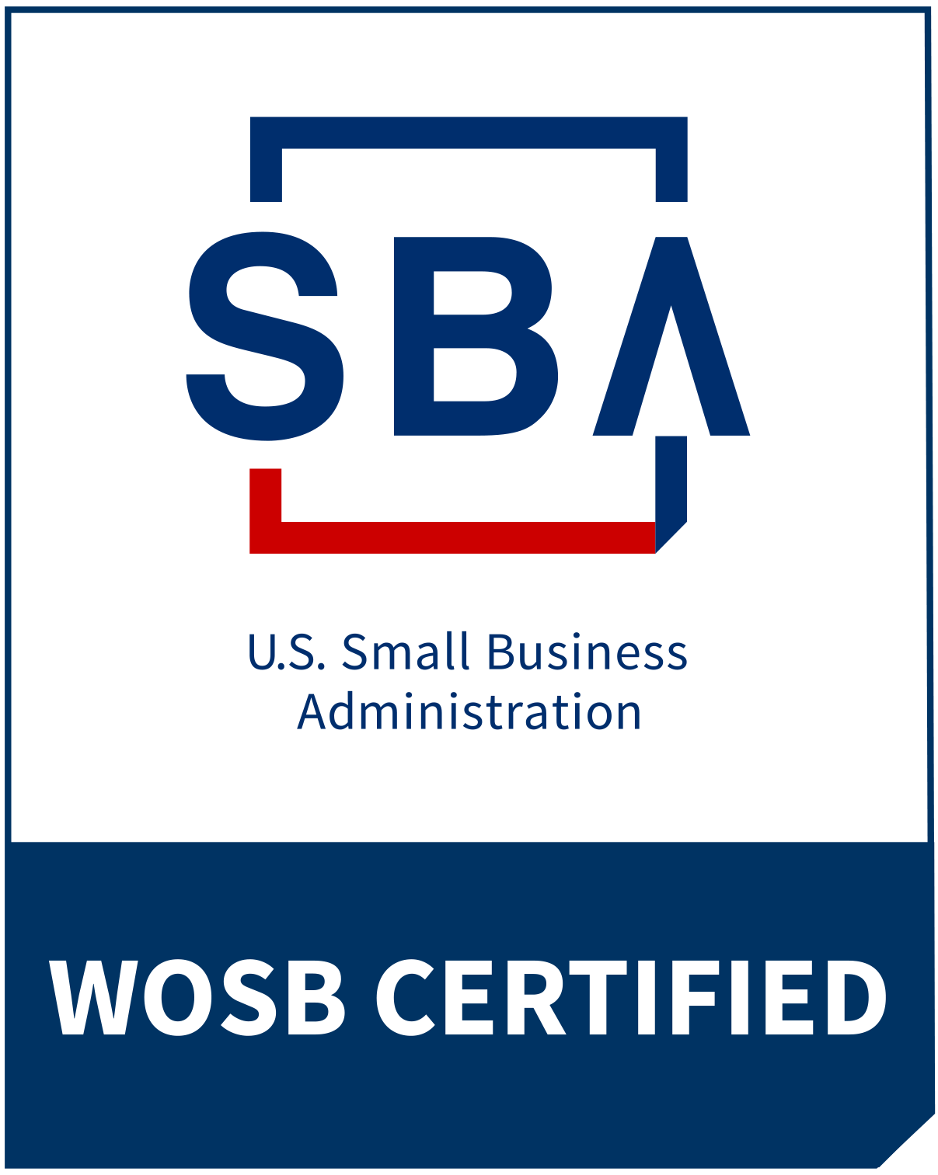



How Can APEX Help Your Business?
(1/3)
Registrations & Certifications
SAM + Vendor Portals
SBA Certifications
PIEE Role Management
  WAWF for Invoicing
  SOL for Bidding
  SPRS for CMMC Reporting
moAPEX.org | moapex@missouri.edu
Slide 6

Slide 7



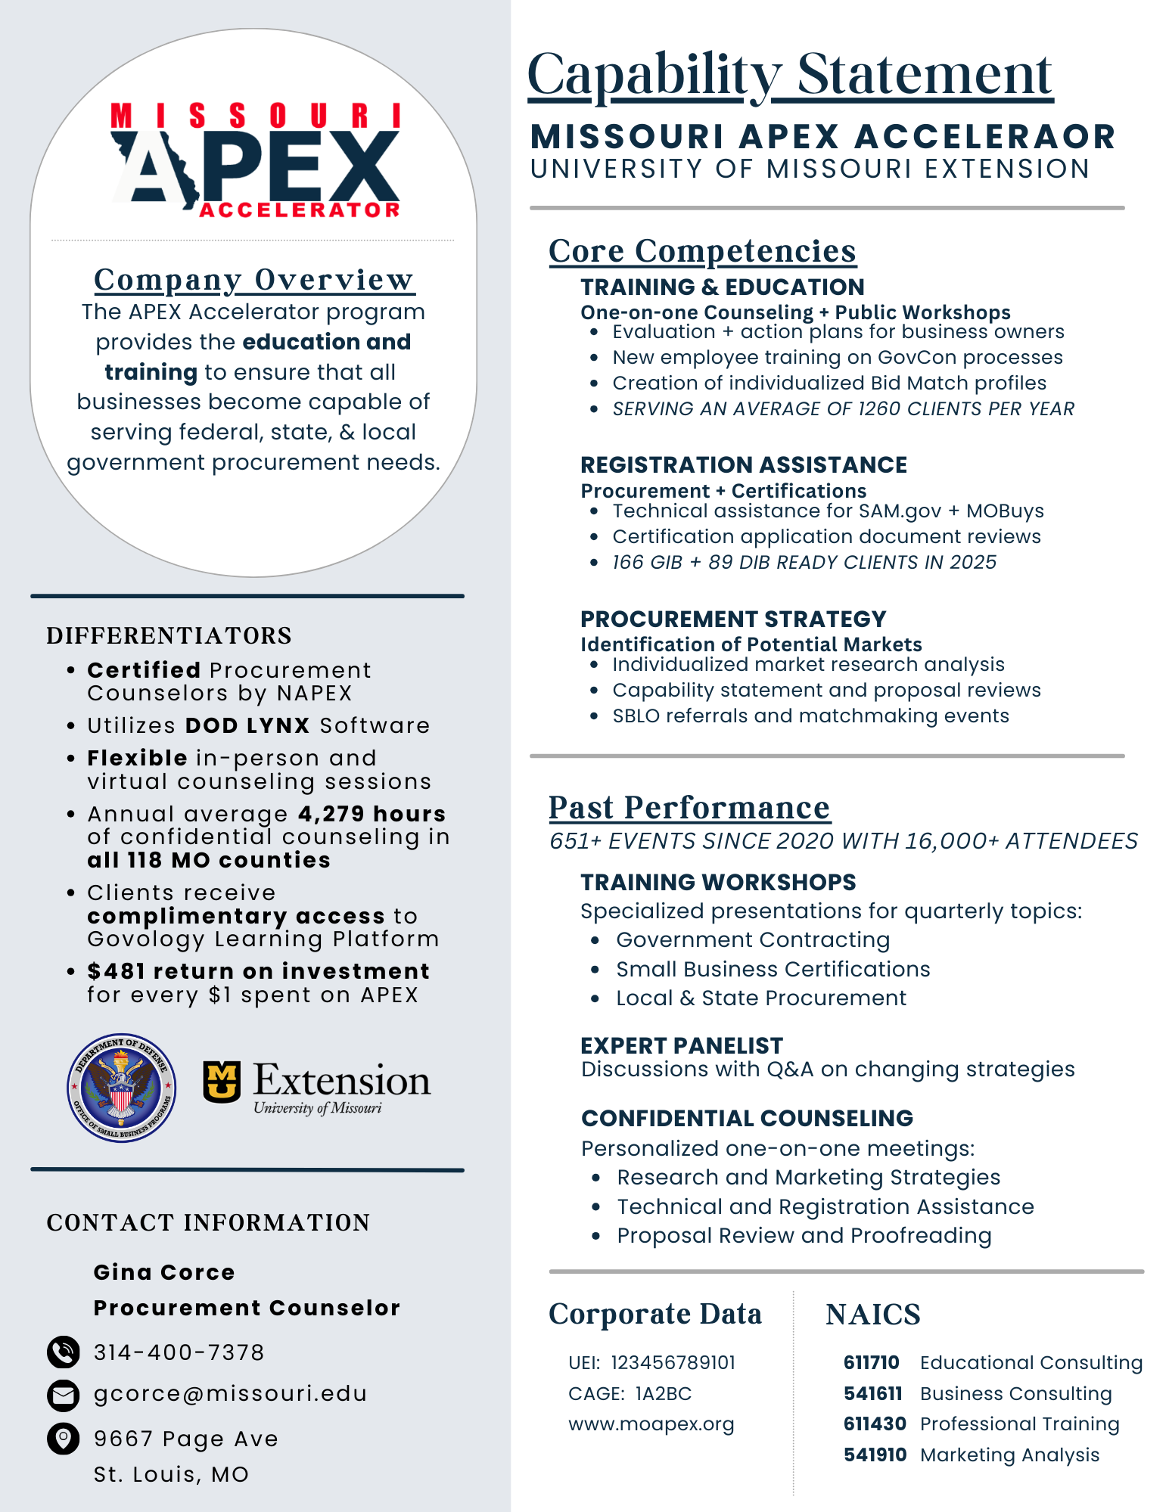
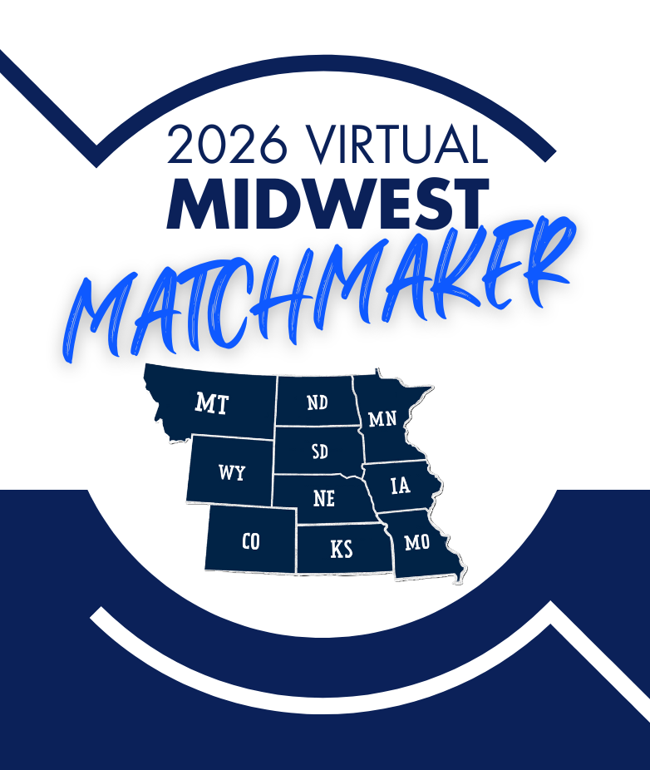
How Can APEX Help Your Business?
(2/3)
Strategic Planning
Bid Match Notifications
Capability Statements
Market Research
Prime-Sub Matchmaking
Ongoing Education
moAPEX.org | moapex@missouri.edu
Slide 7

Slide 8
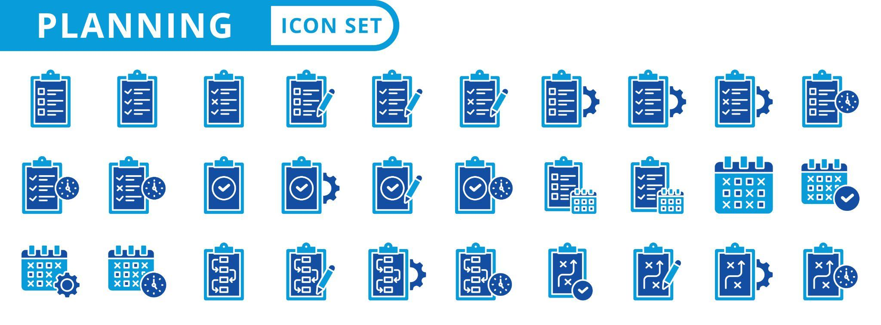
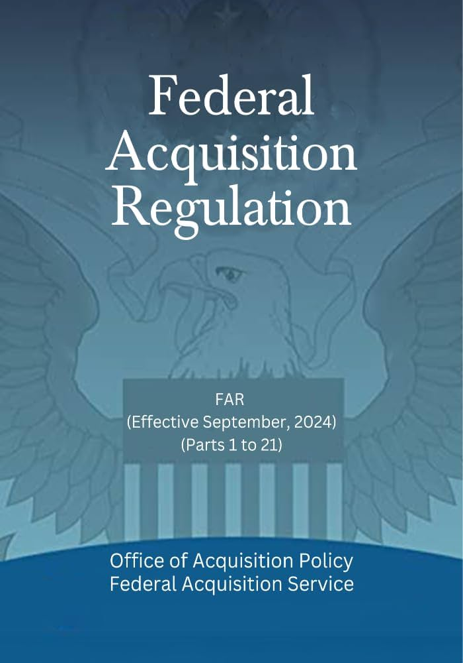
How Can APEX Help Your Business?
(3/3)
Contract Support
Solicitation Review
Bid Proofreading
Submission Assistance
Debrief &
Post-Award Guidance
moAPEX.org | moapex@missouri.edu
Slide 8

Slide 9
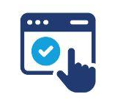

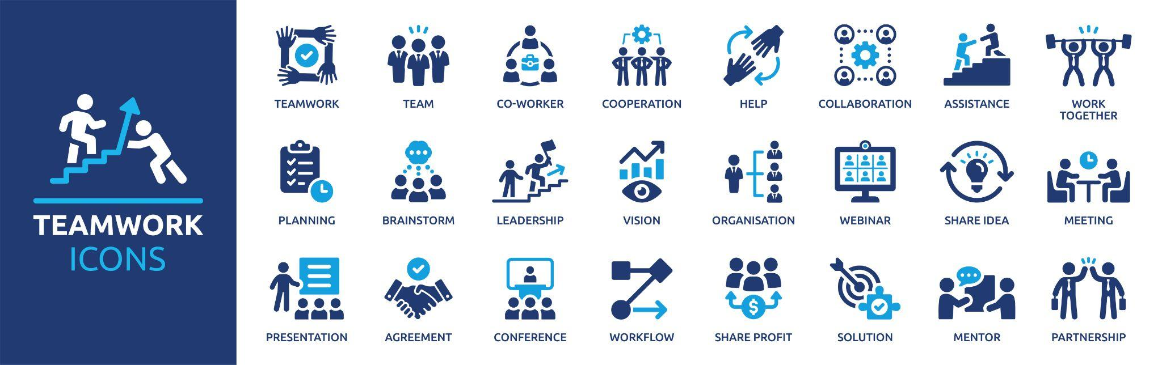
How Can APEX Help Your Acquisition Office?
Troubleshoot Vendor Tech Issues
Marketing of Opportunities & Forecasts
Direct Referrals & Matchmaking Events
SBLO Trainings & Capability Briefings
moAPEX.org | moapex@missouri.edu
Slide 9

Slide 10
The Work We Do Together Matters:
With your collaboration, APEX Accelerators
generate $1,189 ROI per federal dollar invested
Fortifying the DIB & GIB
Strengthening the Supply Chain
Increasing Small Business Certifications & Participation
Increasing Awareness of and Compliance with FOCI
Improving Cybersecurity for the DIB & GIB
Capturing Market Data in Key Industries
Facilitating Innovation via Funding Programs (SBIR/STTR)
moAPEX.org | moapex@missouri.edu
Slide 10

Slide 11
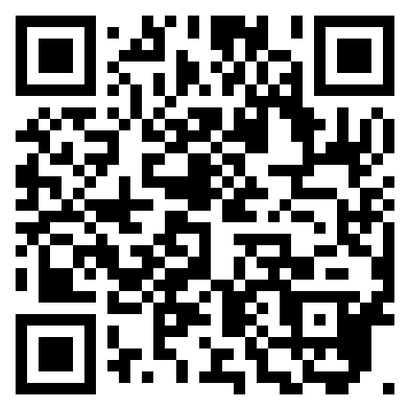

Connect with Us
Missouri APEX
Columbia
Kansas City
Springfield
St. Louis
Illinois APEX
Carbondale
Chicago
Columbia
Glen Ellyn
Peoria
Springfield
Tinley Park
Upcoming: Meet the Buyers 2026
Virtual Conference & Matchmaking
stonesriverem.com/event/mtb2026
April 28-30, 2026
Keynote Speakers
Agency Briefings
Program Updates
moAPEX.org | moapex@missouri.edu
Slide 11

Slide 12
APEX Accelerators
April 15, 2026
Thank you to our stakeholders, partners, and clients!
Gina Corce
Procurement Counselor
gcorce@missouri.edu
MoAPEX.org + Connect with us on LinkedIn

