Slide 1
St. Louis Region’s World Class
Logistics Hub Infrastructure & Global Competitiveness
Mary Lamie, P.E.
Executive Vice President – Multi Modal Enterprises, Bi-State Development

Slide 2
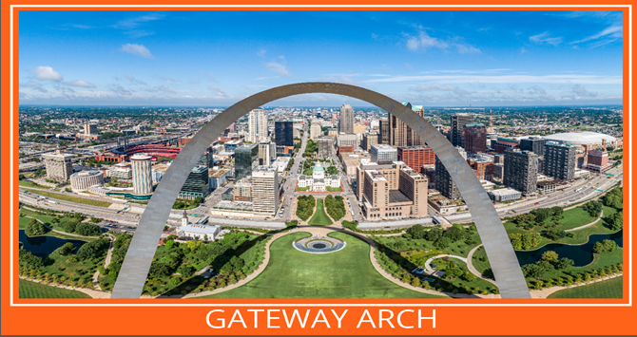

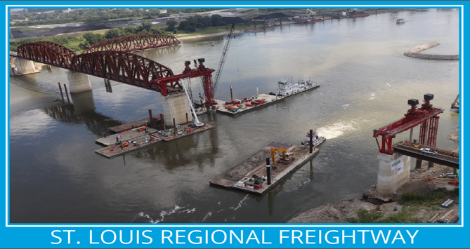
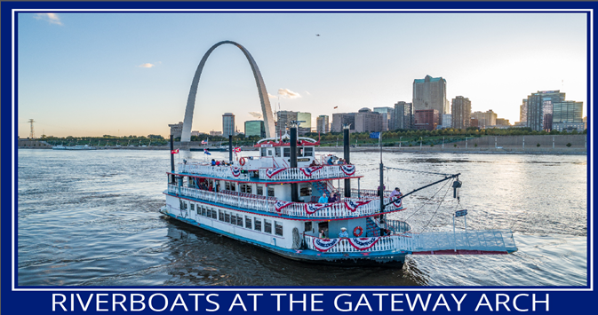
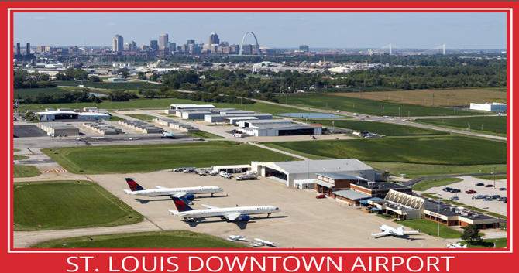
Bi-State Development: Multimodal Enterprises

Slide 3
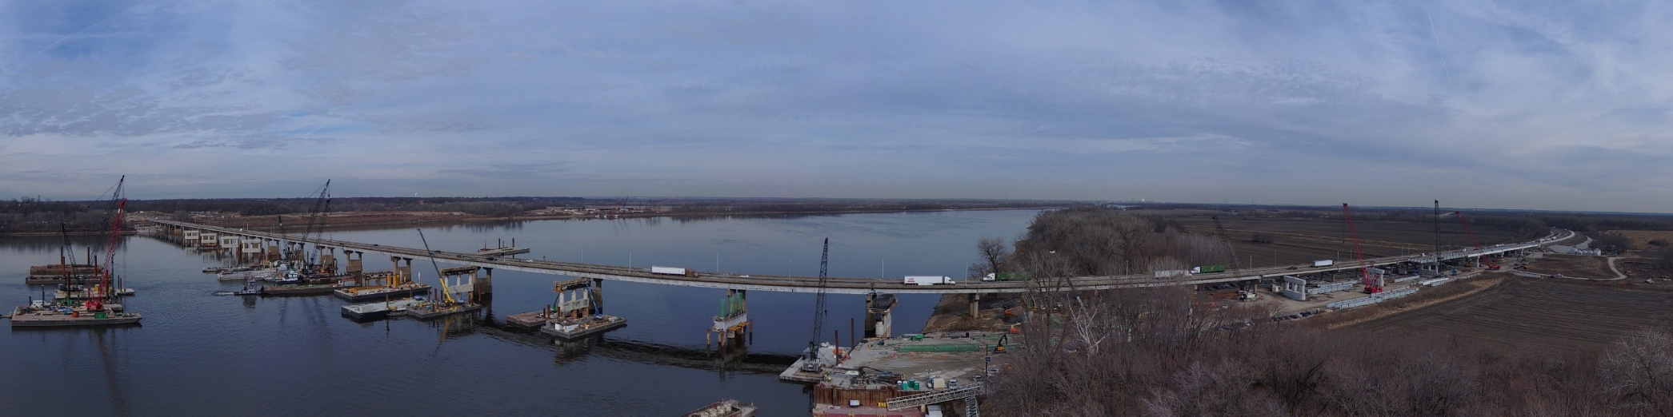
The Freightway Mission and Goals
Optimize the region’s freight transportation network through public-private partnerships.
Produce results that strengthen the St. Louis region by increasing job growth through manufacturing and logistics and improving the local economy.
Develop Regional Freight Needs Analysis and Development Plan – Maximize funding opportunities through public-private partnerships and improving multimodal capabilities.
Develop and implement a Marketing Plan – Position STL region as a national/global freight hub.

Slide 4
Marketing Purpose
Build awareness that attracts industrial real estate brokers, site selectors, shippers and carriers who support manufacturing and logistics developments.

Slide 5
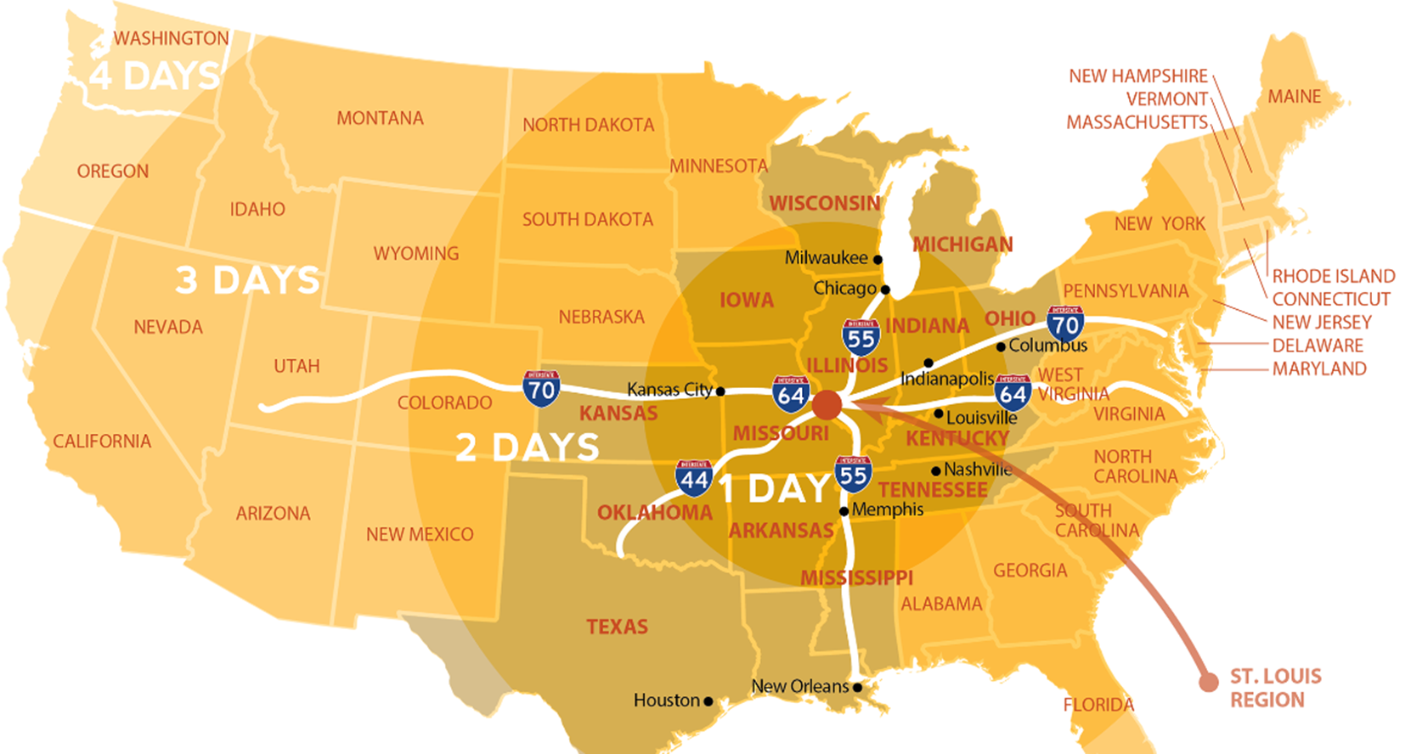
St. Louis Region – Epicenter of the Midwest!
Why the STL region? This graphic answers the question.

Slide 6
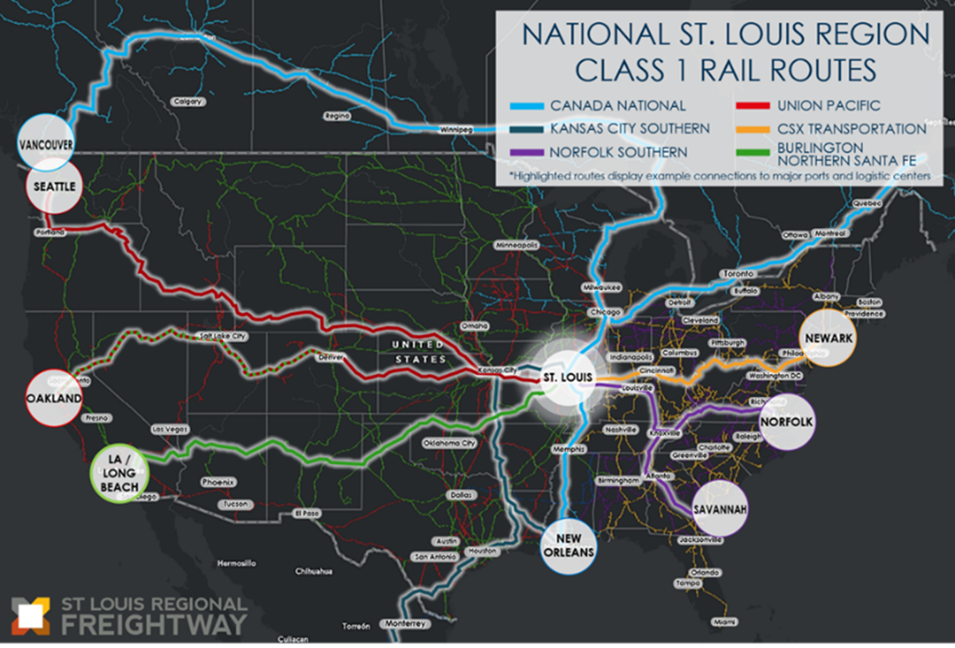
St. Louis Region’s Rail Competitive Advantages
Class 1 Rail Routes

Slide 7
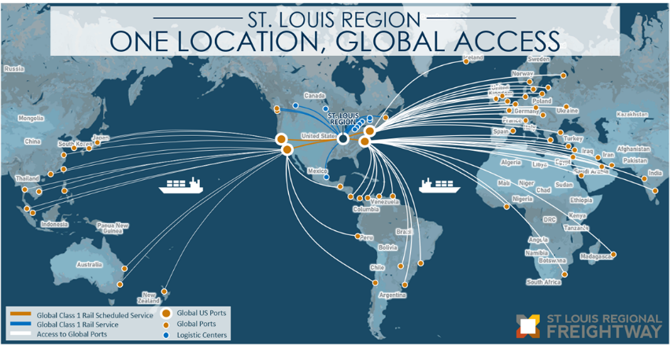
St. Louis Region’s Rail Competitive Advantages
Global Reach from America’s Heartland

Slide 8
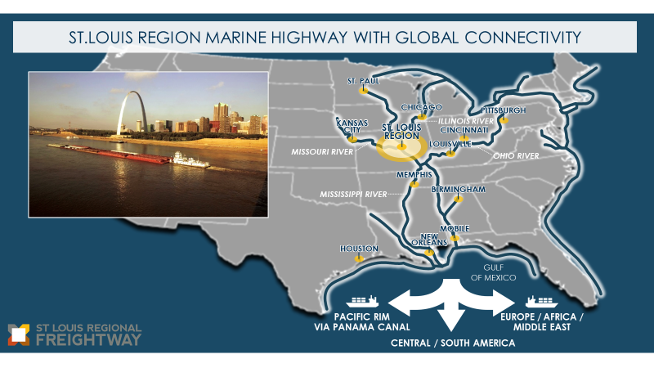
St. Louis Region’s Inland Water Competitive Advantages
Notes:
Lamie

Slide 9
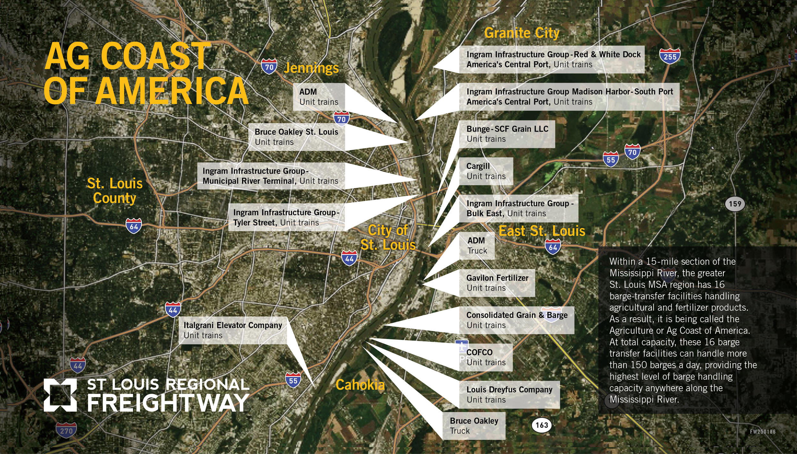
STL Region – Home to The Ag Coast of America &
Most Efficient Inland Port
Why is this area called the Ag Coast of America?
16 barge transfer facilities within a 15-mile section of the Mississippi handling agricultural and fertilizer products
Capacity: Over 150 barges in a day - the highest level of barge handling capacity ANYWHERE along the Mississippi River.
STL Region Remains Home to the Nation’s Most Efficient Inland Port
#1 Ports of Cincinnati-Northern KY (225 miles)
#2 Mid-Ohio Valley Port District (217 miles)
#3 Huntington-Tristate, KY, OH, WV (199 miles)
#4 Southern Indiana District Port (356 miles)
#5 St. Louis Metro Port, IL and MO ( 70 miles)
Notes:
Mary Lamie

Slide 10
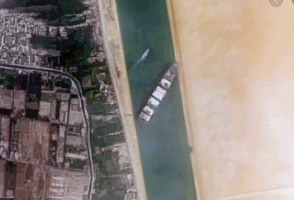
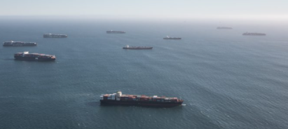
The STL region plays an important role during supply chain disruptions.
Capacity and reliability to support national and global supply chain disruptions.
  Severe weather
  Fluctuations in energy and transportation costs
  Shifts in global government regulations or trade
  Global pandemics
This is the answer to maintaining global competitiveness for the nation’s supply chain.
Question: What are we doing to continue to support these efforts?
Answer: Infrastructure investment and innovation

Slide 11
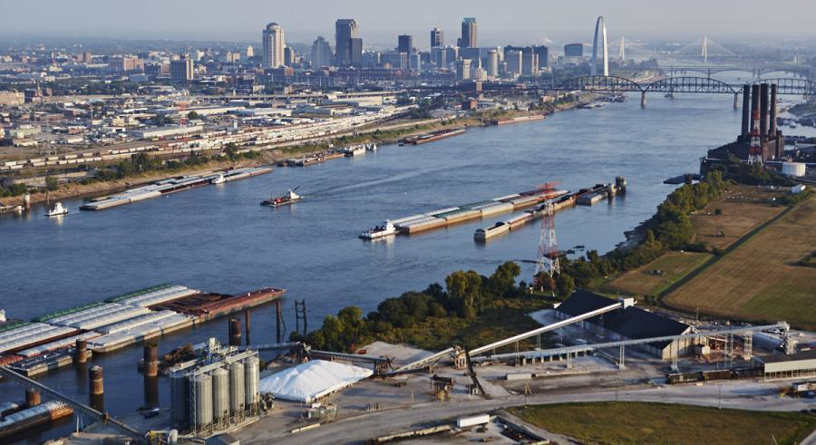
World Class Logistics Hub Infrastructure & Global Competitiveness
This is global commerce!
Notes:
It’s a unified bi-state message that crosses city, county and state lines and congressional delegation

Slide 12
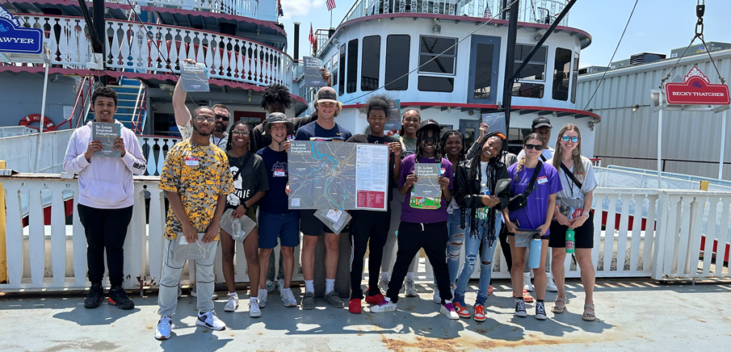
Ag Coast of America Riverboat Cruise
Connecting the classroom to the Mississippi River

Slide 13
TheFreightway.com
Streamlining the Site Selection for Multimodal Shippers

Slide 14
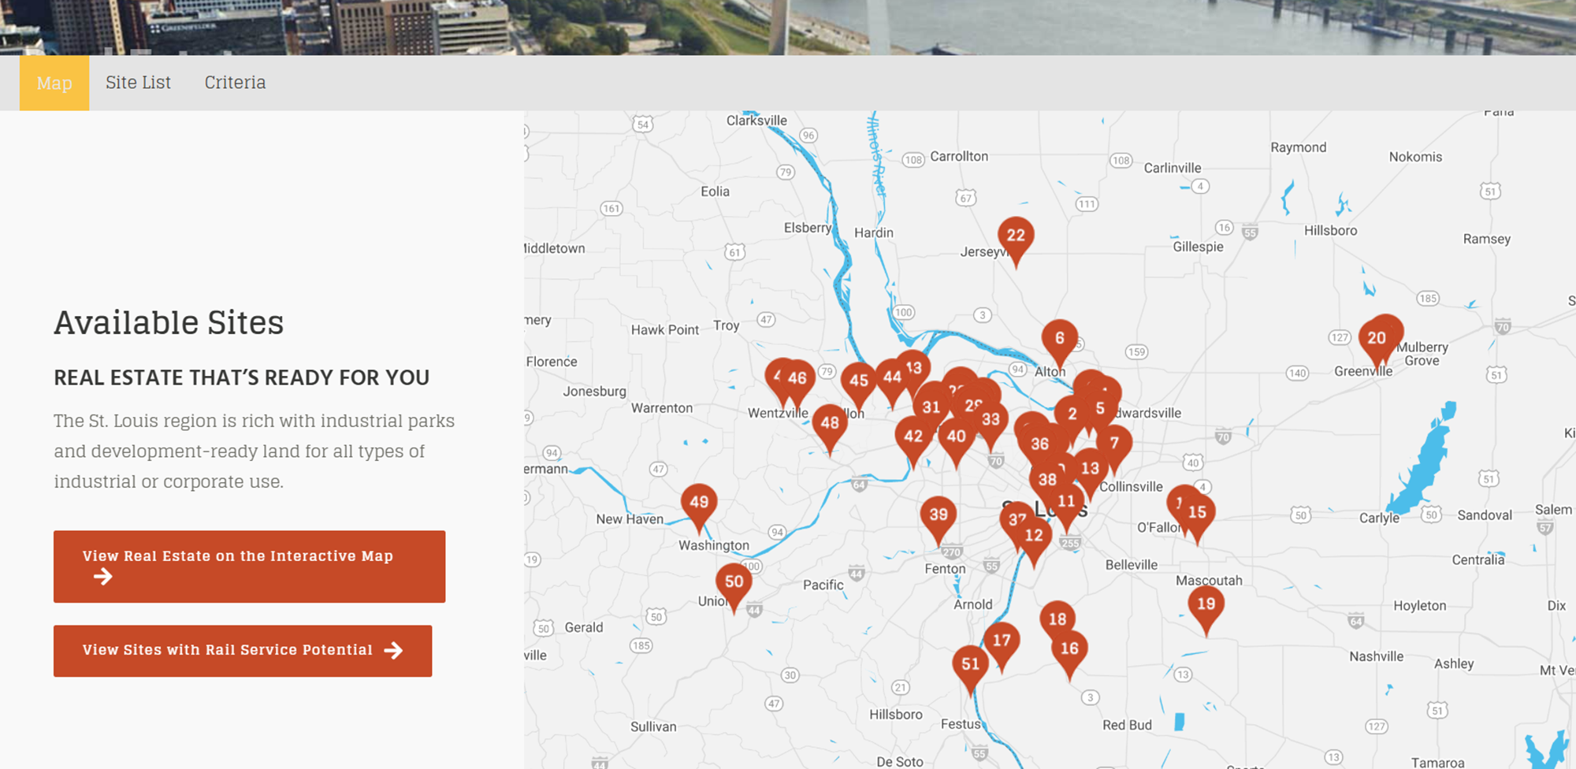
Updates: Featured Industrial Real Estate Sites

Slide 15
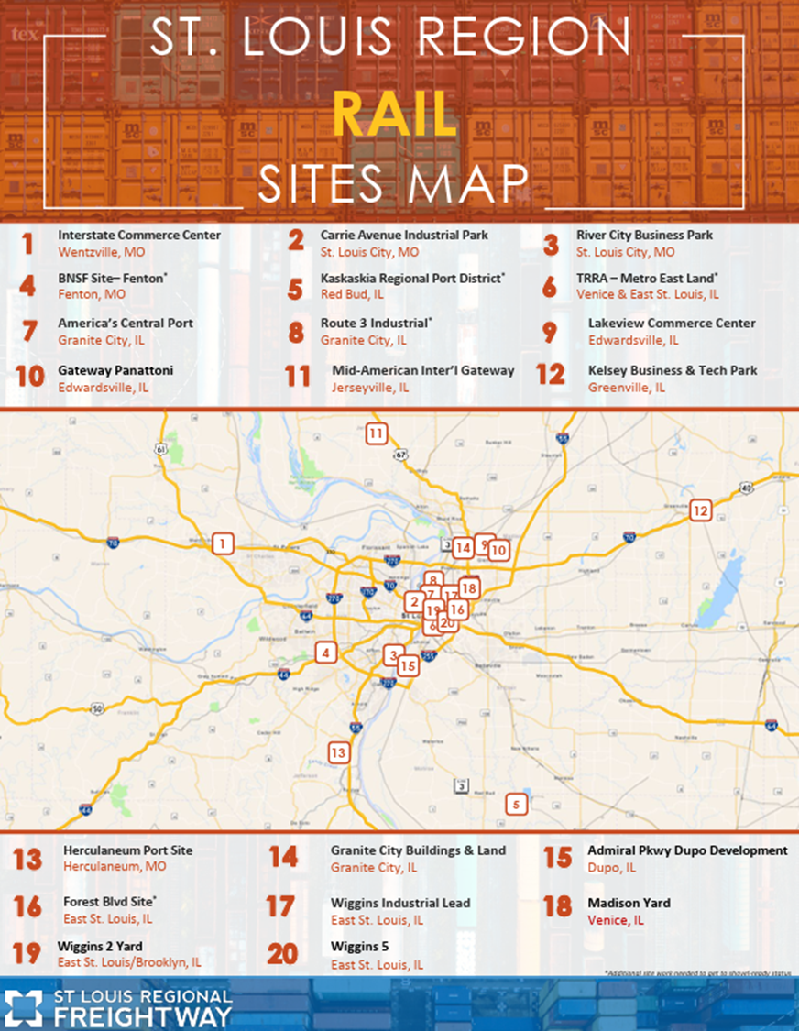
Rail-Served Sites Updates
Added 4 New Sites!
Brings total to 20 locations with
26 sites!

Slide 16
Marketing & PR Updates

Slide 17
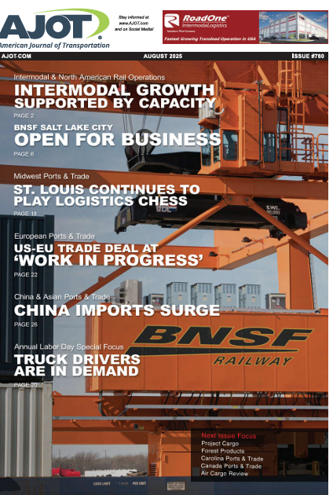
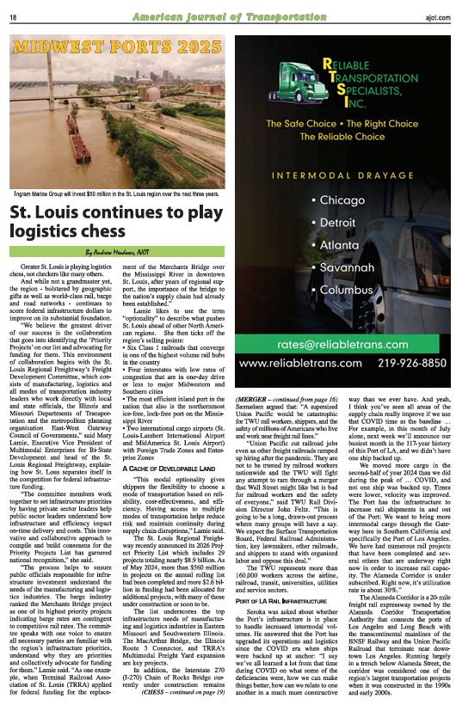
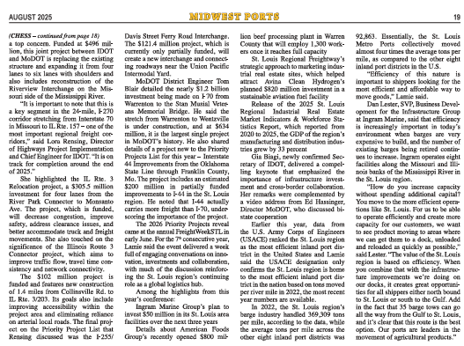
FreightWeekSTL 2025 – Cover Story

Slide 18

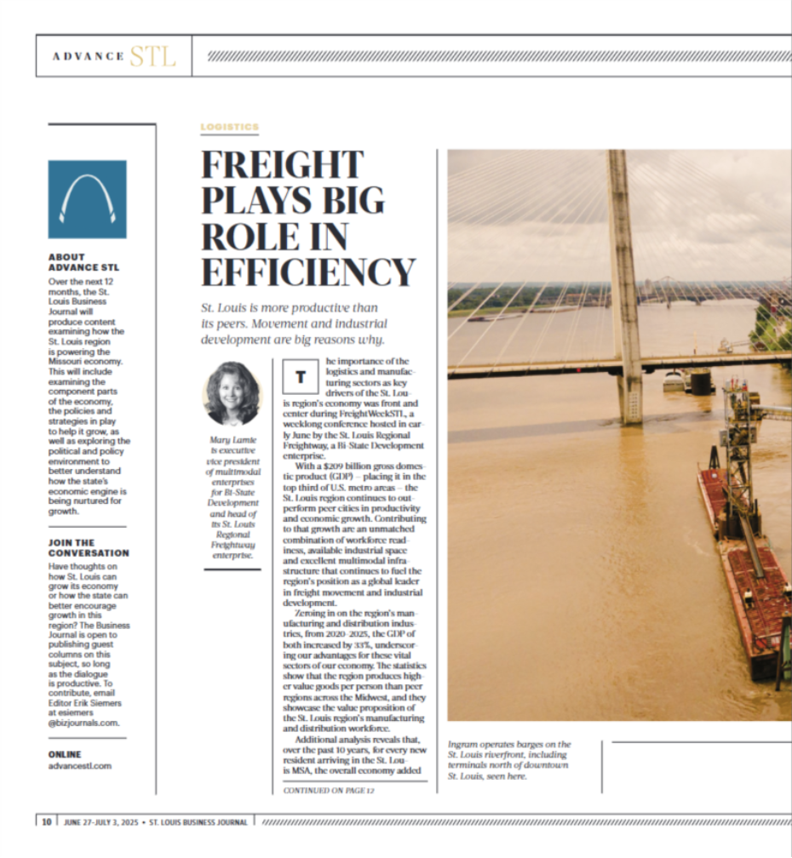
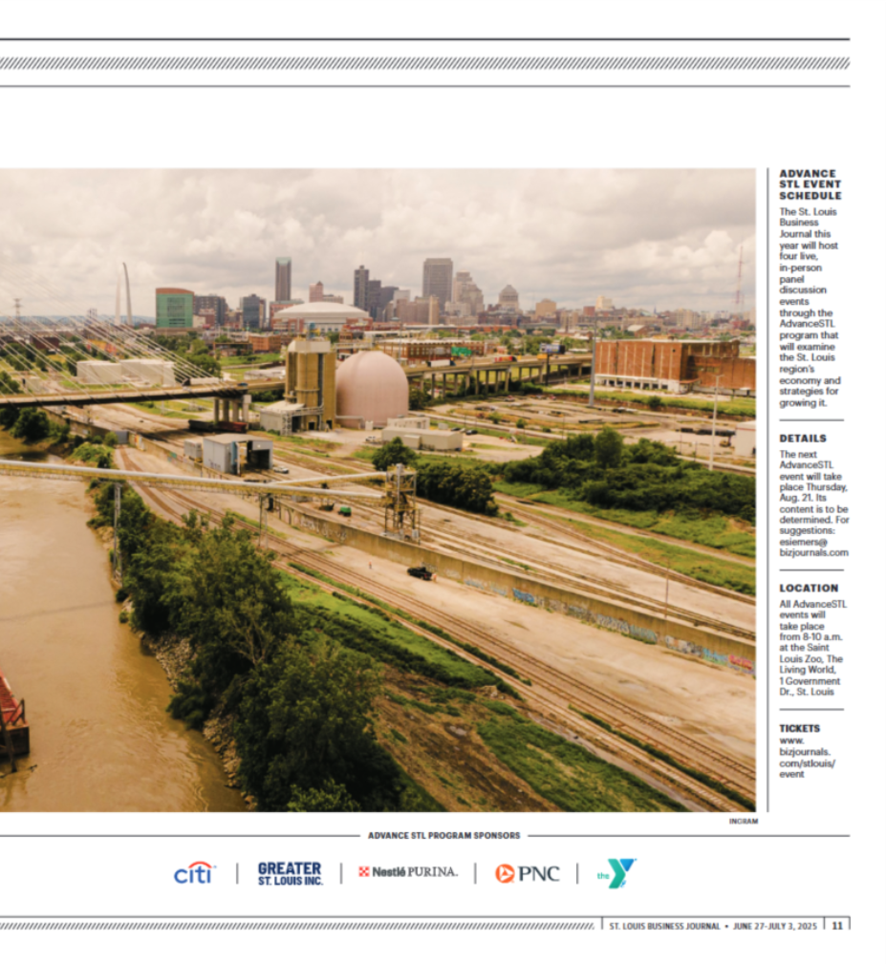

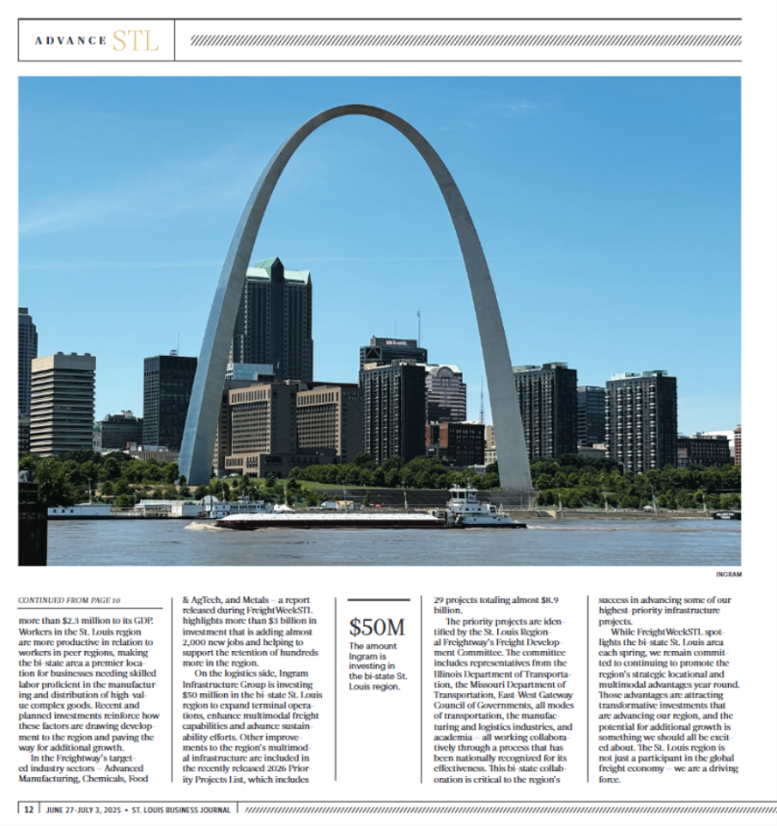
FreightWeekSTL 2025
Media Coverage - Local

Slide 19
Aerospace and Aviation

Slide 20
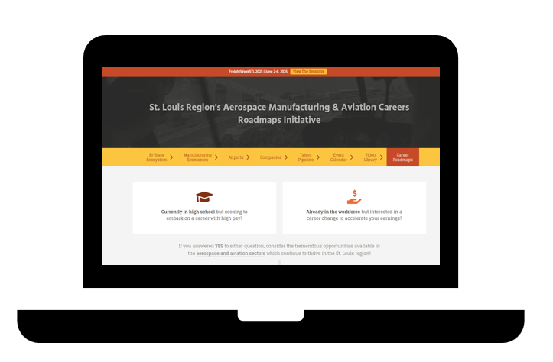
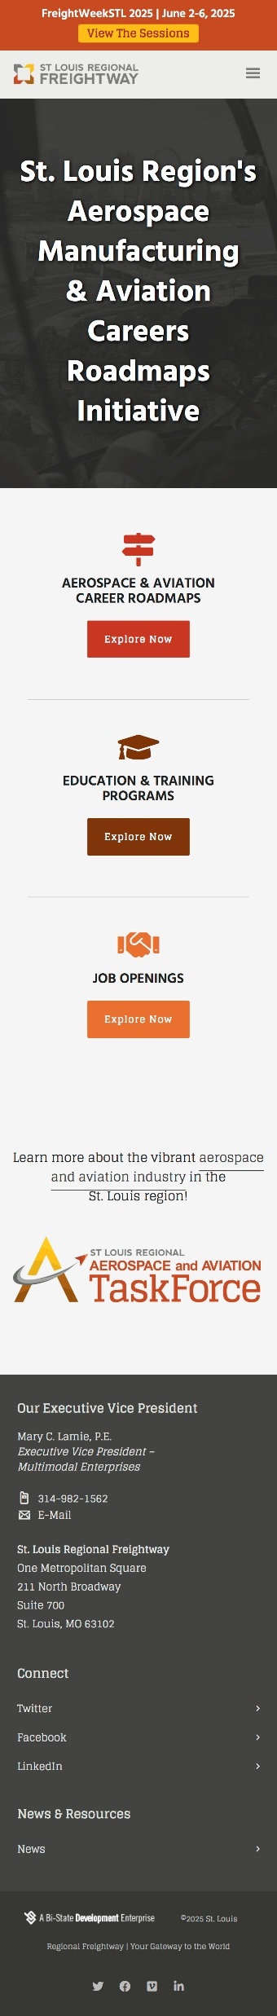

St. Louis Regional Aerospace and Aviation Task Force Roadmaps Launch/One Year Anniversary
Link to: Aerospace and Aviation Careers Roadmaps - St. Louis Regional Freightway

Slide 21
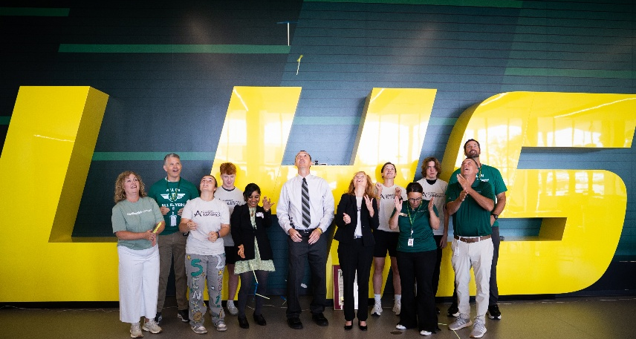
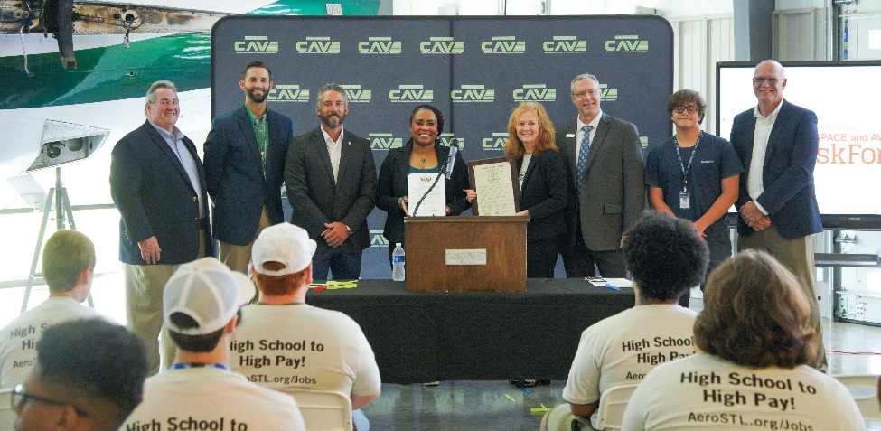
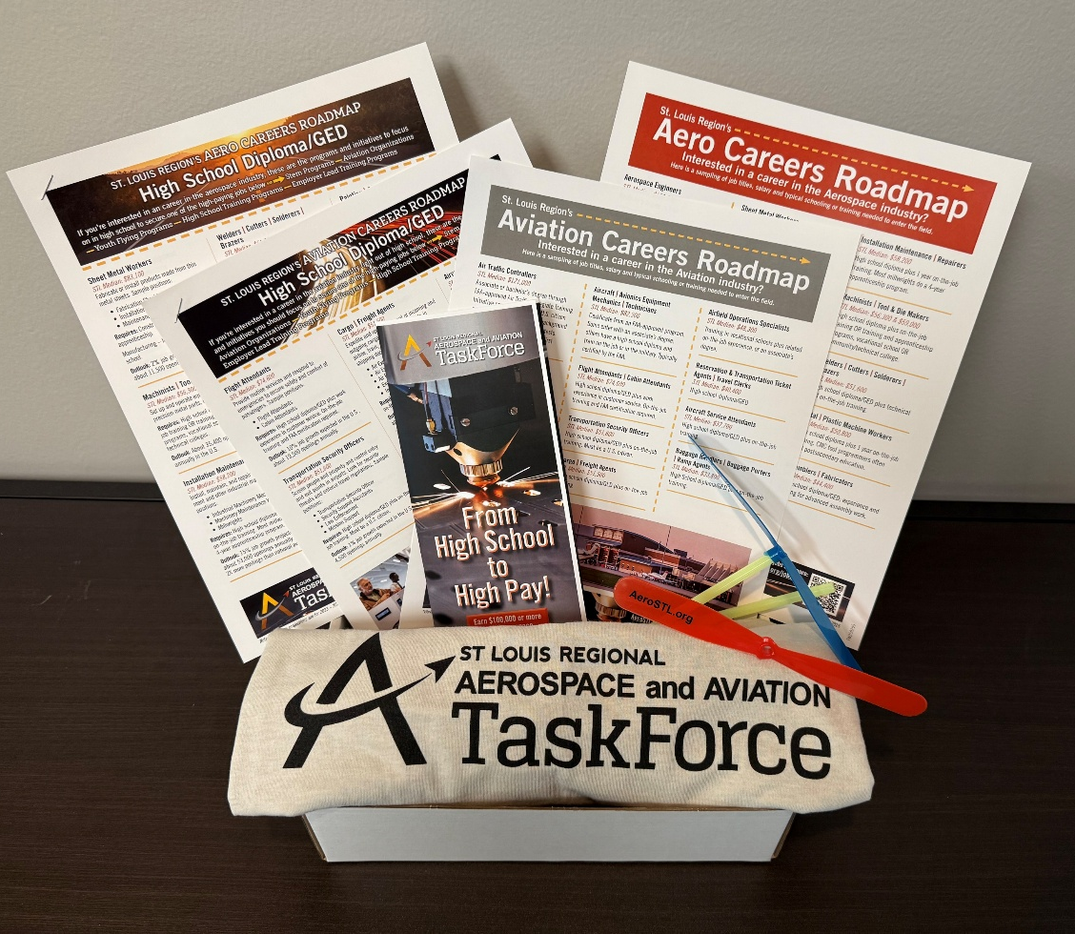

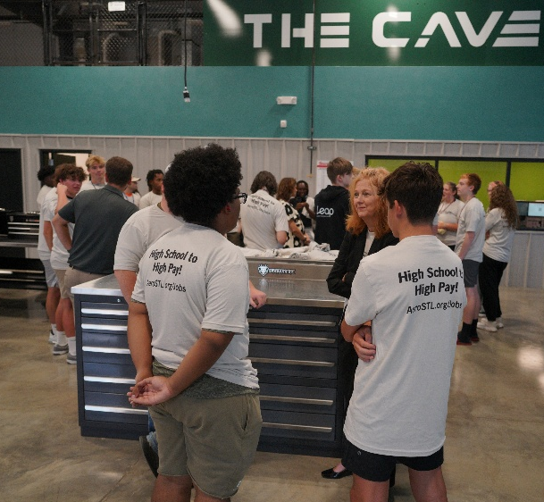
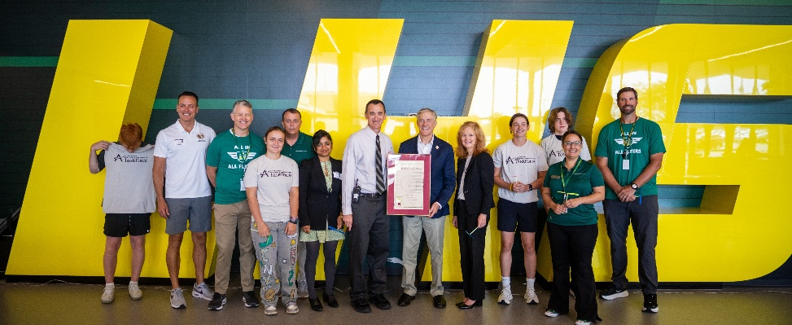
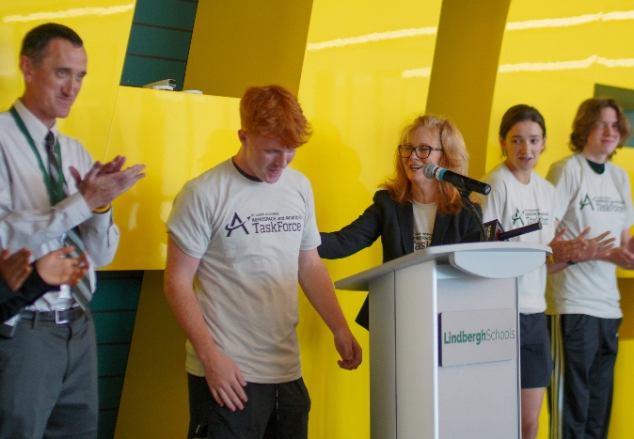
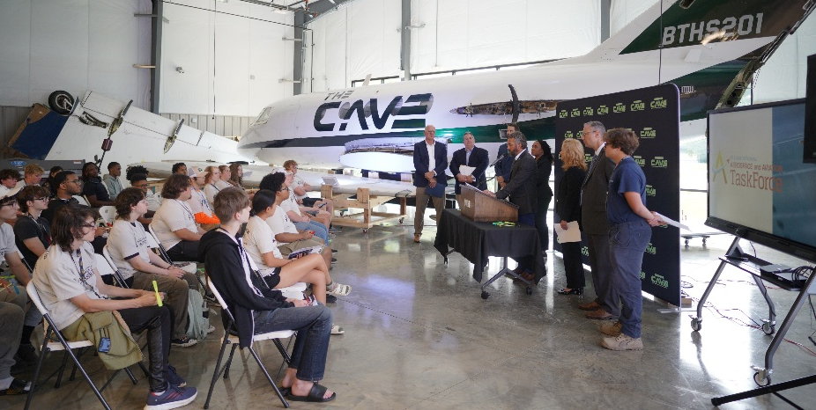
Photo highlights of the launch of the Careers Roadmap

Slide 22
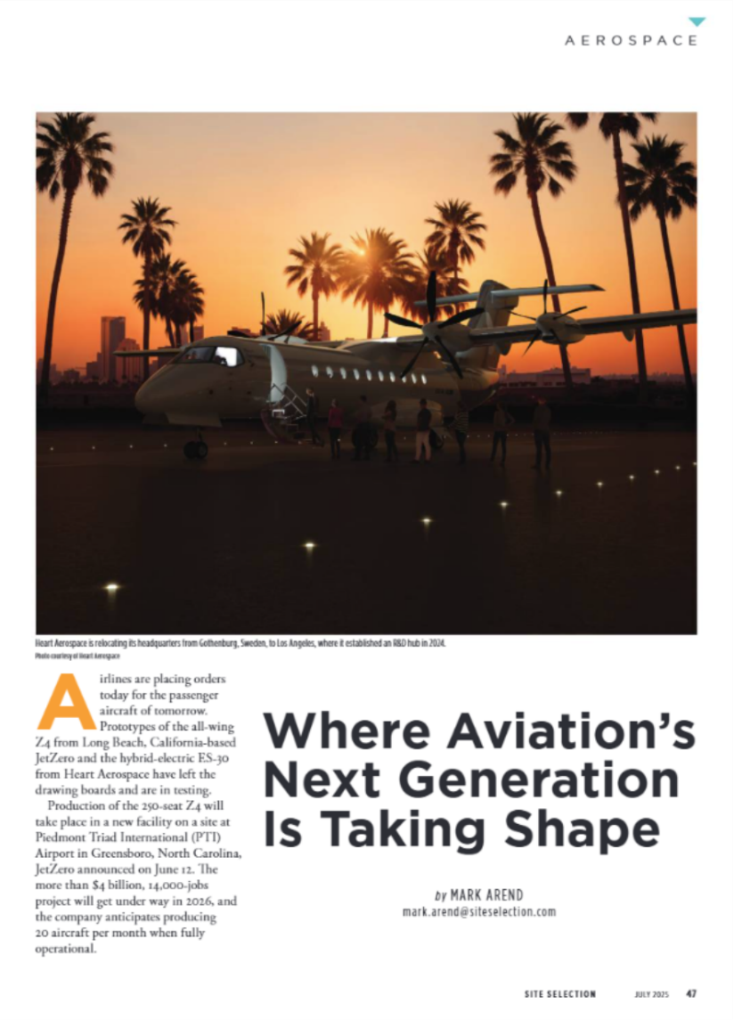
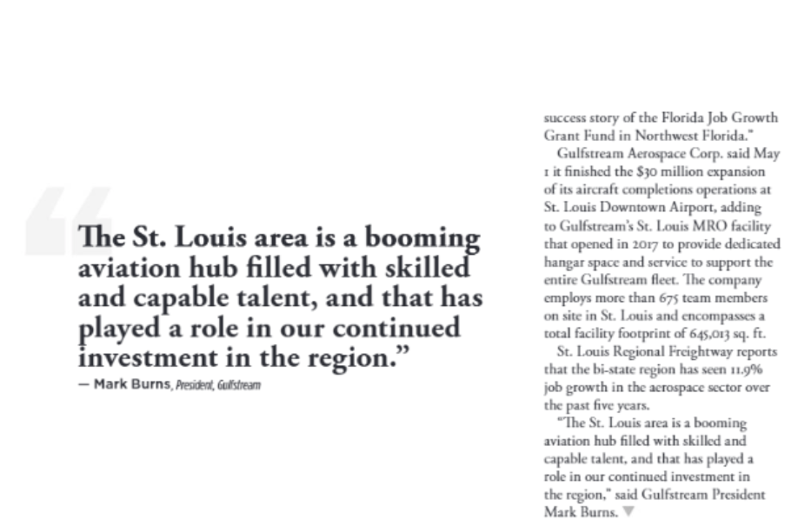
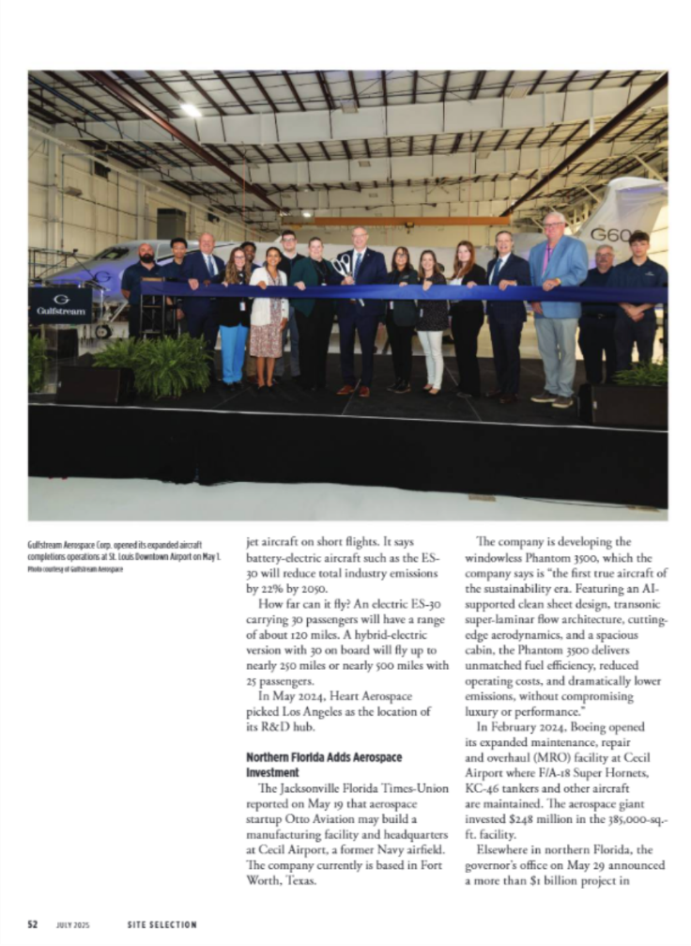
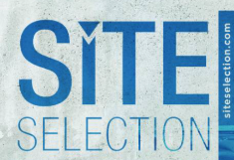
Raising Awareness Year-Round through media coverage in Outlets like Site Selection Magazine

Slide 23
2026 Updates and New Projects

Slide 24
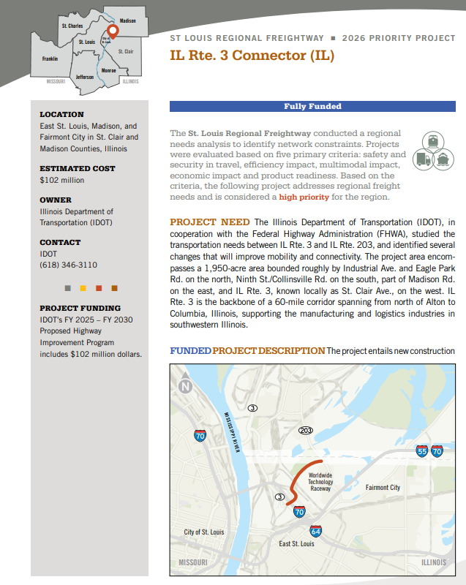
2026 Freightway Priority Projects List
Project-specific and regional freight advocacy efforts
2026 Priority Projects List: 29 projects totaling $8.9B+
(including $3.0 B for the new STL Airport Terminal)
    Projects Completed: $560 Million
    Projects Fully Funded: $1.98 Billion
    Projects Partially Funded: $688 Million
Represents infrastructure needs of the manufacturing and logistics industries; indicates tremendous progress on projects to strengthen critical roads, bridges, rail infrastructure and port/airport facilities.

Slide 25
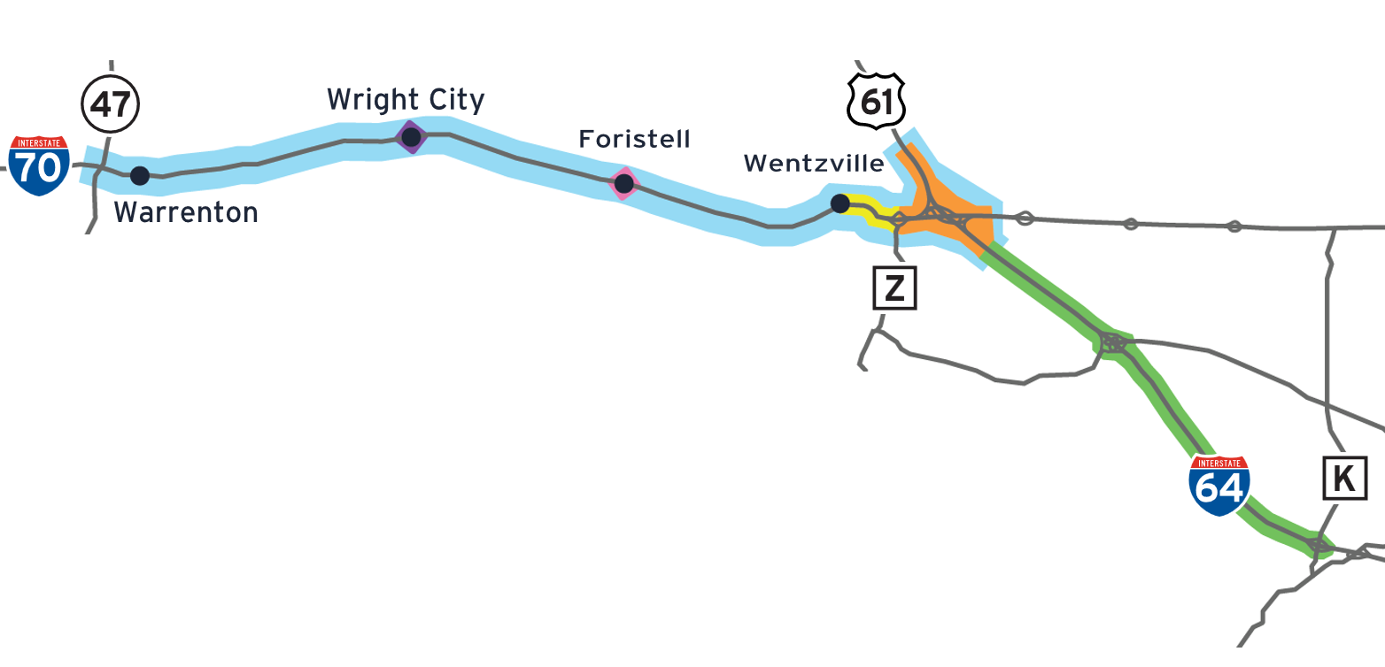
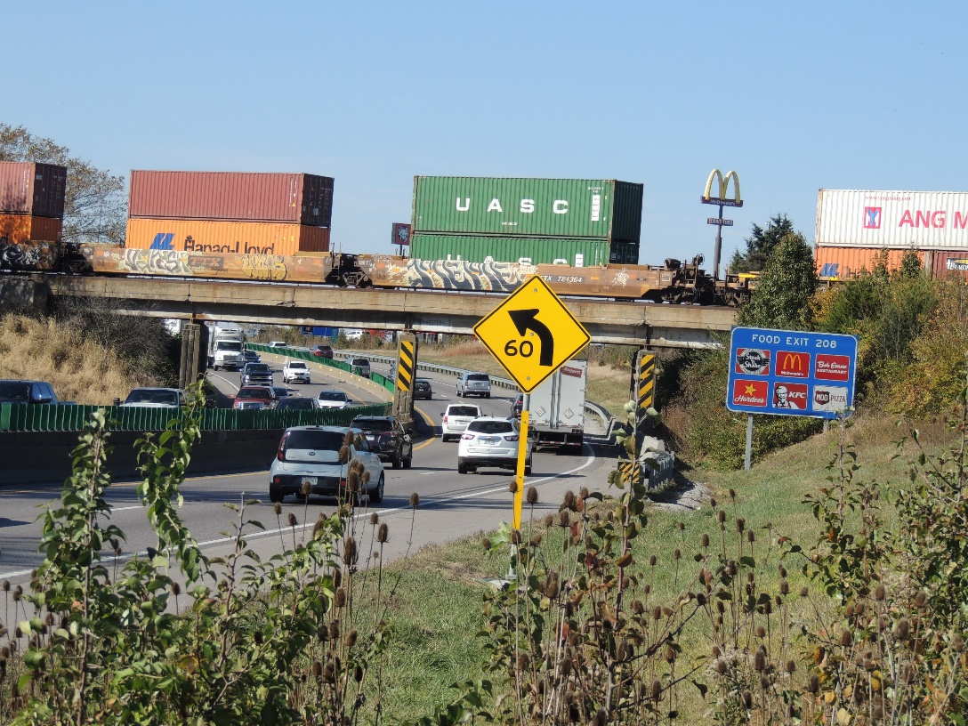

Tracking Progress - I-70 Project Location Updates

Slide 26
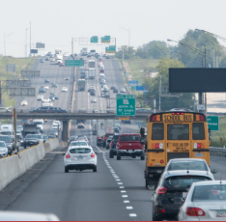
2026 UPDATES Priority Projects List
I-55 from Rte. Z to 67 (MO)
I-55 from Rte. Z to 67 Jefferson Co.
This $246 million project is under construction!
Improvements will expand from a 4-lane highway to a 6-lane highway for approximately 6 miles with interchange improvements.
Local companies benefiting include Dow Chemical, Doe Run Companies, large River Cement quarry and intermodal facility, port operations, proposed Container-on- Vessel service, Desoto Car shop and the recently announced James Hardie Industries in Crystal City.
Design – Build method for project delivery
Project Completion – Estimated December 2026

Slide 27
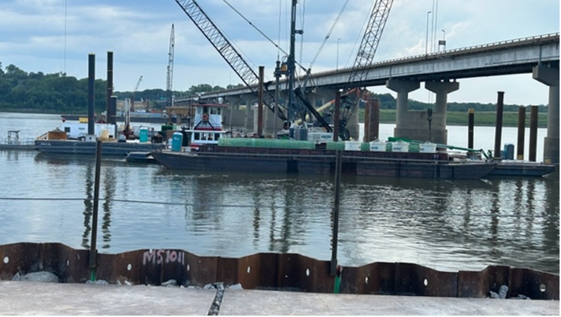
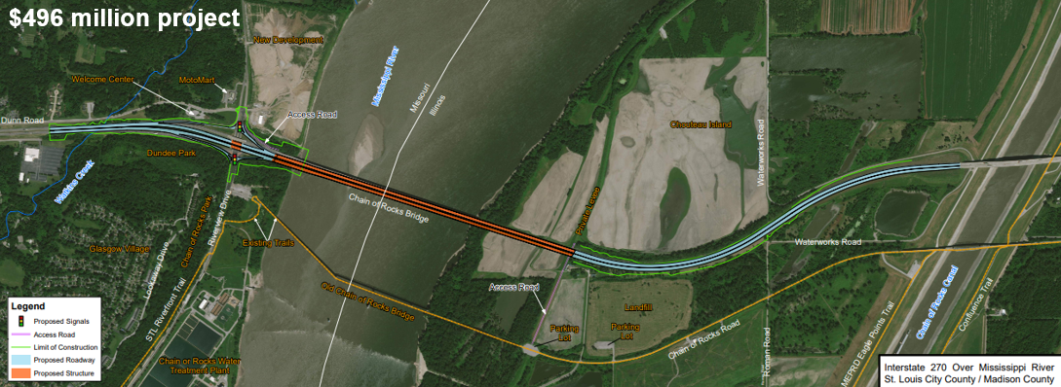
2026 UPDATES Priority Projects List
I-270 over Mississippi River Bridge Replacement
Construction began early 2023. Mainline approaches and new bridge will accommodate six lanes w/ 10’ shoulder
South bridge opened December 2024. Traffic shifted to new bridge, existing I-270 bridge to be demolished to commence north bridge construction.
IDOT committed to doing its best to keep two lanes of traffic each direction on I-270.
Project completion is anticipated late 2026

Slide 28
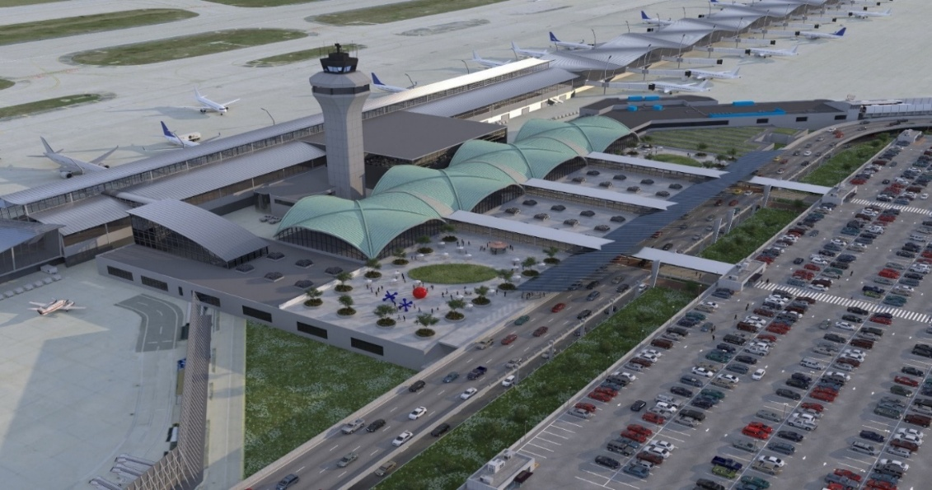
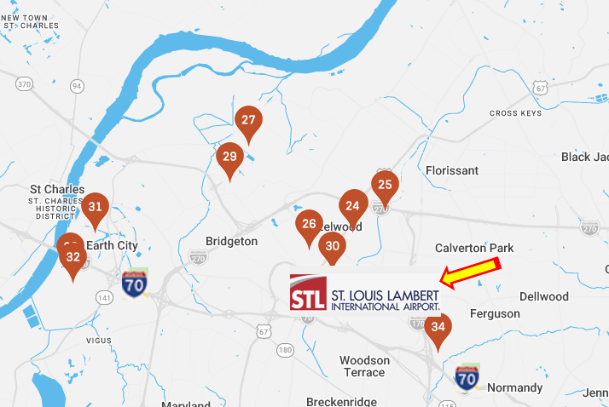
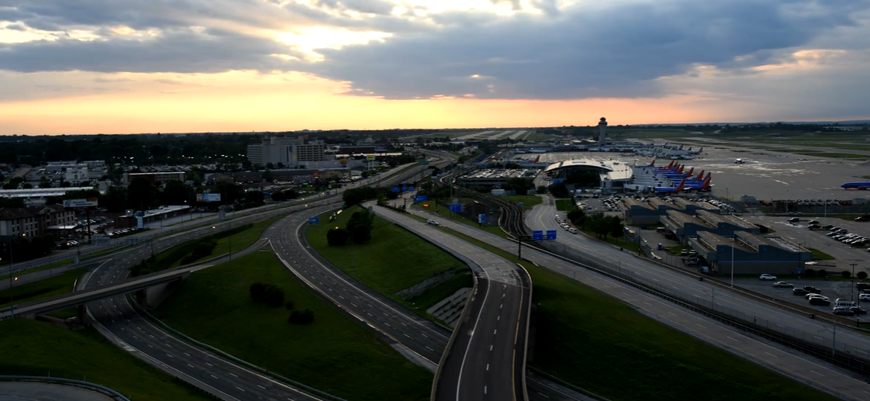
New Terminal for St. Louis Lambert International Airport (MO) and I-70 Improvements from MO River to Hanley Rd
New Terminal STL Lambert International Airport
  Estimated Cost: $3 Billion
Catalyst for Economic Development
I-70 Improvements from MO River to Hanley Rd
  Estimated Cost: $175 million

Slide 29
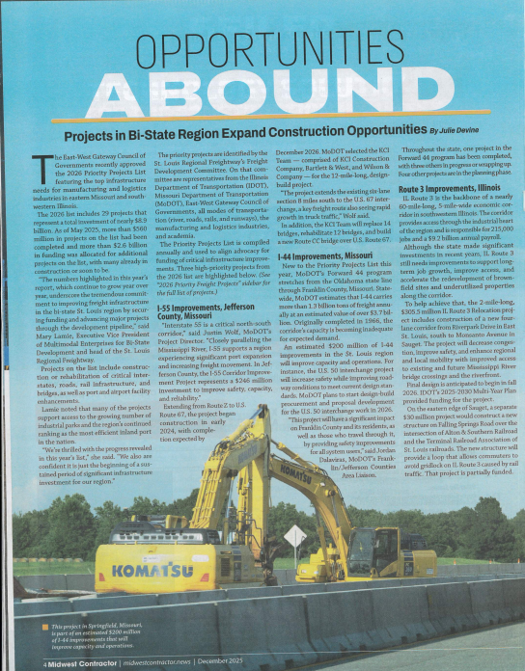
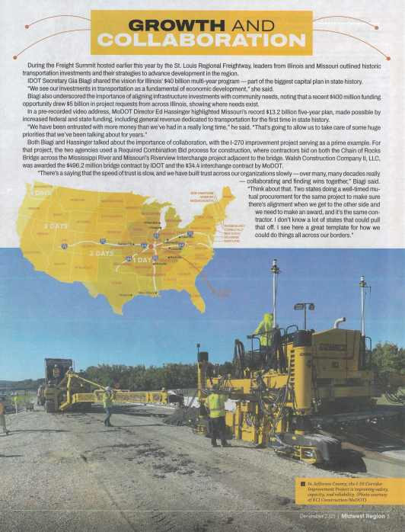

Media Coverage Sample for Priority Projects from print edition of Midwest Contractor

Slide 30

Site Selection & Location Strategy
Site selection definition: Measuring the needs of a new project against the merits of potential locations. Compare markets based on the following.
Site Selection Criteria:
Supply chain flexibility in industrial market (Ranked #1 and #2)
Accessibility – Companies want to be in the middle of the action and connected to major markets, transportation routes and resources.
Transportation Costs (Efficient and reliability) (Ranked #1,#2,#3)
Labor, Labor, Labor (Ranked #1 and #2)
Overall tax burden, incentives and exemptions (Ranked #2 and #3)
Utility costs and infrastructure (#4 and #5)
Real Estate Costs
Quality of Life – (#2,#3,#4)
Available Land (Ranked #4)

Slide 31
FreightWeekSTL 2026

Slide 32

Highlights of this Year’s FeightWeekSTL
Increased number of opportunities for in-person connections
  Facilities Tours
  Annual Freight Summit
  Ag Coast Cruise
  Networking Happy Hour
  Close-up look at innovative solutions originating in the STL region
  Highlight Freightway’s 10th Anniversary
Timely, relevant topics across several virtual sessions
Release of the 2027 Priority Project's & Latest Industrial Market Report
Sponsorship Opportunities Available!

Slide 33
Highlights of FreightWeekSTL 2026
  Virtual & In Person Tours & Panel Discussions — June 8–12
  Tour of Intramotev’s Production Facility & HQ — June 8
  Tour of Ingram’s Facilities, Mel Price Lock & Dam for state legislators/staffers June 9
  Freight Summit & Release of 2027 Priority Projects List — June 10
  St. Louis Downtown Airport Tour and Information Session on Aerospace and Aviation Careers for Educators – June 11
  Ag Coast of America Riverboat Tour — June 11
  Release of the 2026 Industrial Real Estate Market Report
  Session Highlighting St. Louis Regional Freightway’s 10th Anniversary
  Sponsorship Opportunities Available!

Slide 34
Next Steps/Upcoming Meetings & Events
Marketing Committee Meeting — May 18, 2026
FreightWeekSTL 2026 Virtual Panel Discussions — June 8–12, 2026
FreightWeek STL 2026 Freight Summit — June 10, 2026
FreightWeekSTL 2026 Ag Coast of America Riverboat Tour — June 11, 2026
Aerospace & Aviation Task Force Meeting — Spring 2026
Global Aerospace Summit – O’Fallon, IL — August 19 and 20, 2026
Freight Development Committee Meeting — Fall 2026
Take Flight Forum — Fall 2026

Slide 35
TheFreightway.com and mclamie@TheFreightway.com
Thank you!

