Slide 1


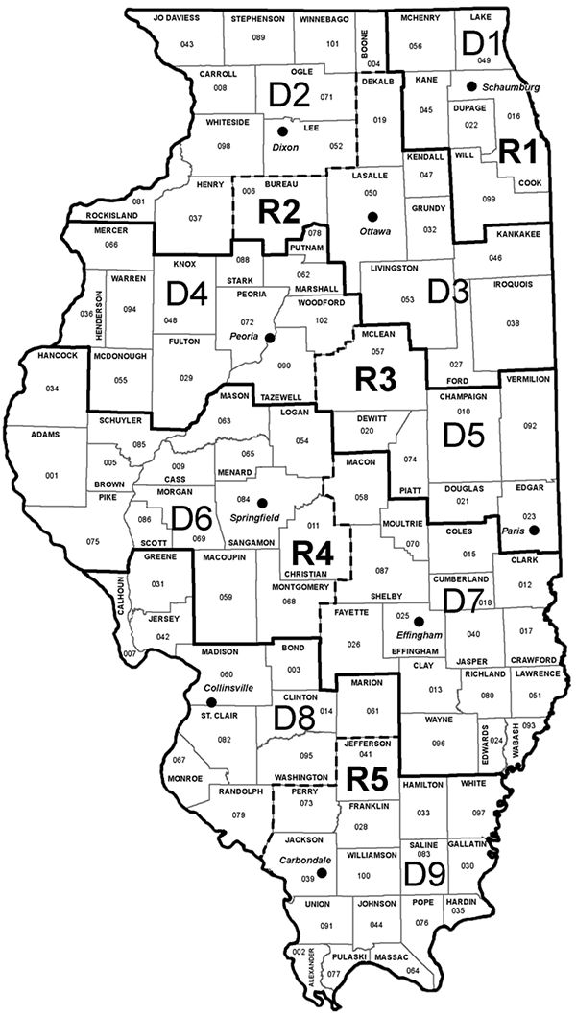

REGION 5 OVERVIEW & OPPORTUNITIES
Illinois Department of Transportation
Presented by Rebecca Tharp, p.e., s.e.
Assistant Region 5 Engineer
Presented to SAME Scott afb/st. louis
Notes:
Good Morning everyone – it is great to be here. I appreciate the opportunity to speak with you today.
I know you just heard a little bit about me, so I’ll skip the formal introduction and jump right in.
Before I do that, I want to get a quick feel for the room.
How many of you have worked with IDOT before?
How many of you are in engineering?
Construction?
Alright – perfect. That helps me tailor what I focus on today.

Slide 2
PRESENTATION OVERVIEW
What is IDOT
Region 5 overview / Organizational structure
Projects under construction
multi-year program/upcoming projects
Working with idot – engineering / Land Acquisition / construction
Notes:
Here is what I’ll cover today: a quick look at IDOT, a tour of Region 5 and its districts, some key projects underway, our multi-year program and upcoming projects, and finally, ways to get involved with IDOT in engineering, construction, or land acquisition.

Slide 3
What is IDOT?
IDOT Is Statewide Transportation Agency
Mission: Safe, Cost‑effective Multimodal Transportation
Multimodal: Roads, Bridges, Railroads, Transit, Bikeways, Airports, Waterways, Port Districts
State Led Project & Local Led Projects
Notes:
IDOT is a multi-modal agency – so that includes everything from roads to bridges to transit, rail, and even ports. We manage both state-led and locally-led projects.

Slide 4
NEW HAPPENINGS
BLUE RIBBON COMMISSION (BRC)
  DRIVEN BY LEGISLATION & CREATED BY THE ILLINOIS GENERAL ASSEMBLY
  LOOKED AT HOW IL FUNDS, MAINTAINS, AND IMPROVES ITS TRANSPORTATION SYSTEM
  ONGOING
Notes:
One initiative we are currently supporting is the Blue Ribbon Commission, which was created by the Illinois General Assembly to examine how IL funds, maintains, and improves its transportation system.

Slide 5
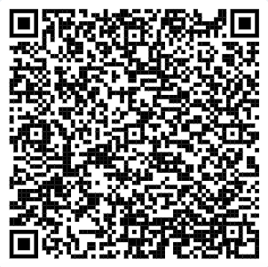
BRC Final Report
5 OVERARCHING OBJECTIVES
  Accelerate Project Delivery
  Expand Workforce Capacity
  Maximize The Value of Investments
  Drive Sustainable Outcomes
  Secure Adequate Funding
SCAN
ME!
https://idot.illinois.gov/programs-and-projects/multimodal-transportation/blue-ribbon-commission-on-transportation-infrastructure.html
Notes:
The final report was released last year and is available on our website. The commission focused on five objectives: Accelerating project delivery, expanding workforce capacity, maximizing investment value, driving sustainable outcomes, and securing funding.
These objectives are already shaping how we plan and deliver projects across the state.

Slide 6
Region 5 Overview
District 8:
11 COUNTIES
3,819 Lane Miles (State Only) / 13,677 Total Lane Miles (State + Local)
1,014 Bridges (State Only) / 2,523 Total Bridges (State + Local)
Collinsville Office
District 9:
16 Counties
3,101 Lane Miles (State Only) / 12,581 Total Lane Miles (State + Local)
764 Bridges (State Only) / 2,554 Total Bridges (State + Local)
Carbondale Office
Notes:
Now that you have a sense of what IDOT does, let’s zoom in on region 5 and see how it’s structured.
Region 5 is made up of District 8 and District 9.
District 8 covers 11 counties, thousands of lane miles, and thousands of bridges. The main office is in Collinsville.
District 9 covers 16 counties, also thousands of lane miles and bridges, and the main office is in Carbondale.

Slide 7
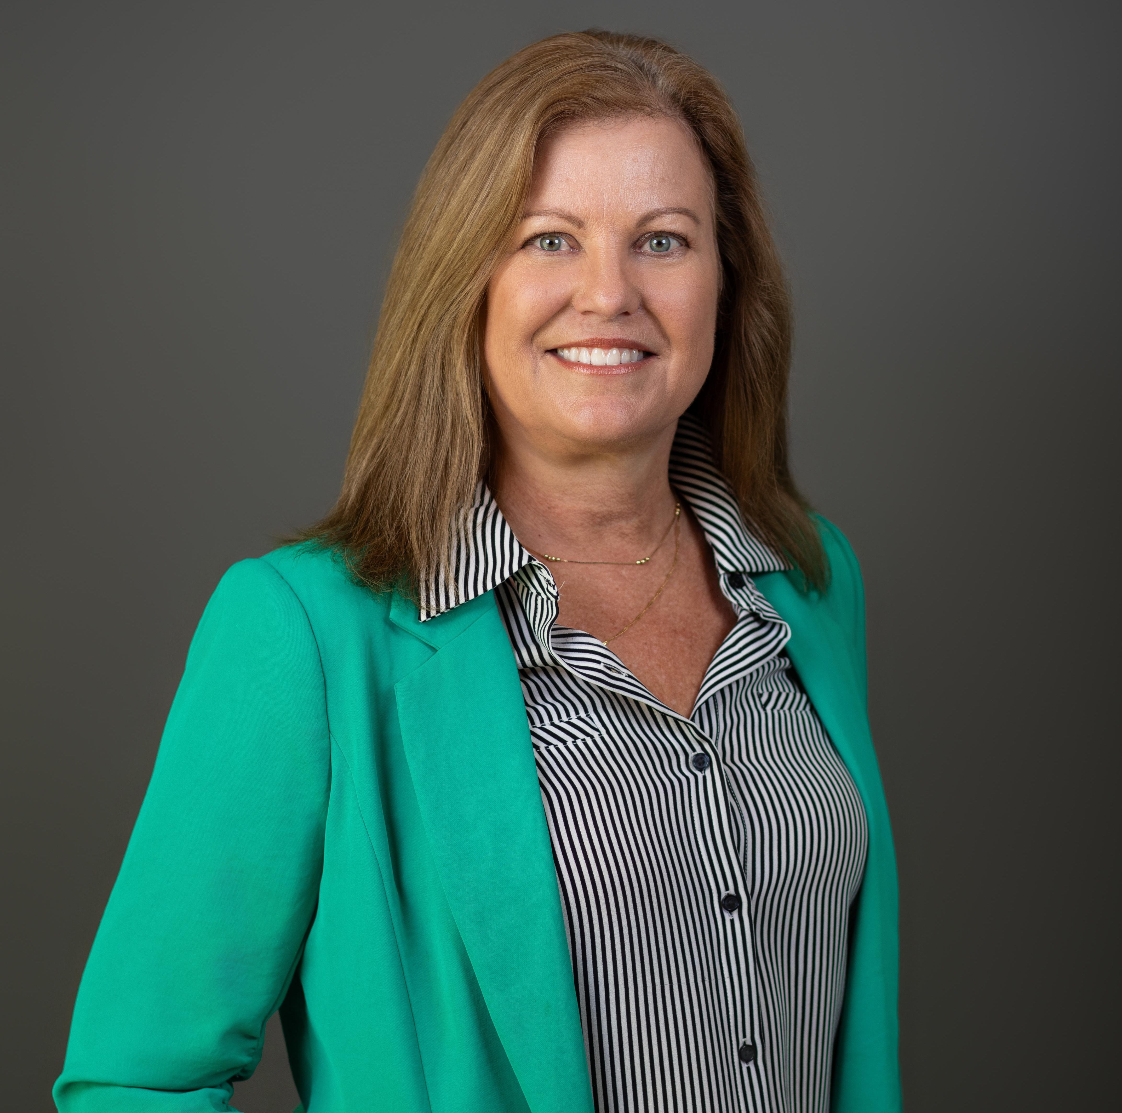
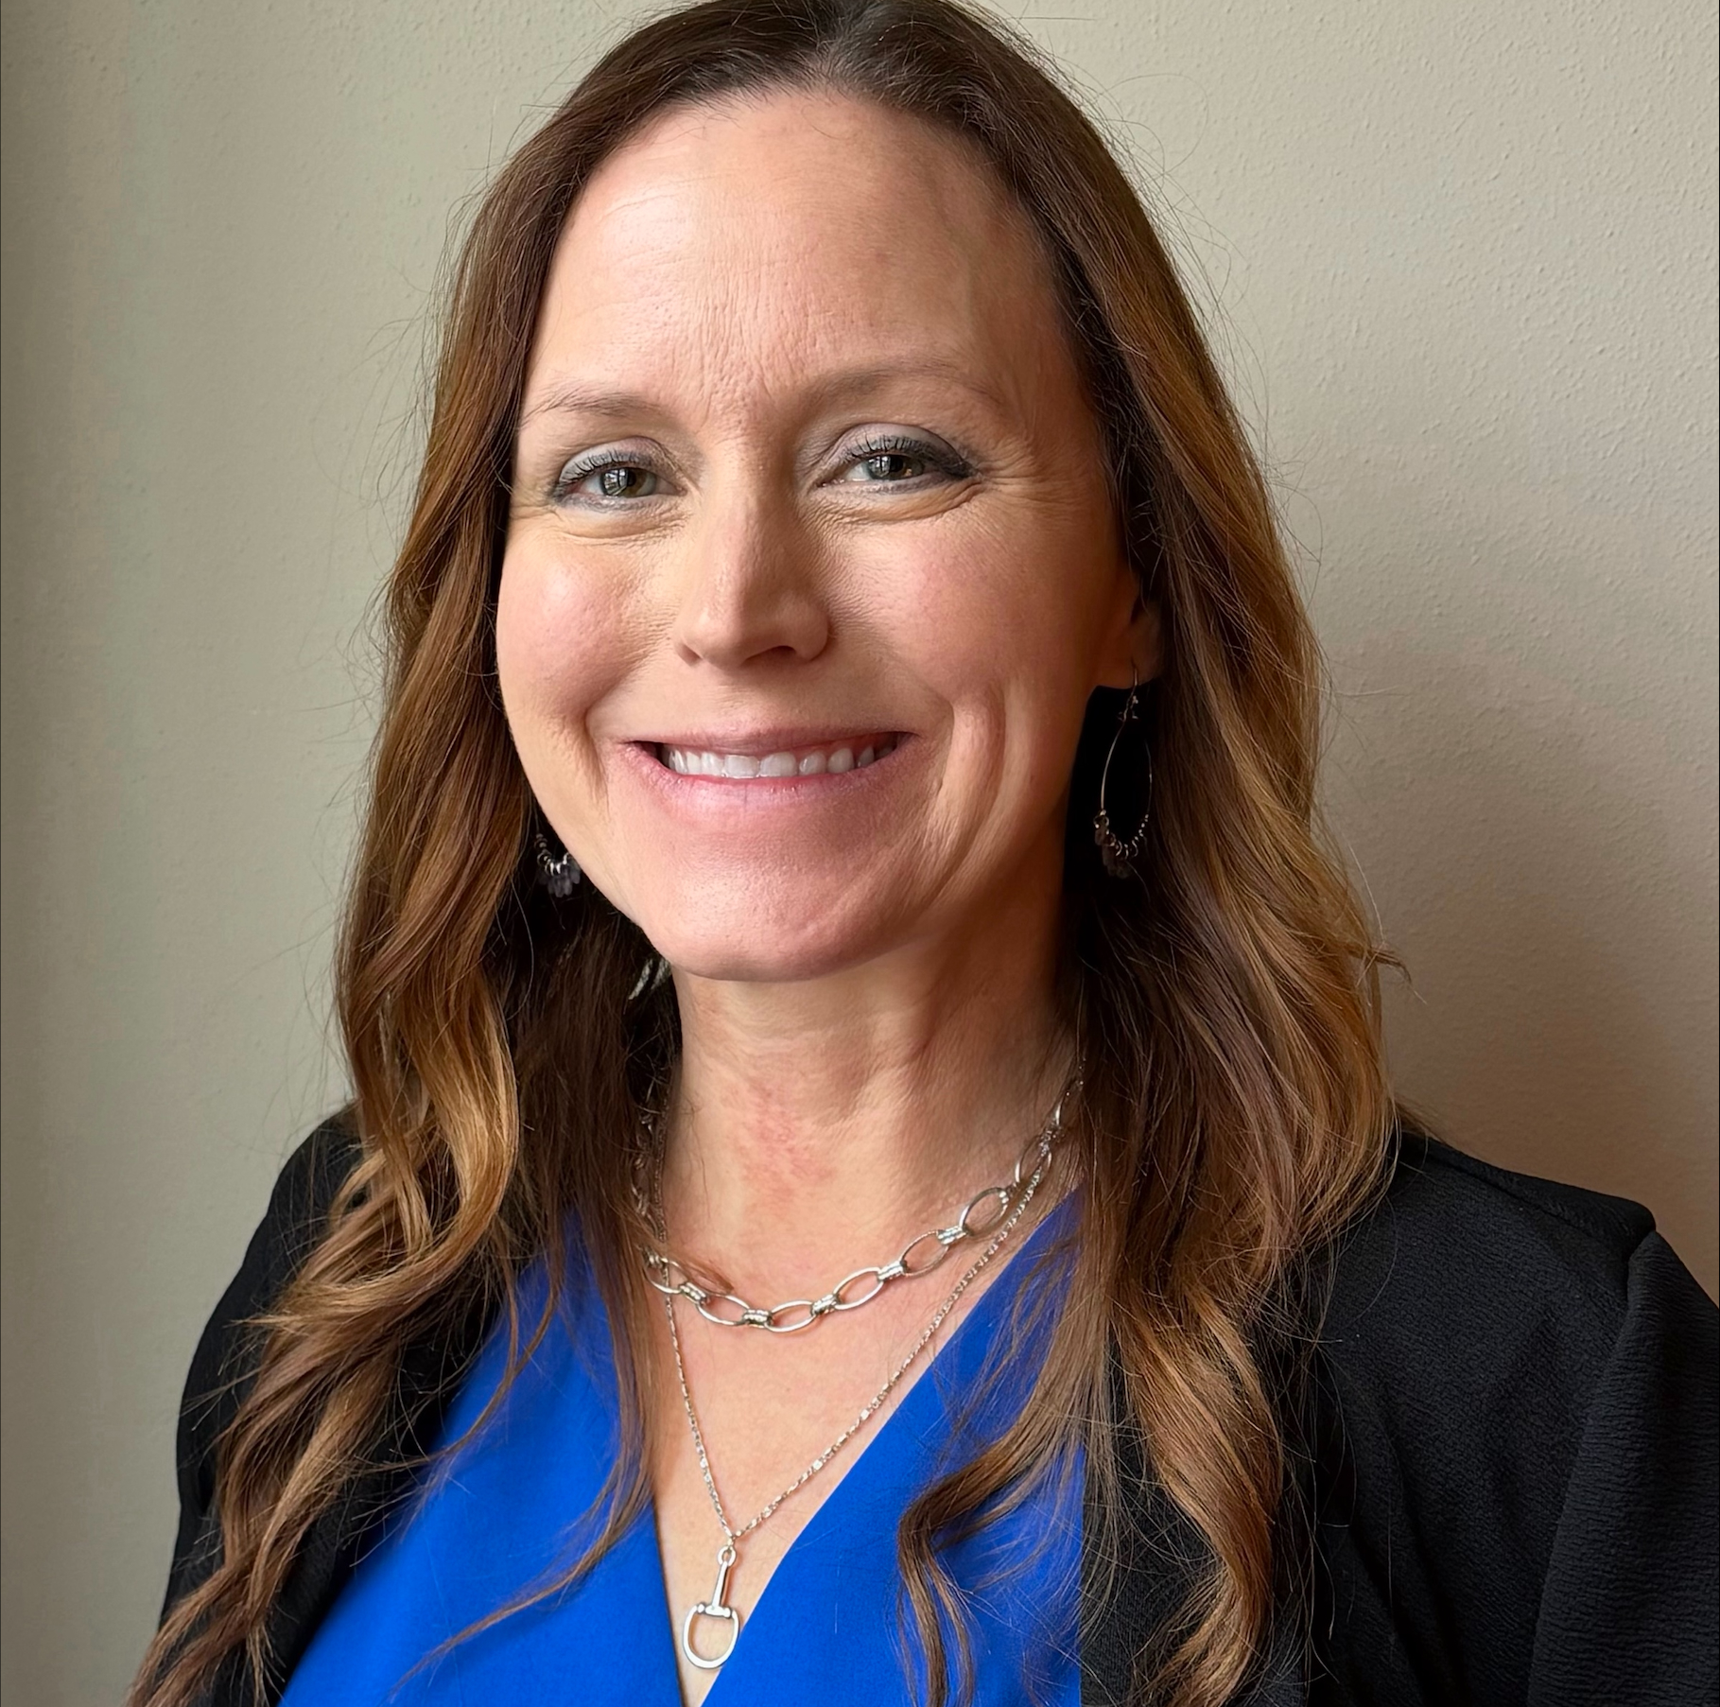

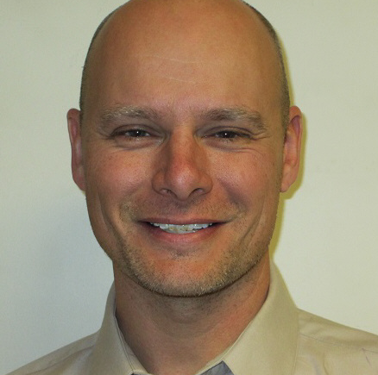
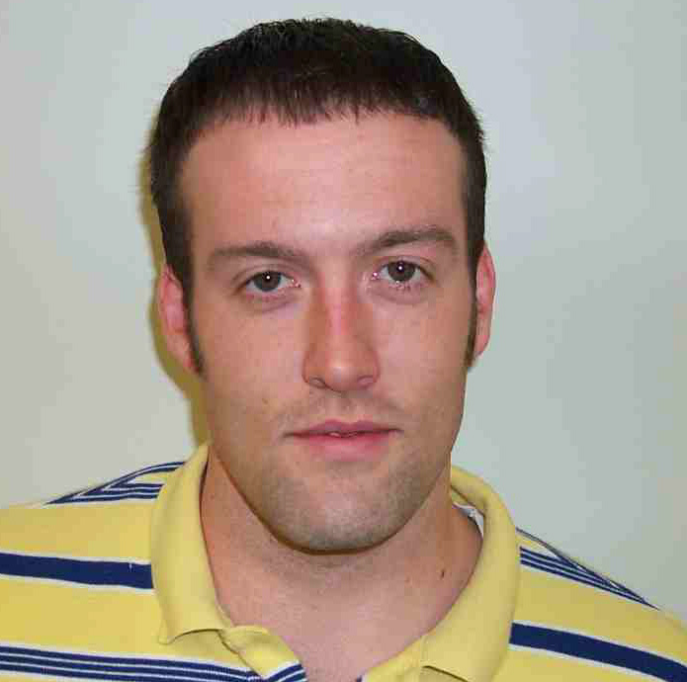
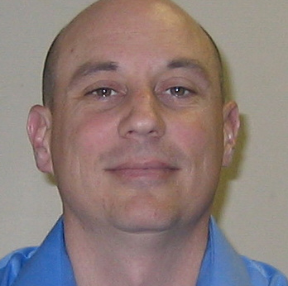
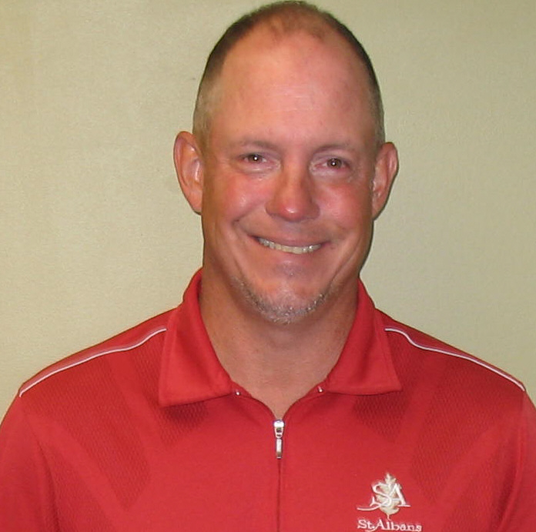
Carrie Nelsen
Region 5 Engineer
Rebecca Tharp
Assistant Region 5 Engineer
Program Development Engineer
Project Implementation Engineer
Operations Engineer
Vacant (D8)
Vacant (D9)
Joel Cumby (D8)
Ben Wills (D9)
Joe Monroe (D8)
Rob Graeff (D9)
Notes:
One month ago, on March 16th, Carrie Nelsen was appointed Region 5 Engineer and I was appointed Assistant Region 5 Engineer – overseeing both districts.
Both districts are organized into 3 main areas:
Program Development – This covers Phase 1 and Phase 2, NEPA, design, surveying, land acquisition, and coordination with railroads and utilities.
Project Implementation – This includes construction, materials, and local roads
Operations – Day to Day maintenance, access permits, snow removal, and keeping our roads safe and functional.
Currently in D8, I am filling the Program Development role until it’s permanently staffed, while Carrie continues in that role in D9.
The other leaders include Joel Cumby, Ben Wills, Joe Monroe, and Rob Graeff, who manage Project Implementation and Operations.

Slide 8
Stateside vs Local Roads Projects
 | Stateside Projects | Local Roads Projects
ADMINISTERED BY: | IDOT | Local Agency (with IDOT Oversight if fund source is under IDOT purview)
LOCATION: | State Routes | Local or State Routes (with IDOT approval for State Routes)
DESIGN LEAD: | IDOT | Local Agency
CONSTRUCTION OVERSIGHT: | IDOT responsible for field staff | Local Agency Responsible; IDOT provides a supervising field engineer if on a State Letting
CONTRACTING: | IDOT Letting | IDOT Letting or Contractor’s Bulletin
Notes:
Next I want to clarify how Stateside, or IDOT led projects, differ from Local Roads projects.
Stateside Projects are planned, designed, funded and let by IDOT – on the State highway system – and use IDOT staff, consultants, and contractor processes.
Local Roads Projects are locally administered but when MFT, state, or federal funds are involved IDOT’s Local Roads Section provides the oversight to ensure compliance. The design is led by the Local Agency

Slide 9
BUILDING REGION 5: Key Projects Under Construction
Notes:
Now that we have covered how IDOT is structured, the distinction between Stateside and Local Roads projects, and how projects move through our districts, let’s focus on what’s happening on the ground in Region 5. I want to highlight some of the key projects currently under construction in both District 8 and District 9.
We will take a look at a few examples to give you a sense of scale and scope of the work that is happening now.

Slide 10
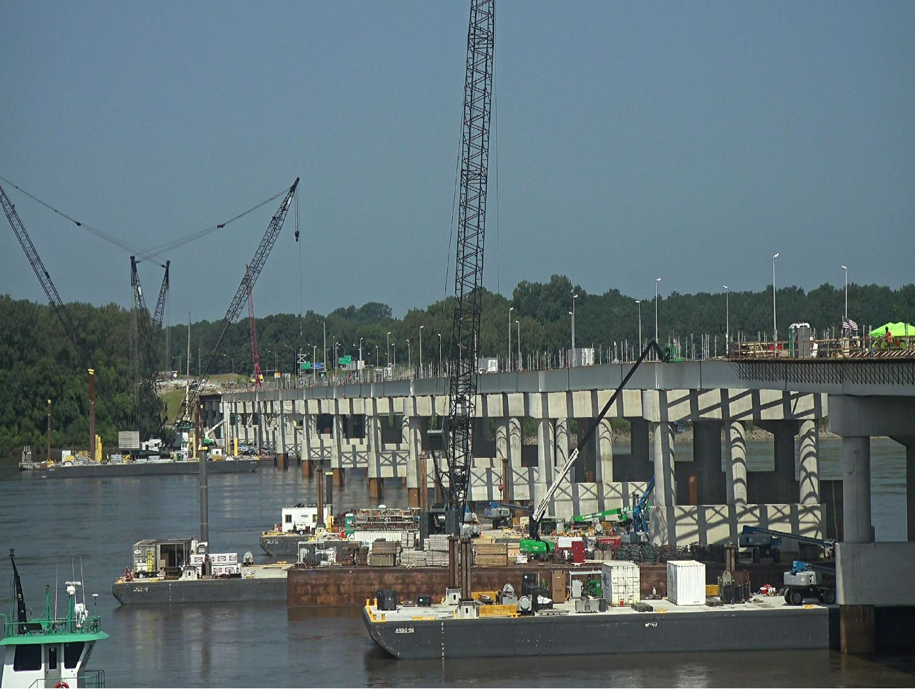
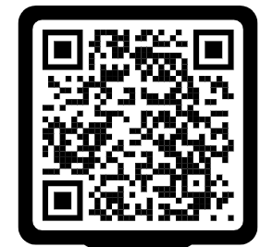
PROJECTS UNDER CONSTRUCTION
D8
I-270 OVER THE MISSISSIPPI RIVER BRIDGE REPLACEMENT
IL 158 (AIR MOBILITY DRIVE) EXTENSION
I-64 SIX-LANING FROM W OF GREENMOUNT RD TO W OF IL 158
I-55/70 OVER B&O RR BRIDGE REHABILITATION
I-64 RESURFACING FROM IL 157 TO W OF GREENMOUNT RD
REPLACEMENT OF THE CHESTER BRIDGE (MoDOT LEAD)
Notes:
The I-270 Mississippi River Bridge is the single largest contract in District 8’s history, at $496 M. This was a joint letting with MoDOT. MoDOT had a contract for the Riverview Drive interchange on their side, and IDOT had the bridge contract. The tied bidding process required that the successful contractor be the low bidder across both contracts combined, which was unique and complex coordination effort between the two states.
Air Mobility Drive – near the base, this project extends 158 from 161 down to 177. Once complete, this new section will become Route 158, giving direction access to 177, and the current section of 158 will become unmarked.
I-64 Six Laning from Greenmount West to 158 – right now there is a 2 lane gap in an otherwise 6 lane corridor. This project fills that gap, giving continuous six lane travel from I-55 all the way to Greenmount Rd.
I-55 over the B&O Railroad – A major bridge project near the racetrack. There’s a lot of work happening underneath the structure, with lane closures on top to repair joints.
I-64 Resurfacing – The pavement was wearing, especially along the lane and shoulder edges which required a full asphalt replacement to maintain safety and smooth travel.
Chester Bridge Replacement – A MoDOT led design build project. IDOT is participating with 50% of the main span cost. Progress is excellent and there is even a drone you can follow online to watch construction updates in real time. If you scan that QR code, it will take you to the site.

Slide 11
PROJECTS UNDER CONSTRUCTION
D8
IL 157 AT IL 162 INTERSECTION REALIGNMENT IN GLEN CARBON
I-55/70 RESURFACING AND BRIDGE REPAIRS FROM I-64 TO W OF BLACK LANE
IL 3 RESURFACING IN GRANITE CITY/VENICE
IL 158 RESURFACING FROM US 50 TO IL 161
IL 159 RESURFACING FROM WASHINGTON TO IL 15 IN BELLEVILLE
Notes:
Here are a few more projects currently underway in District 8. An interchange realignment, bridge repairs, and resurfacing.

Slide 12
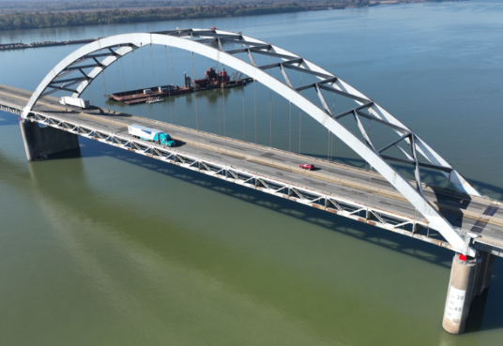
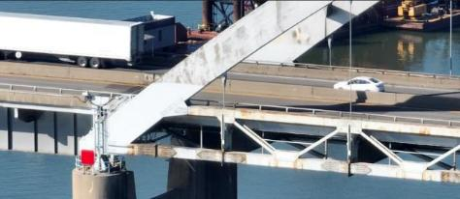
PROJECTS UNDER CONSTRUCTION
D9
I-24 over Ohio River bridge rehab in Massac County
Modular Expansion JOINTS, Bridge deck Patching, microsilica Concrete Overlay, Parapet Rail removal & concrete parapet cap, bridge painting
Detour route is 90 miles / 1.5 hours
One lane in each direction during the specified time frame:
  2025: March 1- October 14
  2026: March 1- October 13
  2027: March 1- September 1
  Completion Date = 10/3/2027
Incentive Plan – $2.0 M max payout in incentives
  $10,000 per calendar day to complete work before September 1, 2027
  200 days of incentives (Hopefully the contract will end in 2026)
Notes:
Now that we have taken a look at what’s happening in District 8, I want to shift over to District 9 and highlight a couple of projects that may really catch your attention. The first project I want to highlight is the I-57 bridge rehab over the Ohio River . If you are driving to Florida this summer, you may want to take note. The I-57 bridge over the Ohio river is currently being rehabilitated and traffic will be reduced to one lane. That means delays are very likely and travel time could be significantly longer than expected. This project is anticipated to be completed by the end of 2027, so this is something to keep in mind for both this summer and next.

Slide 13
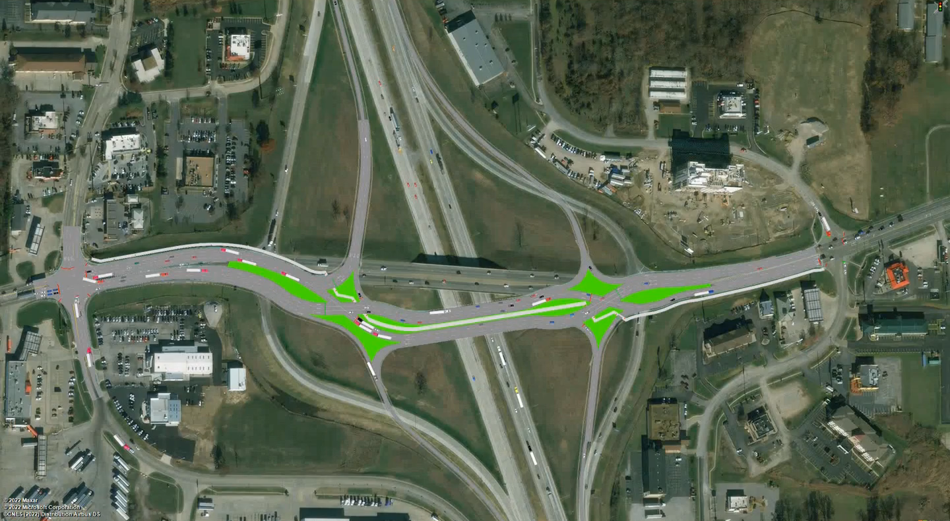
PROJECTS UNDER CONSTRUCTION
D9
I-57/64 & IL 15 Diverging Diamond Interchange
Notes:
Another exciting project underway in District 9 is the new diverging diamond interchange at IL 15 in Mt. Vernon. This design helps improve traffic flow and reduces conflict points, making the intersection both safer and more efficient. It is expected to be completed by the end of 2027 – and I have a quick video her that shows how traffic will move once it’s fully operational.

Slide 14
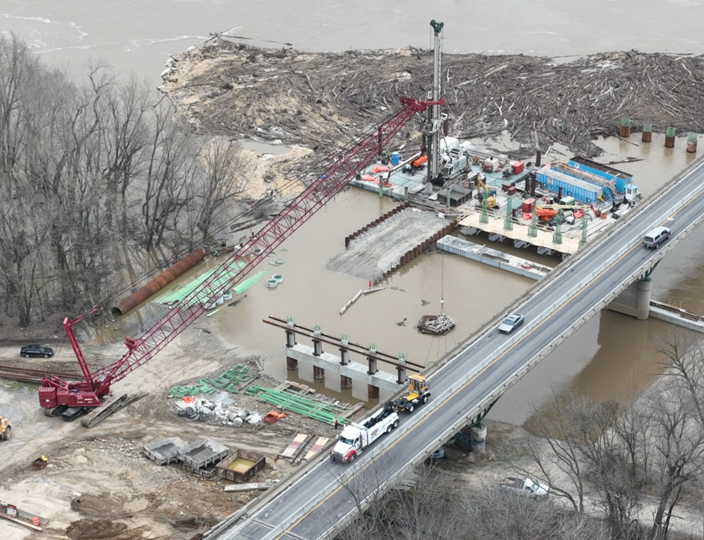
PROJECTS UNDER CONSTRUCTION
D9
I-64 - WABASH RIVER BRIDGE REPLACEMENT
I-57 - N OF BENTON TO I-64 - ADD LANE
I-57 - I-24 TO MARION - ADD LANE
I-57 - MISSISSIPPI RIVER BRIDGE – PAINT
IL 13 - SPILLWAY RD TO SHAWNEE TRAIL - ADD LANE
IL 37 – WILDCAT DR TO IL 148 – 3R
Notes:
Here are a few more projects currently underway in District 9. A bridge replacement, resurfacing, bridge painting and a few projects adding a lane.

Slide 15
BUILDING REGION 5: Future Projects
Notes:
So we have talking about what we are building today – projects that are already in construction in D8 and D9. Now I want to shift gears a bit and talk about what is coming next. Because what you are seeing in construction today is just one piece of a much larger pipeline.

Slide 16
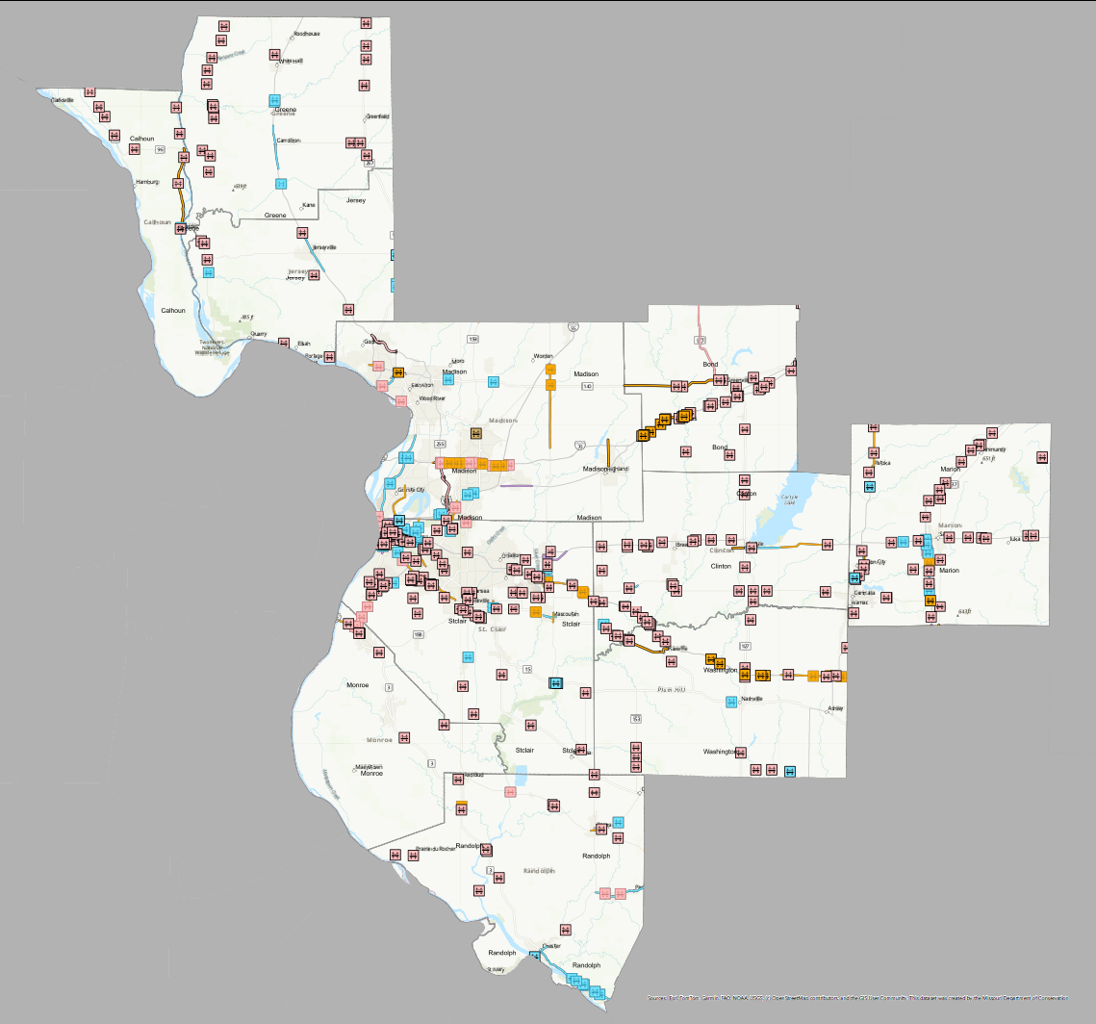

FY 26 – FY 31 MULTI-YEAR PLAN
D8
$3.8 BILLION (FY 26 – FY 31) FOR STATE HIGHWAYS IN D8
187 MILES OF ROADWAY MAINTENANCE
1,153,175 SQ FT OF BRIDGES IMPROVED
8 SAFETY LOCATIONS
15 MILES OF SYSTEM EXPANSION
$319 M IN PRESERVATION
Notes:
This is a snapshot of our FY26 through FY31 Multi-Year Program from District 8. In total it represents $3.8 B in investment in State highways just in this district. And that investment really spans everything that we do – from maintaining nearly 187 miles of roadway, to improving over a million square feet of bridges, to targeted safety improvements and system expansion. And a big portion of that – over $300M – is focused on preservation, which is really about taking care of the system we already have.
And when you look at the map, you really start to see the scale of this program. The projects are spread out throughout the entire district – urban areas, rural corridors, interstates. It’s a coordinated effort across the whole transportation network.

Slide 17
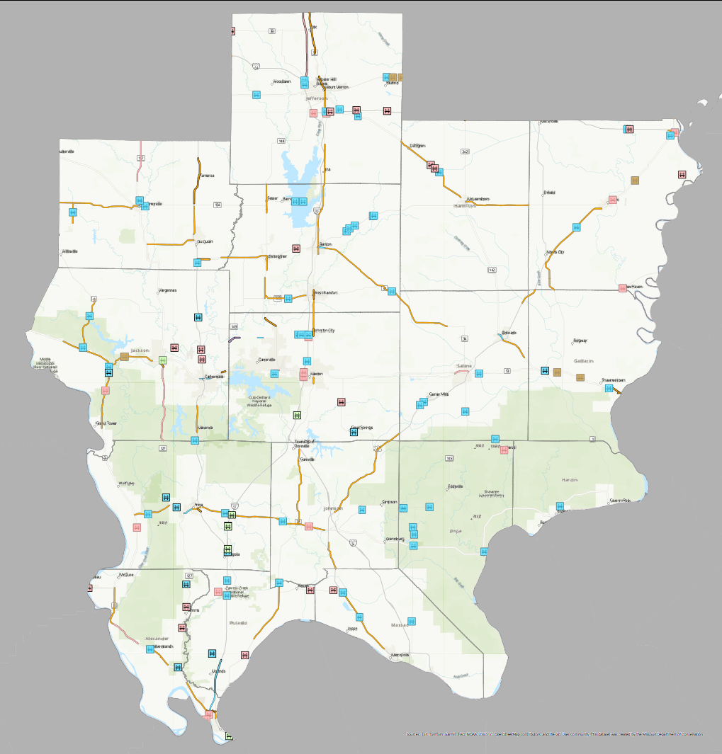
FY 26 – FY 31 MULTI-YEAR PLAN
D9
$1.1 BILLION (FY 26 – FY 31) FOR STATE HIGHWAYS IN D9
310 MILES OF ROADWAY MAINTENANCE
487,706 SQ FT OF BRIDGES IMPROVED
9 SAFETY LOCATIONS
2 MILES OF SYSTEM EXPANSION
$121 M IN PRESERVATION
Notes:
District 9 has a very similar story so I will show you that next. $1.1 B invested in this District. It covers maintaining over 300 miles of roadway maintenance, improving nearly 500K square feet of bridges, and safety improvements and system expansion.

Slide 18
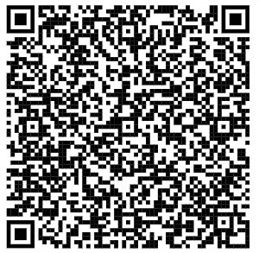

Multi-Year Program
https://idot.illinois.gov/programs-and-projects/multimodal-transportation/multi-year-program--highway-and-multimodal.html
Notes:
And this was just a really high level summary. If you are interested in digging into more specifics, you can scan this QR code and the full program is available to explore the details by district, route, and project type.
Now the program is available online, but I will be honest, it’s not always the easiest thing to navigate. So what I wanted to do was to pull out a few highlights – starting with projects that are coming up very soon.

Slide 19
UPCOMING CONSTRUCTION (ANTICIPATED NEXT 12 MONTHS)
D8
I-64 RESURFACING AND BRIDGE REHAB FROM BEAVER POND CREEK TO 0.9 MI W OF CH 11
IL 111 AT CHAIN OF ROCKS RD INTERSECTION IMPROVEMENT
I-70 RESURFACING AND BRIDGE REHABILITATION FROM THE MADISON COUNTY LINE TO W OF SUGAR LOAF RD (Bond County)
I-255 RESURFACING FROM IL 157 TO IL 3 IN DUPO
IL 100 RESURFACING FROM IL 16 TO IL 96 (Calhoun County)
IL 157 BRIDGE REPLACEMENT AT THE AMERICAN LEGION IN EDWARDSVILLE
IL 140 RESURFACING FROM THE MADISON COUNTY LINE TO IL 127 (Bond County)
Notes:
So these are upcoming FY 26 construction projects in District 8.
These are ones you’re going to start seeing advertised in the near term – so for those of you in the construction space, these are really the immediate opportunities.
You will see a strong mix of resurfacing and bridge rehab work across several key corridors --- including I-64, I-70, and I-255.
We also have intersection improvements, like the IL 111 and Chain of Rocks Road, and a bridge replacement in Edwardsville that will be a pretty visible project locally.
And then additional resurfacing work on routes like IL 100 and IL 140.
Now these are the projects coming up in the near term, but if we look a little further in the program, there are also some larger and longer-term projects I want to highlight.

Slide 20
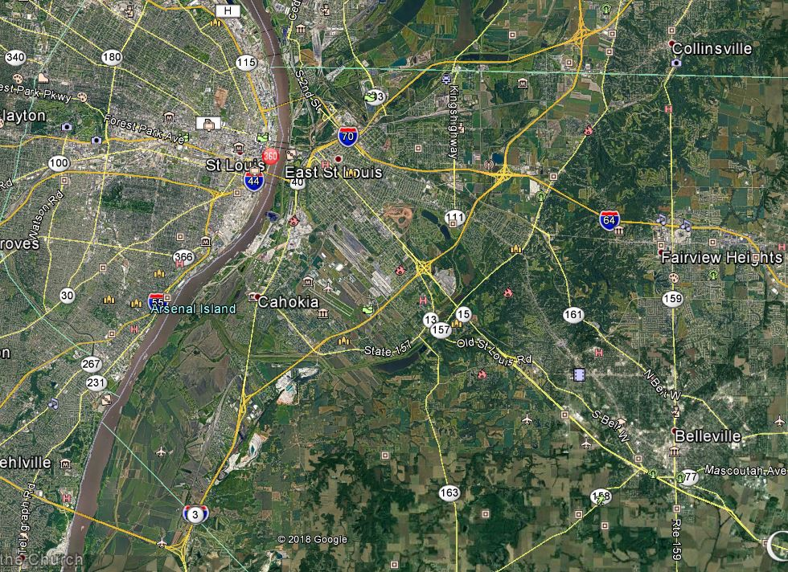
REBUILD ILLINOIS PROJECTS
D8
I-255 REHABILITATION & BRIDGE REPAIRS
IL 157 TO JB BRIDGE
$163.4 MILLION
RESURFACING AND BRIDGE REPAIRS
DONE IN PHASES
UP TO 57,400 ADT
Notes:
This is the I-255 rehabilitation and bridge repair project, running from IL 157 up to the JB Bridge. And this actually builds directly on one of the projects I just mentioned. The section from IL 157 to IL 3 in Dupo is part of the near term work we just looked at. But the full corridor is being delivered in phases.
The first phase is that IL 157 to Route 3 in Dupo. Then we continue from Route 3 in Dupo down to Route 3 in Columbia. And finally from Columbia up to the JB Bridge.
So when you look at this as a whole, this is about a $163M investment across all 3 phases.
So that is one of the bigger corridor investments in the program. Another project I want to highlight is along 270.

Slide 21
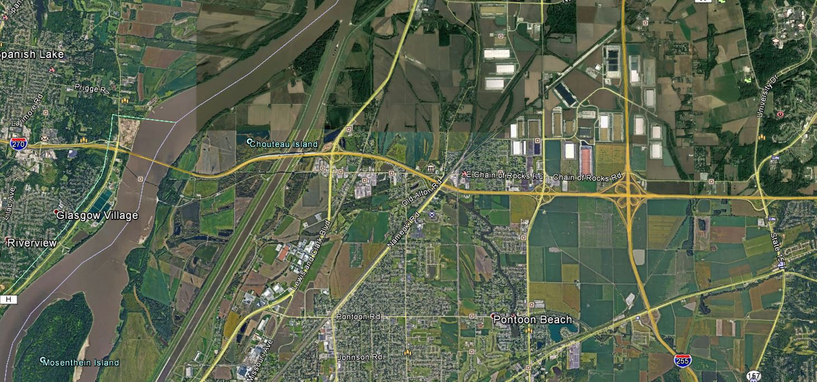
REBUILD ILLINOIS PROJECTS
D8
I-270 SIX-LANING
I-270 FROM THE MISSISSIPPI RIVER TO IL 157 - BEING STUDIED
CANAL BRIDGE TO EAST OF ST THOMAS RD FUNDED - $115M
Notes:
This is the I-270 six-laning project – specifically the first phase of expanding the corridor to six lanes. The long term goal here is to expand I-270 to six lanes beyond IL 111. But in the current multi-year program, we have funding only for this initial segment – from east of St. Thomas Rd to the canal bridge.

Slide 22
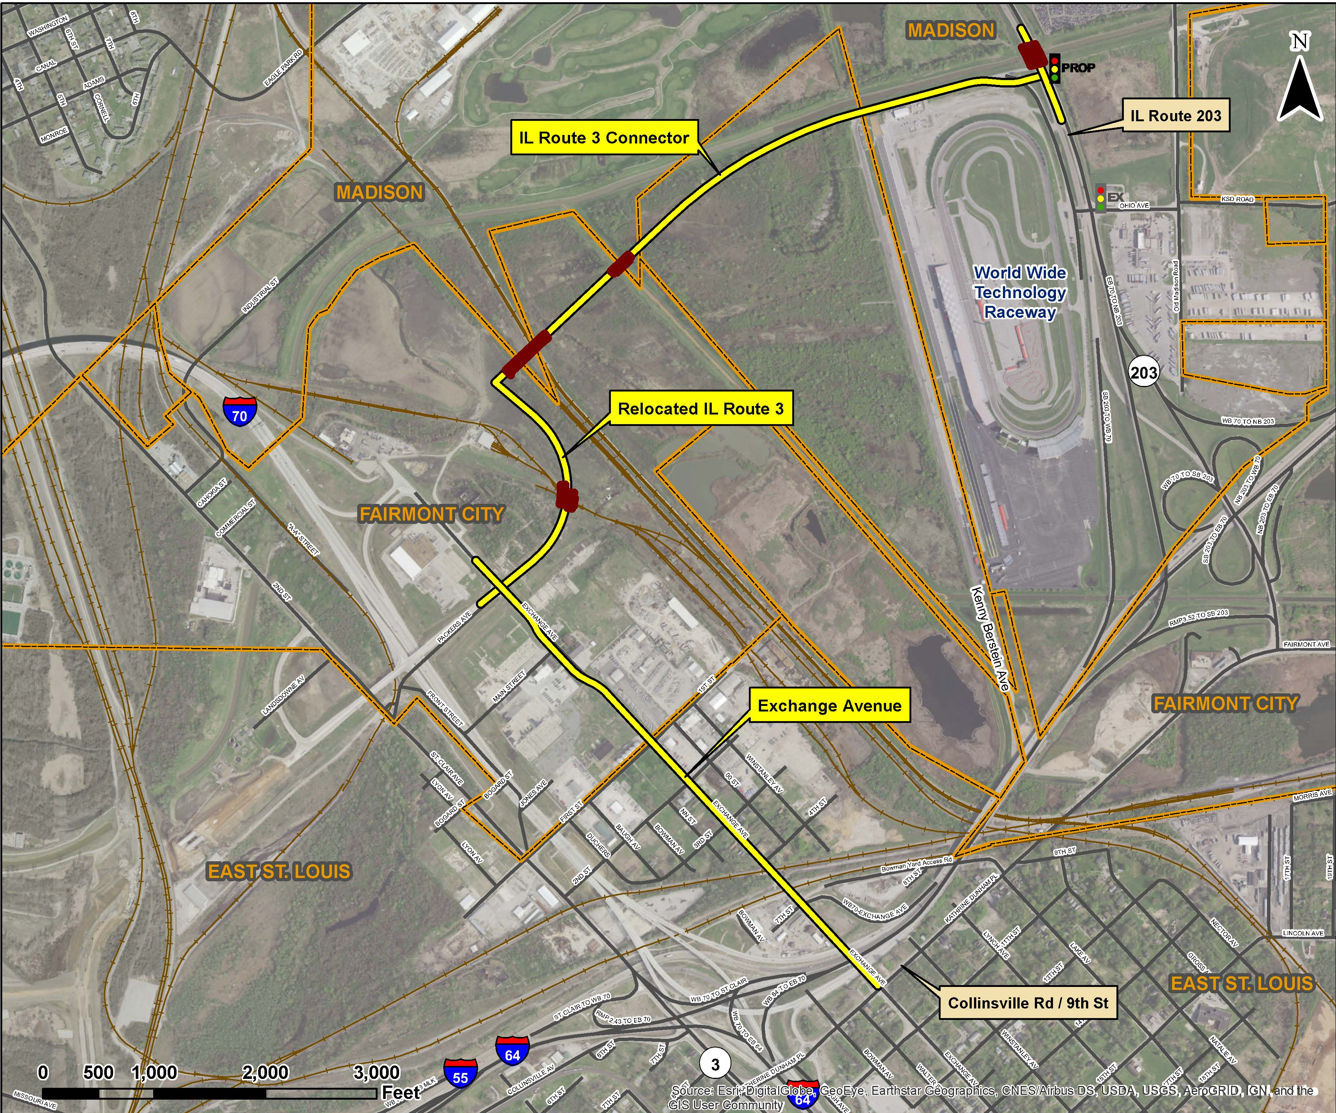
REBUILD ILLINOIS PROJECTS
D8
IL 3 CONNECTOR
  $96 MILLION
  IMPROVE TRAFFIC FLOW AND CONNECTIVITY BETWEEN IL 3 AND IL 203
  IMPROVEMENTS TO EXCHANGE AVENUE
Notes:
So we have looked at corridor improvements. Another important piece of the program is improving connectivity, and this next project is a good example of that.
This is a brand new two-lane roadway connecting IL 3 to Fairmont City Boulevard, tying into the new I-70 interchange – right in the vicinity of the World Wide Technology Raceway.
This will help improve access and overall mobility in the area that already sees a lot of traffic activity.

Slide 23
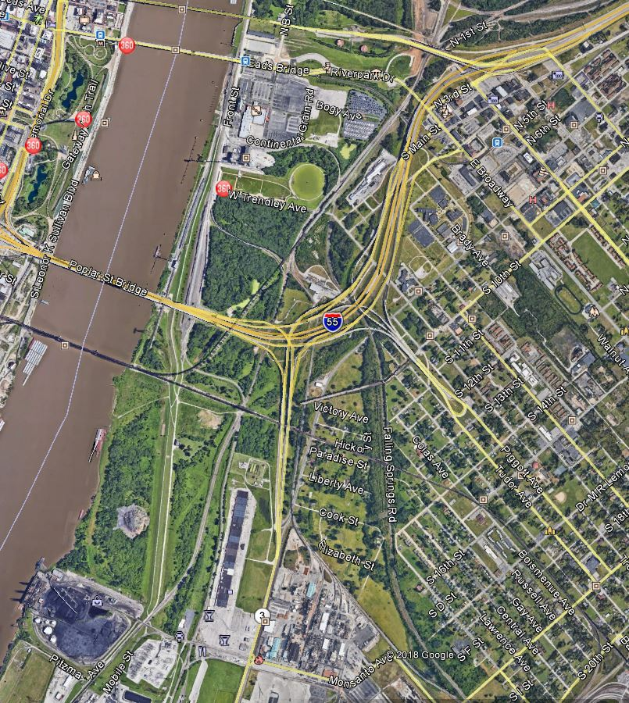
REBUILD ILLINOIS PROJECTS
D8
RELOCATED IL 3
$283 MILLION
NEW FOUR LANE ROADWAY
RIVERPARK DRIVE IN EAST ST. LOUIS TO MONSANTO AVENUE IN SAUGET
Notes:
This is the relocation of IL 3. We’ve already completed a portion of this from I-70 down to River Park Drive, and this project continues that corridor further south.
It will be a new four-lane facility extending down to Monsanto Avenue in Sauget – essentially creating a continuous, separate alignment all the way to the south.
One of the benefits here is freight movement. This will help shift traffic off the Poplar Street complex and provide a more direct, efficient route through the area.
This $283 million project is included in the multi-year. We are still in phase I, so there’s additional coordination ahead. As this progresses, you can expect to see future public meetings as we continue through the development process.

Slide 24
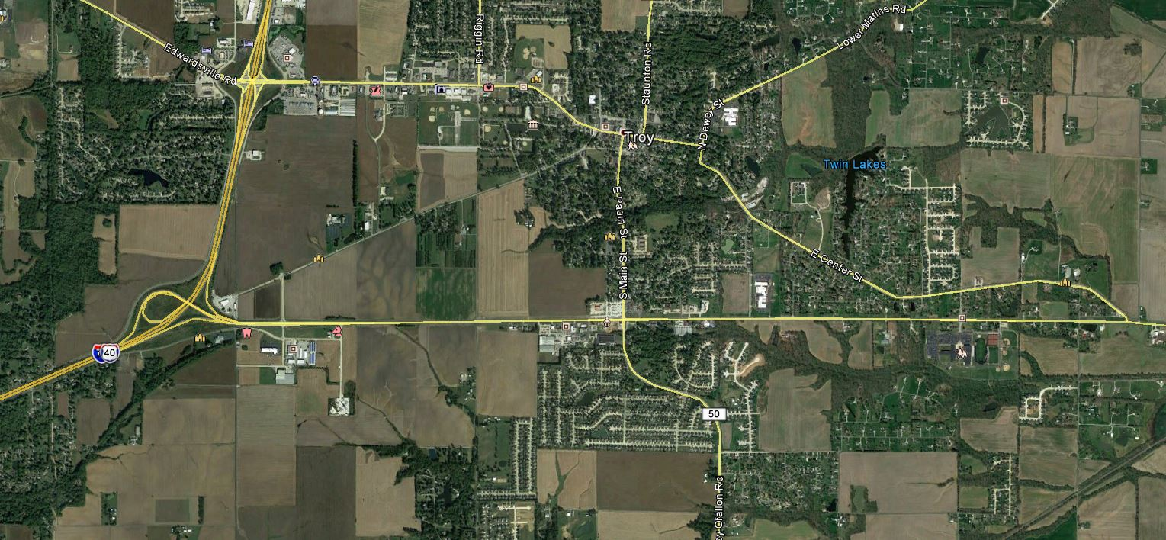
REBUILD ILLINOIS PROJECTS
D8
US 40 FROM I-55 TO IL 162
$48.2 MILLION
ADD LANES
7,450-15,100 ADT
Notes:
This project focuses on improving US 40 between I‑55 and IL 162 in Troy. We are evaluating options to add capacity, improve traffic flow, and enhance safety along the corridor. Several lane‑addition alternatives are being reviewed, including different median types and the potential for bi‑directional turn lanes. We are also assessing if and where dedicated turn lanes may be needed.
At this stage, no final design has been selected. We are gathering input, reviewing impacts, and working toward identifying the most appropriate cross‑section for the full project corridor.

Slide 25
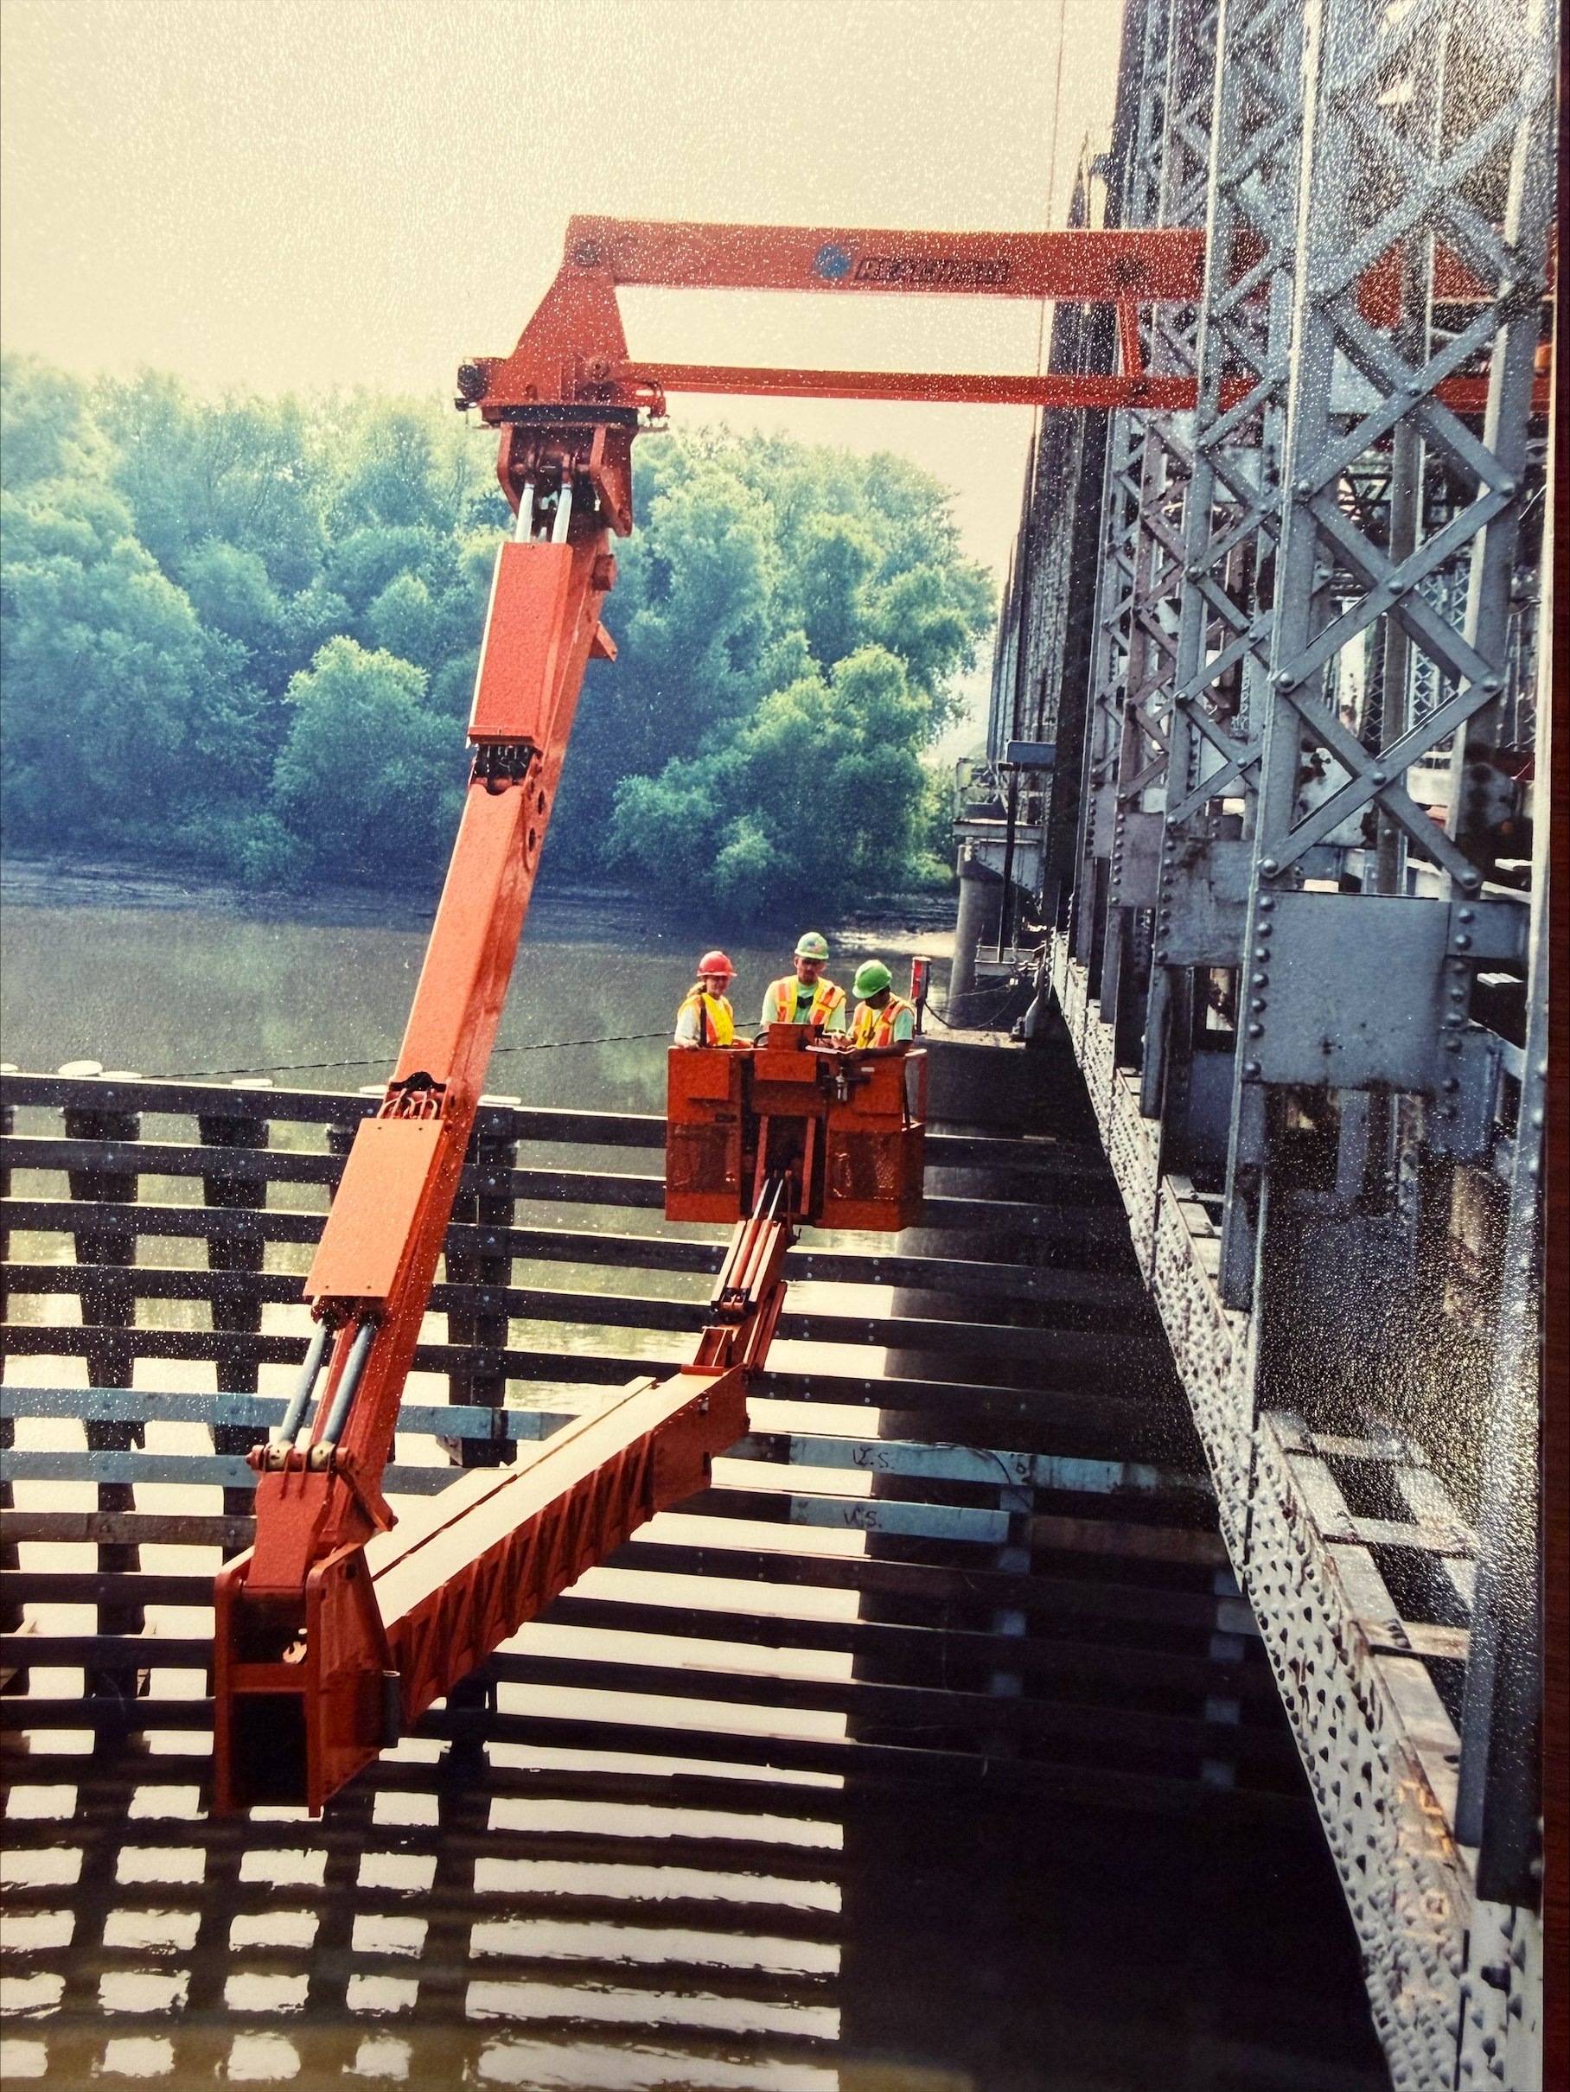
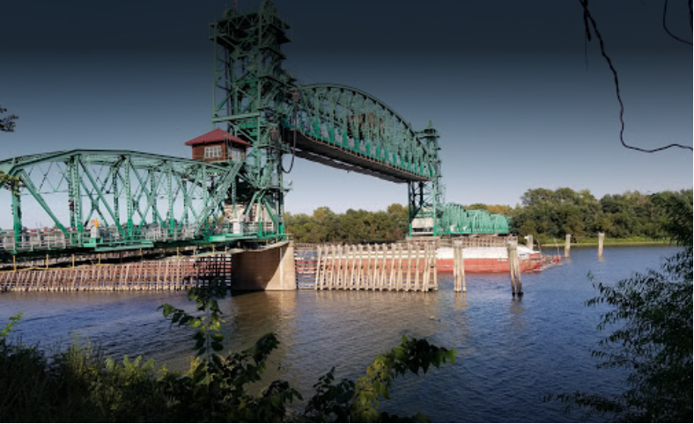
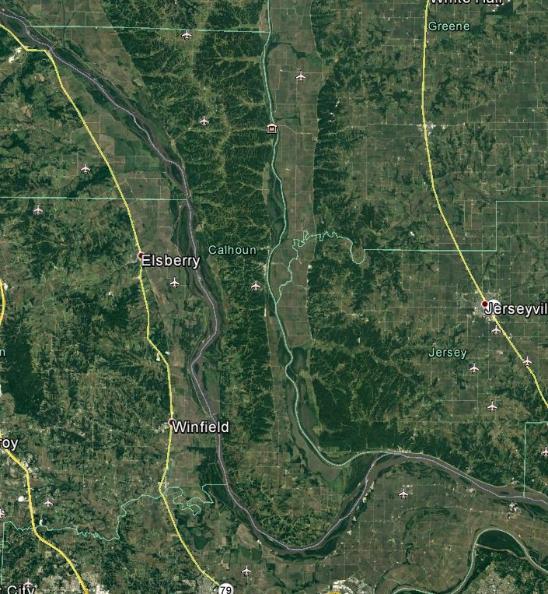
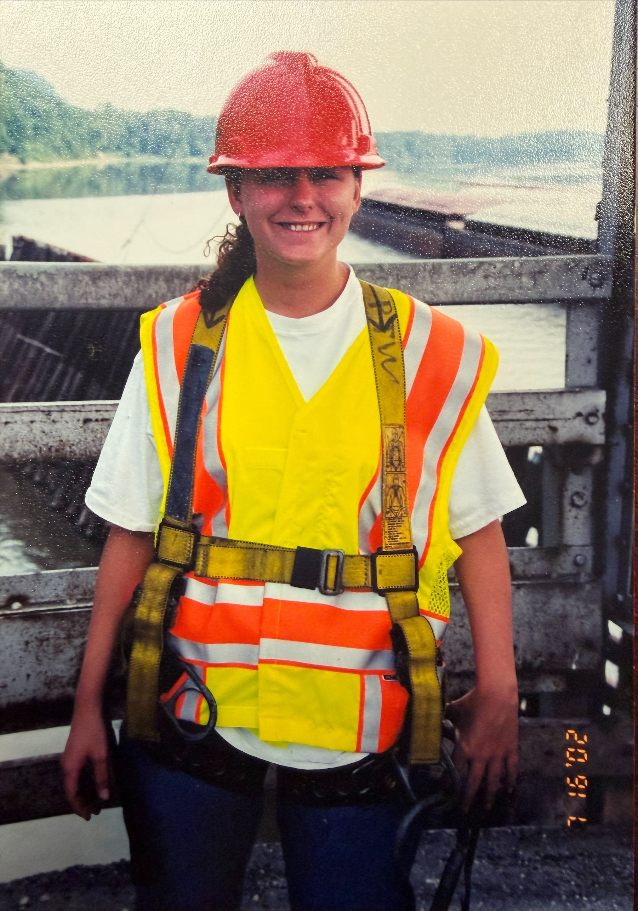
REBUILD ILLINOIS PROJECTS
D8
???
2002 Inspection
REPLACEMENT OF JOE PAGE BRIDGE IN CALHOUN COUNTY
Est. $225 M
LOCATION TBD
STAY TUNED!
Notes:
The next project is the replacement of the Joe Page Bridge in Calhoun County. This is one of the few remaining lift‑span bridges in the state, but it is in need of replacement. One personal note on the Joe Page Bridge project --- early in my career at IDOT, I had the opportunity to inspect the Joe Page bridge. At the time, I never imagined I would still be here to see the day we are planning to replace it.

Slide 26
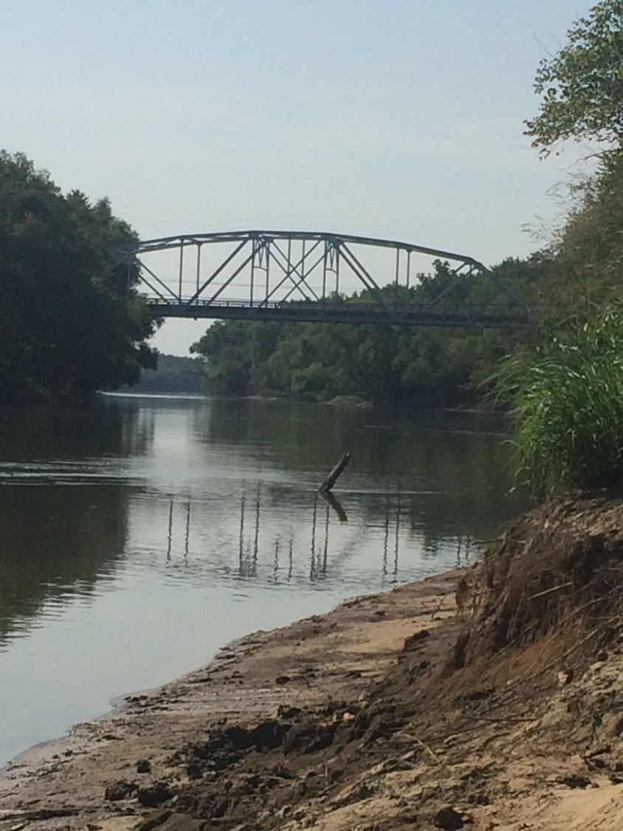
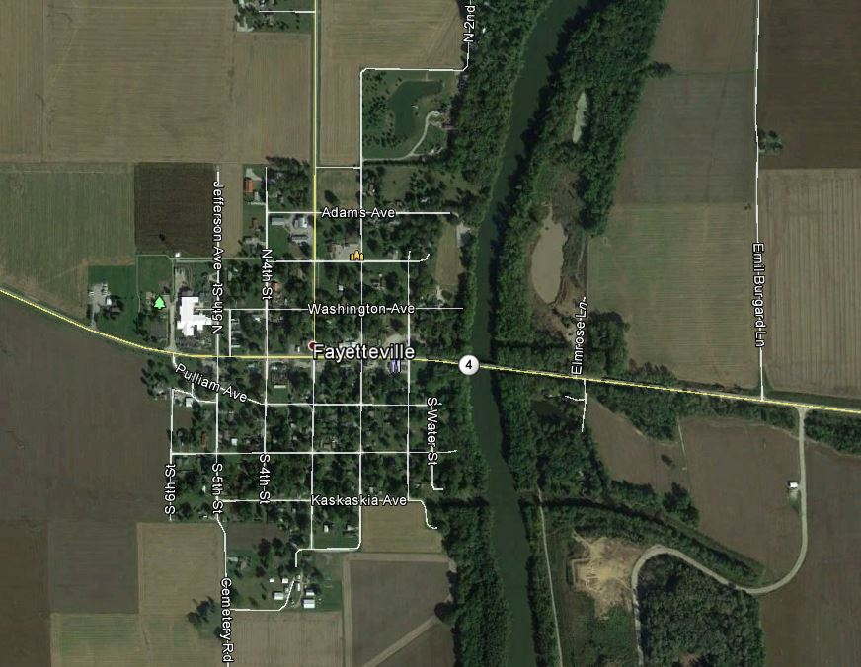
REBUILD ILLINOIS PROJECTS
D8
IL 15/4 OVER KASKASKIA RIVER IN FAYETTEVILLE
$66 MILLION
BRIDGE REPLACEMENT
CMGC PROJECT
Notes:
The next project I want to highlight is the IL 15/4 bridge replacement over the Kaskaskia River in Fayetteville. This is an Innovative Project Delivery, or IPD, project using the Construction Manager/General Contractor method. IDOT recently short‑listed three contractor teams for the CMGC phase, and that information is available on our website.
I’m mentioning this project because it shows that we are actively using IPD delivery methods, and we have additional IPD projects planned in the future.

Slide 27
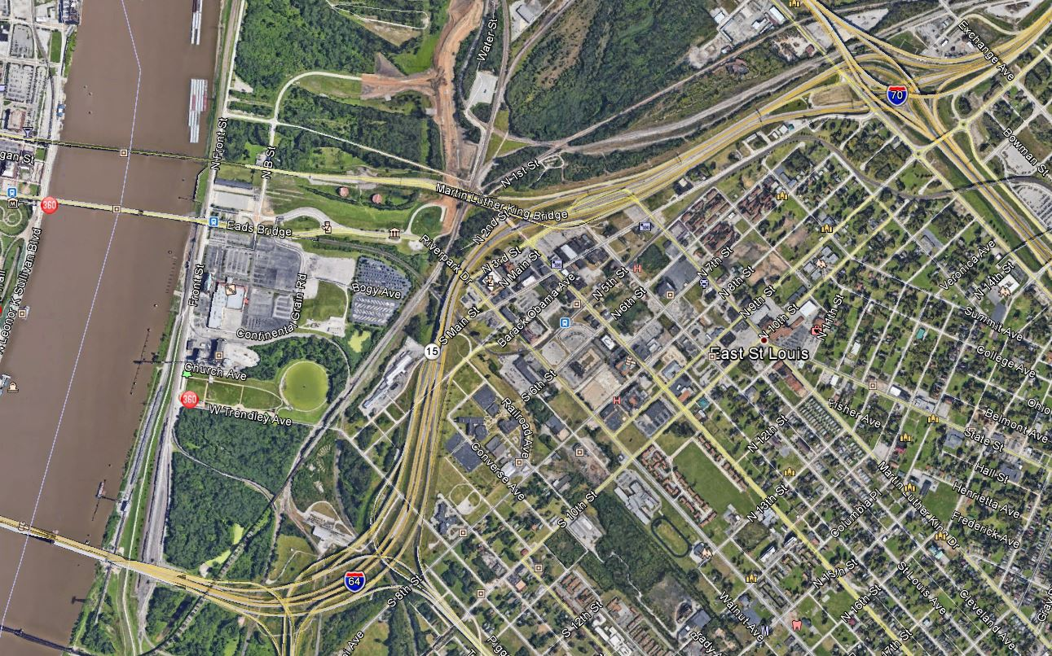
REBUILD ILLINOIS PROJECTS
D8
I-55/64 REHABILITATION INCLUDING IL 3 RAMPS
$357.1 MILLION
MISSISSIPPI RIVER TO I-64 SPLIT
PAVEMENT REHABILITATION AND BRIDGE REPAIRS on I-55/64
BRIDGE REPLACEMENT/REHAB on IL 3 RAMPS
94,700 ADT
START
FINISH
Notes:
This project involves rehabilitation work within the Poplar Street Complex. It has been identified as a potential Innovative Project Delivery project and is currently flagged as such in the Multi‑Year Program.

Slide 28
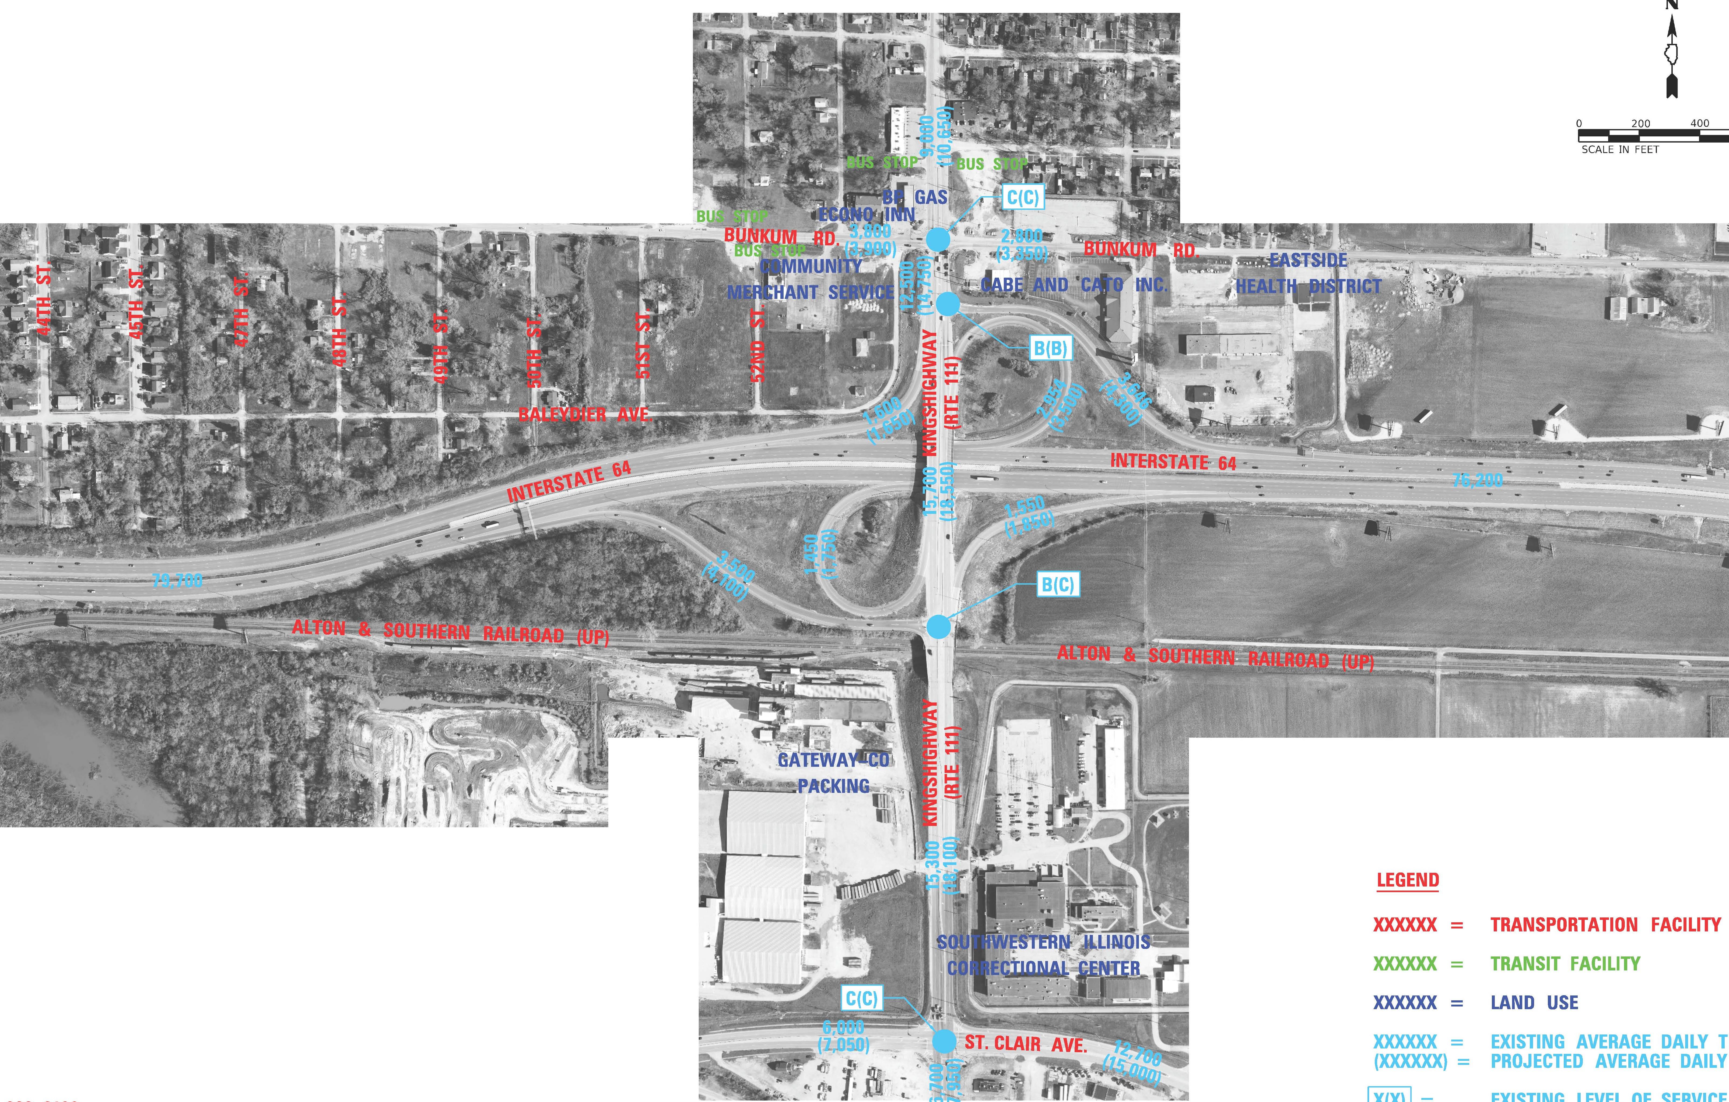
REBUILD ILLINOIS PROJECTS
D8
I-64 AT IL 111
$48.5 MILLION
INTERCHANGE RECONSTRUCTION
BRIDGE REPLACEMENT
79,700 ADT ON I-64; 15,400 ADT ON IL 111
Notes:
The next project is the interchange reconstruction in Washington Park, and this one has quite a twist. During a Phase I meeting, someone mentioned there might be an old historic cemetery in the area. That sent us into a deeper investigation, and we confirmed that human remains are present.
This discovery has slowed the project while we work through the required process with the burial coordinator, but it’s important we handle it properly and respectfully.
Even with that, our goal remains the same: to rebuild the interchange into a safer, more traditional layout. The current configuration has a high crash history, and the bridge is low enough that it gets hit all the time, so improvements are definitely needed.

Slide 29
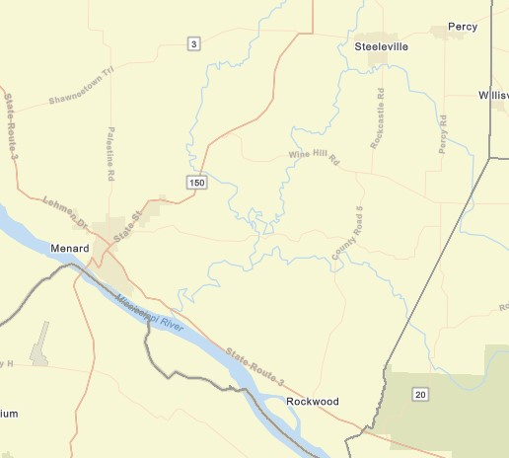
REBUILD ILLINOIS PROJECTS
D8
IL 3 & IL 150 IN RANDOLPH COUNTY
$130.3 MILLION
REMOVE & REPLACE PAVEMENT
MULTIPLE CONTRACTS OVER MULTIPLE YEARS
IL 150 FROM PERRY COUNTY LINE TO IL 4; IL 150 FROM MURPHYSBORO RD TO IL 3; IL 3 FROM IL 150 TO JACKSON COUNTY LINE
Notes:
This next project is the IL 3 and IL 150 pavement replacement in Randolph County. This corridor has taken a beating over the years from heavy coal‑haul traffic, and the pavement is in rough shape. The project runs from north of Percy to south of Chester, and we’re investing about 130 million dollars to fully replace the pavement and restore the corridor to a durable, long‑lasting condition

Slide 30
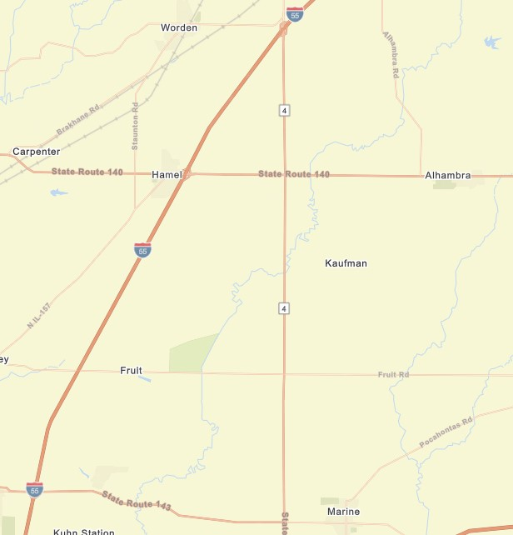
REBUILD ILLINOIS PROJECTS
D8
IL 4 REHABILITATION FROM I-55 TO IL 143
$49.5 MILLION
PAVEMENT REHABILITATION, SHOULDERS AND DRAINAGE IMPROVEMENTS
SIGNIFICANT TRUCK ROUTE CONNECTOR BETWEEN I-55 AND I-64
Notes:
The next project is the IL 4 rehabilitation from I‑55 to IL 143. This stretch is located close to the base, and the work will include pavement and drainage improvements along with adding shoulders. These upgrades will help improve safety, durability, and overall mobility through the corridor.

Slide 31
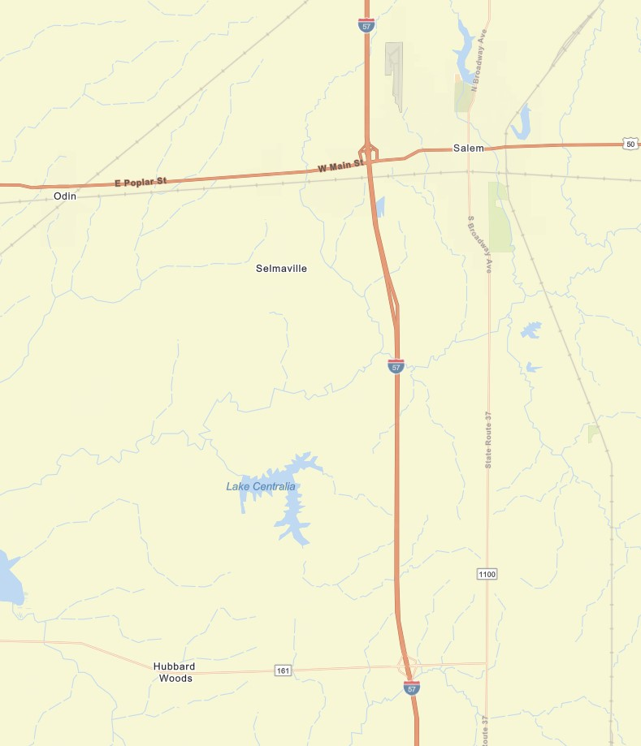
REBUILD ILLINOIS PROJECTS
D8
I-57 PAVEMENT REPLACEMENT FROM
N OF IL 161 TO US 50
$172.9 MILLION
ABOUT 20,000 ADT
54% TRUCKS
Notes:
We recently completed the pavement replacement on I‑57 from the Jefferson County line to just north of IL 161. This next project is simply continuing that work northward, carrying the pavement replacement up to US 50 in Salem

Slide 32
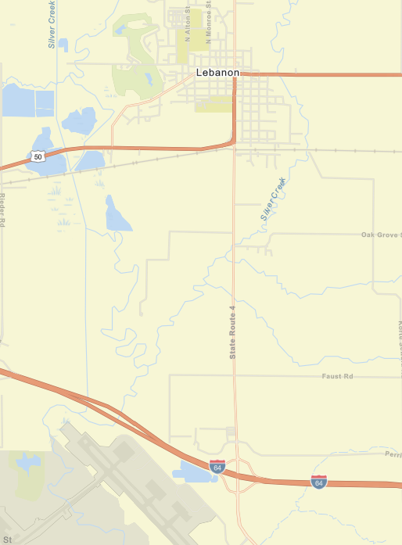
REBUILD ILLINOIS PROJECTS
D8
IL 4 PAVEMENT REPLACEMENT
$21 MILLION
SOUTHERN DR TO PERRIN RD
ABOUT 6,000 ADT
20% TRUCKS
Notes:
The next project is a pavement replacement on Route 3 just south of Lebanon.

Slide 33
District 8 Local Roads Program
(FY26-FY29)
D8
Four – Year Program: FY 26 – FY 29
Total Funding: $220+ M
  Anticipated 250+ Projects
  60+ Bridge Projects
  10+ Safety Projects
Available Online (Included in MYP)
Notes:
Now I will give an overview of the Local Roads Program in D8. The Local program is a 4 year program and the total funding is over $220M and over 250 project. For more information you can follow the QR code to the MYP.
Total #– total of all funding sources
Structures – 7ISBP+11LBFP+44TBP (assume 1 per county per year)
Safety – 9HSIP+4SRTS

Slide 34
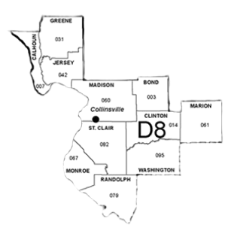
LOCAL ROADS PROJECTS
D8
Resurfacing on Bluff Rd in Monroe County, 5.4 miles, $2.98M
Resurfacing on County Line Rd in Randolph County, $3.9M
Roundabout on Freeburg Ave at IL 158 & IL 3 in Belleville, $4.7M
Resurfacing on Dr. Martin Luther King Jr Dr in E St. Louis, 0.4 mi $799K
Shared Use Path on Ashland Ave in Fairview Heights, 0.72 mi $880K
Widening on Green Mount Rd in Shiloh, 1.6 mi, $7.3M
Intersection Reconstruction and Resurfacing on Tolle Lane in Godfrey, $1.9M
Resurfacing on HH Road in Waterloo, $1M
Roundabout on IL 162 & Old Troy Road in Madison County, $3.8M
Notes:
The full local roads program is available online, but this slide highlights a few of the projects in District 8 expected to go to construction over the next year. These include a couple of roundabout projects, several resurfacings, shared‑use path work, and a number of pavement reconstruction projects.

Slide 35
UPCOMING CONSTRUCTION (ANTICIPATED NEXT 12 MONTHS)
D9
I-57 RECONSTRUCTION FROM COUNTY LINE TO NORTH OF MOUNDS RD IN PULASKI CO $36M
IL 14 PAVEMENT RECONSTRUCTION FROM I-57 NB RAMP TO BENTON SQUARE IN BENTON $6.6M
IL 13 WB PAVEMENT RECONSTRUCTION FROM WALL ST TO MARION ST IN CARBONDALE $5M
IL 37 PAVEMENT REPLACEMENT & I-64 RAMP PATCHING AT I-64 & IL 37 INTERCHANGE $2.8M
IL 37 FROM BONNIE TO I-64 SAFETY PROJECT (STRUCTURE REPLACEMENT, SHOULDERS, ETC) $9M
I-64 BRIDGE REPLACEMENT OVER CASEY FORK & UP RR IN JEFFERSON COUNTY $20M
IL 152 FROM IL 127 TO US 51 SHOULDERS AND DRAINAGE IMPROVEMENTS NEAR DUQUOIN $13.5M
HERRIN ROAD EXTENSION FROM HERRIN RD ROUNDABOUT TO CASINO ROUNDABOUT $19M
IL 37 AND LONGSTREET ROUNDABOUT $2.5M
Notes:
Now switching over to District 9. These are upcoming construction projects in District 9 expected to go to construction within the year

Slide 36
FUTURE CONSTRUCTION
(MULTI-YEAR PROGRAM)
D9
BRIDGE REPLACEMENT AT OHIO RIVER 1 MILE SOUTH OF CAIRO. KENTUCKY IS LEAD. $67.4M
RECONSTRUCTION OF I-57/US 51 FROM MISSISSIPPI RIVER AT CAIRO TO 1.3 MILES NORTH OF MOUNDS RD. 9 MILES. $70.4M
RESURFACING OF IL 37/14 FOR 1.8 MILES FROM IL 14 TO THE BENTON SOUTH CORPORATE LIMITS AND A CONSTRUCTION OF A ROUNDABOUT AT BENTON SQUARE. $28M
RESURFACING FOR 13.8 MILES AND NEW SHOULDER FROM CAMPGROUND RD IN BONNIE TO IL 14 IN BENTON, INCLUDING A 5 MILE BIKEWAY $41M
SLOPE STABILIZATION ON IL 141 FROM THE LITTLE WABASH RIVER NORTH OF NEW HAVEN TO THE WABASH RIVER. $39M
Notes:
These projects are further out in the multi year program

Slide 37
District 9 Local Roads Program
(FY26-FY29)
D9
Four – Year Program: FY 26 – FY 29
Total Funding: $100+ M
  Anticipated 100+ Projects
  50+ Bridge Projects
  5+ Safety Projects
Available Online (Included in MYP)
Notes:
Here is an overview of the D9 program which is $100 M for 4 years and over 100 projects.

Slide 38
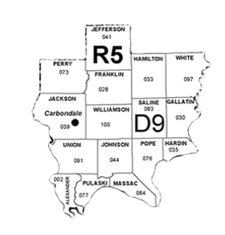
LOCAL ROADS PROJECTS
D9
Roundabout on Cambria/Grand Rd in Williamson County, $2.6M
Bridge Replacement with Intersection Realignment Greens Market Rd in Perry County, $2.7M
Cement Stabilization with A3 Sealcoat in Perry County, $5.1M
Road Reconstruction on Union Hill Rd in Jackson County, $2.2M
Bridge Replacement on Grapevine Trail in Alexander County, $7.5M
Bridge Replacement on Tick Ridge Rd in Pulaski County, $7.3M
Resurfacing on Blairsville Rd in Hamilton County, $3.6M
Concrete Pavement on Woodlawn Rd at I-64 intersection in Jefferson County, $2M
Piles Fork Greenway Bike Path in Carbondale, $800K
Notes:
This slide highlights upcoming District 9 local roads projects. District 9 has a wide variety of work on the way, including bridge replacements, road reconstructions, a roundabout, a bike path, and cement stabilization with an A3 sealcoat.

Slide 39
REBUILD ILLINOIS PROJECTS
D8 &
D9
MANY MORE REHABILITATION/RESURFACING AND BRIDGE REPLACEMENT/REPAIR PROJECTS
CONSULTANT ENGINEERING
ACQUISITION OF NECESSARY RIGHTS-OF-WAY
UTILITY RELOCATIONS
Notes:
Before I move on, I want to point out that what I’ve shown for District 8 and District 9 is only a small sample of the full program. There is a lot more work happening in both districts beyond the projects I highlighted—additional rehabs and resurfacings, bridge repair and replacement projects, ongoing engineering efforts, right‑of‑way acquisition, and utility relocations.
If you’re interested in digging deeper into the full program, all of this information is available online in the Multi‑Year Program.

Slide 40
Opportunities to Engage with IDOT
Engineering Services
Land Acquisition Services
Construction Services
Notes:
Now that we’ve walked through some of the major state and local projects in Districts 8 and 9, I want to shift to the opportunities that exist for engaging with IDOT. Beyond the construction projects themselves, there are many ways to participate in and support the work we’re doing.
There are opportunities in engineering services, land acquisition services, and construction services. These areas continue to grow as more projects move through the program, and we rely on strong partnerships to help deliver them.

Slide 41
Engineering Services: Phases
Phase I – planning/preliminary engineering
Studies, Feasibility, Environmental (NEPA)
Traffic Analysis
Public Involvement
Phase ii – design
Plans, Specs, Estimates (PS&E)
Drainage, Structural, Roadway Design
Utility Coordination
Right of Way Design
Phase iii – construction
Construction Inspection
Documentation (Daily Diaries, Pay Quantities)
Change Orders & Field Decisions
Material Testing
Notes:
Since engineering is one of the main ways to engage with IDOT, I want to give a quick snapshot of what ‘engineering services’ actually covers.
We break our work into three phases:
Phase I is the planning side—studies, environmental work, traffic analysis.
Phase II is design—turning concepts into plans and specifications.
And Phase III is construction—inspection, documentation, and materials testing out in the field.
I’m keeping it brief, because the next slide gets into what you actually need to do to engage with IDOT in these engineering roles.

Slide 42
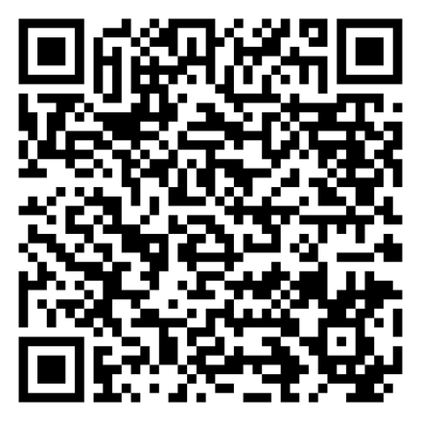
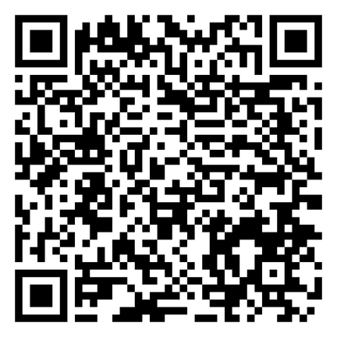
Working with IDOT: Engineering
Professional Transportation bulletin (ptb)
Prequalification
SCAN
ME!
SCAN
ME!
Quality based selection (qbs)
Notes:
Engineering work with IDOT follows a quality‑based selection process, and firms must be prequalified in order to perform this work. That prequalification process is governed by state statute—30 ILCS 535/1.
The QR code on this slide links directly to information on how to become prequalified.
IDOT advertises for professional services four times a year through the Professional Transportation Bulletin, or PTB. The PTB schedule is posted publicly, and each bulletin lists the projects and disciplines we’re seeking qualifications for—covering engineering, surveying, and other professional services. Scan the QR code to get you to the website where the PTBs are advertised.
So if you’re looking to engage with IDOT in engineering, the PTB is where those opportunities are announced.

Slide 43
Land Acquisition Services
Areas of work:
  Specialty agents – appraiser
  Specialty agents – negotiator
  Specialty agents – relocation agent
  Specialty agents – review appraiser

Slide 44

Working with IDOT: Land Acquistion
LAND ACQUISITION
Bulletin (LAb)
SCAN
ME!
Quality based selection (qbs) – as of 2023
Prequalification process similar to engineering

Slide 45
Working with IDOT: Construction
Prequalification
state letting or contractors bulletin
Award to Lowest responsible bidder
Local public agency (LPA)opportunities
Notes:
Prequalification – most require it. State Lettings – can be Stateside or Local Agency work. 7 lettings per year usually. Bids submitted electronically via IDOT and open publicly on letting day. Bulletin is ran every Thursday and bids are open publicly on the listed letting date. For state funded projects, they are required to advertise for 11 days and if federal funds are involved, they advertise for 21 days. Materials and/or projects are advertised here.

Slide 46
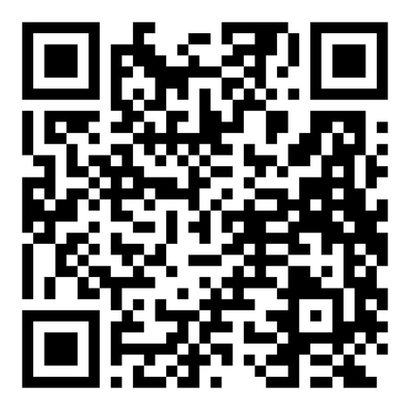
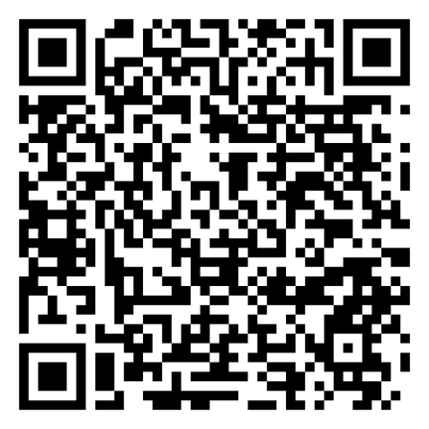
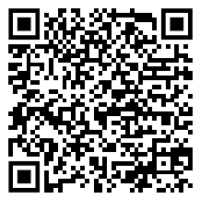
Working with IDOT: Construction
State lettings
(state & Local agency work)
Contractors bulletin (local agency work)
SCAN
ME!
SCAN
ME!
Innovative project delivery (IPD)
SCAN
ME!
Notes:
The Notice to Contractors Bulletin is a service to Local Public Agencies (LPAs) to advertise LPA let construction, maintenance, and material contracts. The bulletin provides details to the contractor and material supplier in order to prepare and submit their bid.

Slide 47
SUMMARY
What is IDOT
REGION 5 Organizational structure/overview
Projects under construction
multi-year program/upcoming projects
Working with idot – engineering / land acquisition / construction

Slide 48

Questions?
REBECCA THARP, PE, SE
ASSISTANT REGION FIVE ENGINEER
REBECCA.THARP@ILLINOIS.GOV
(618) 346-3330

Slide 49
Thank You!

