Slide 1
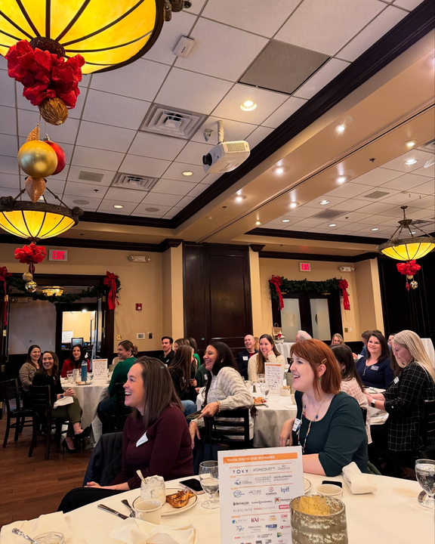
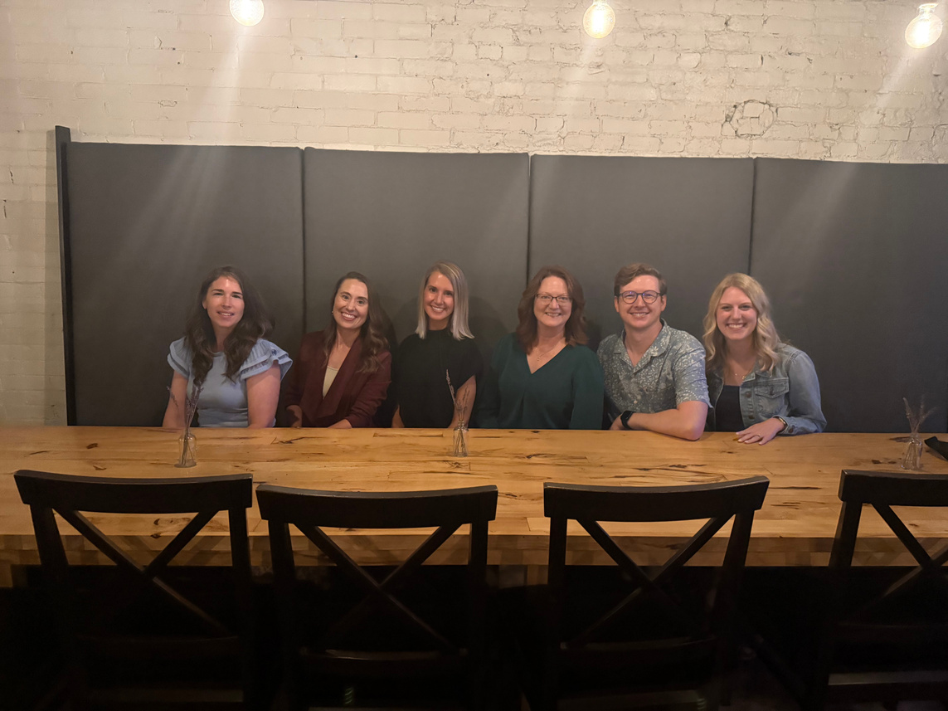

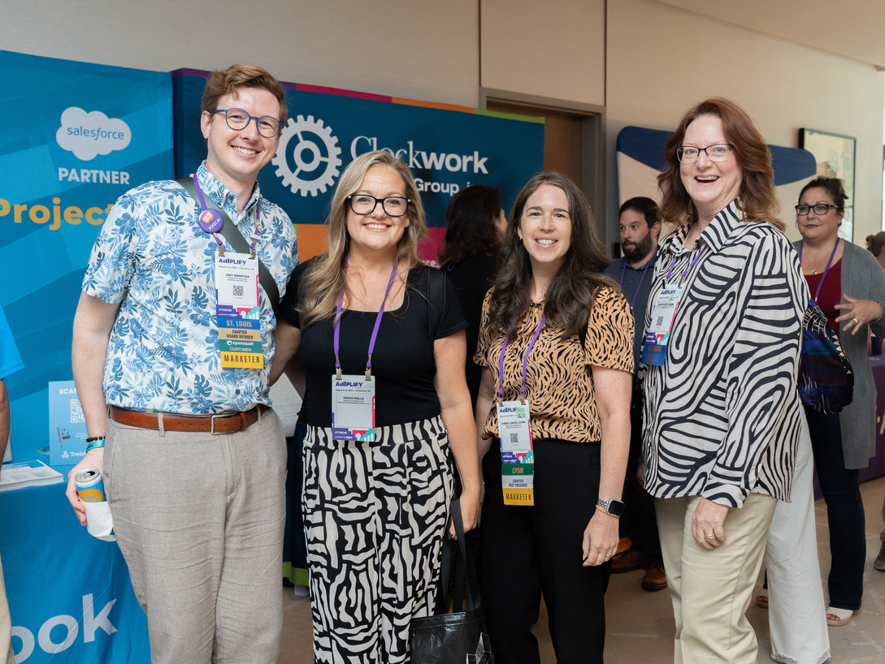
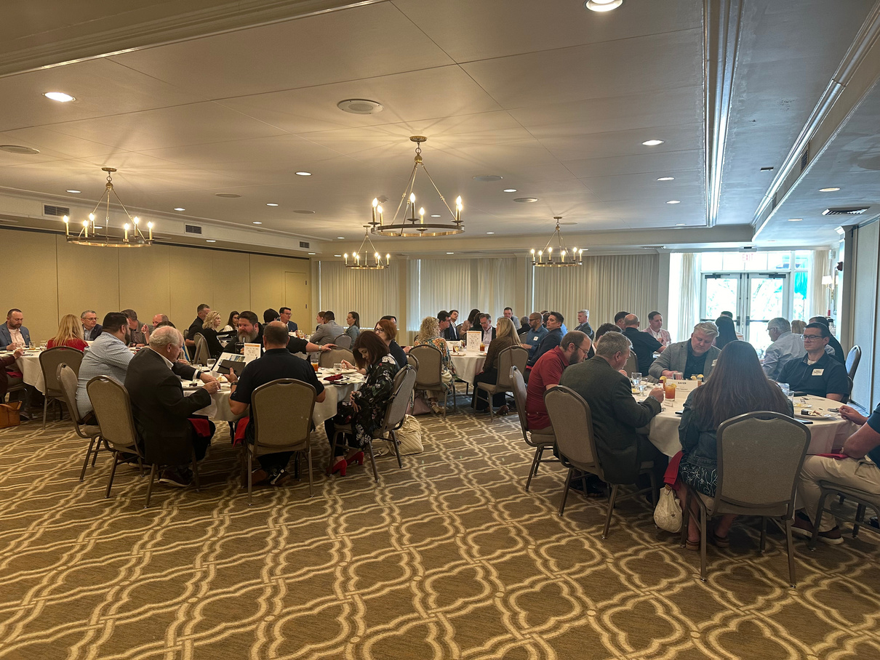

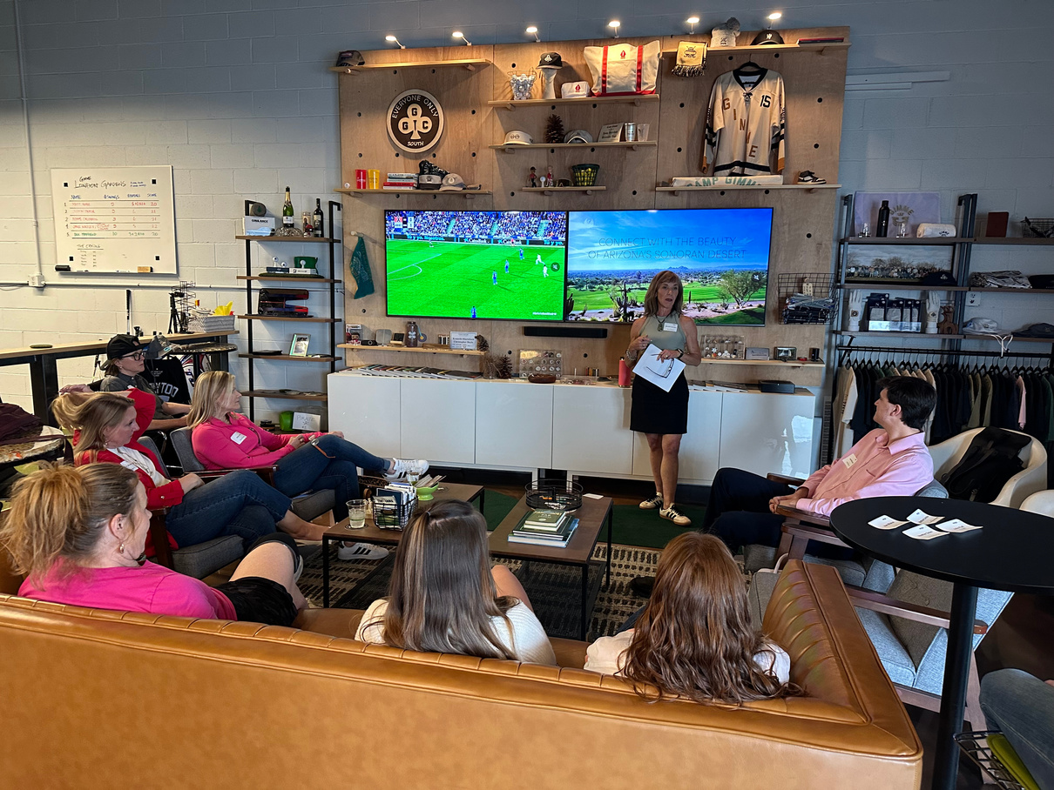
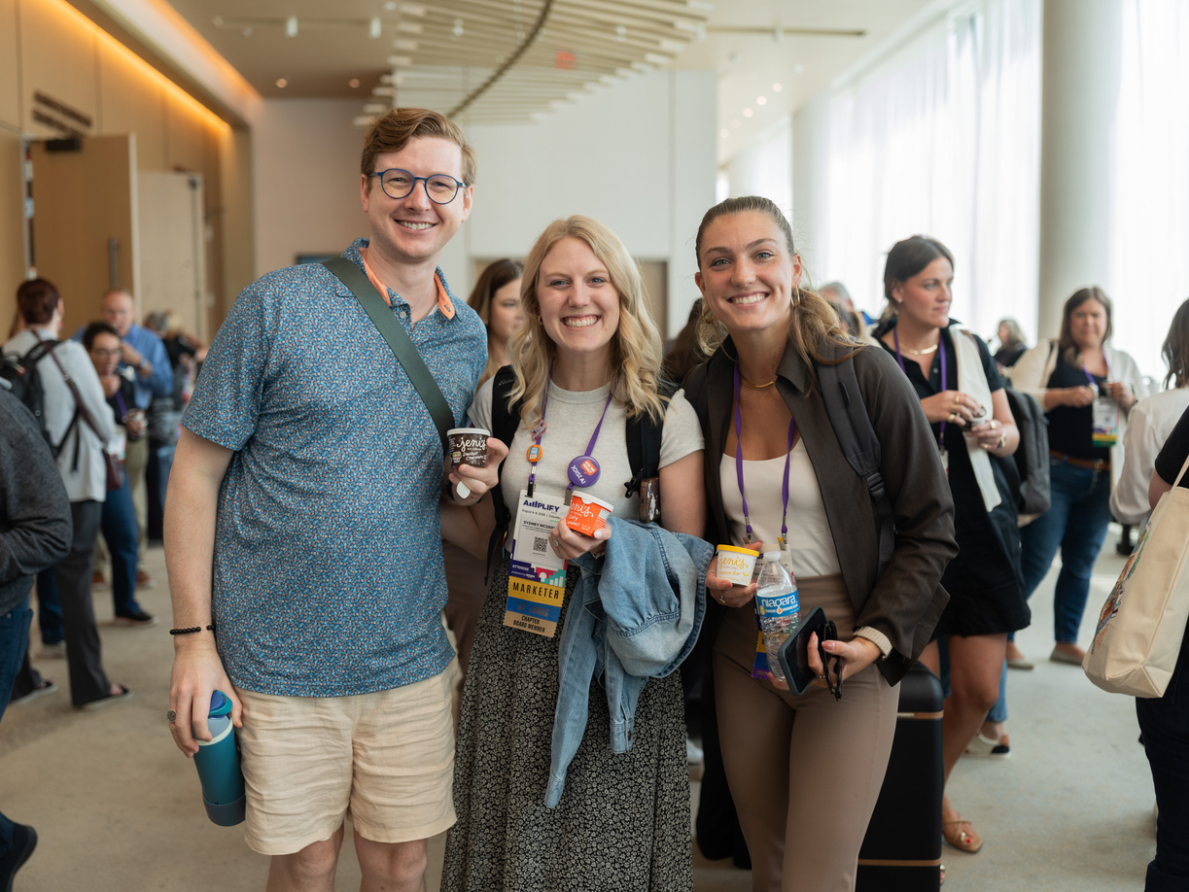

Slide 2
Upcoming Events
CHECK OUR WEBSITE FREQUENTLY
Scan the QR code to the right to save our Events Page to the browser on your phone and check back often for updated events!
EVENTS PAGE
MAY
7 | 8 on 8: Lunch with a Prospective Client
JUN
9 | Communicating the Value of Green Building
JUL
9 | Annual Pickleball Tournament

