Slide 1

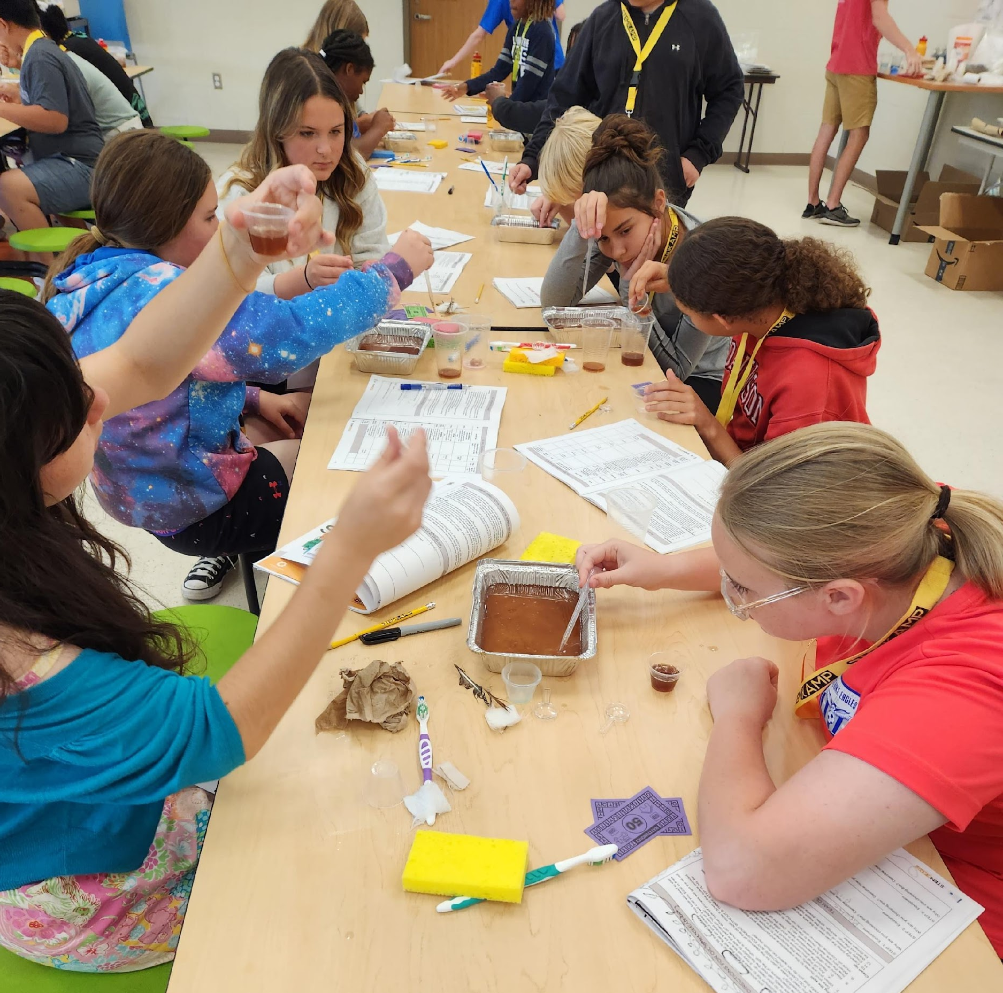


Science, Technology, Engineering and Mathematics
for
Kids of Active Military Personnel
the spark that ignites a passion in students
to pursue a STEM career
Funded by:

Slide 2

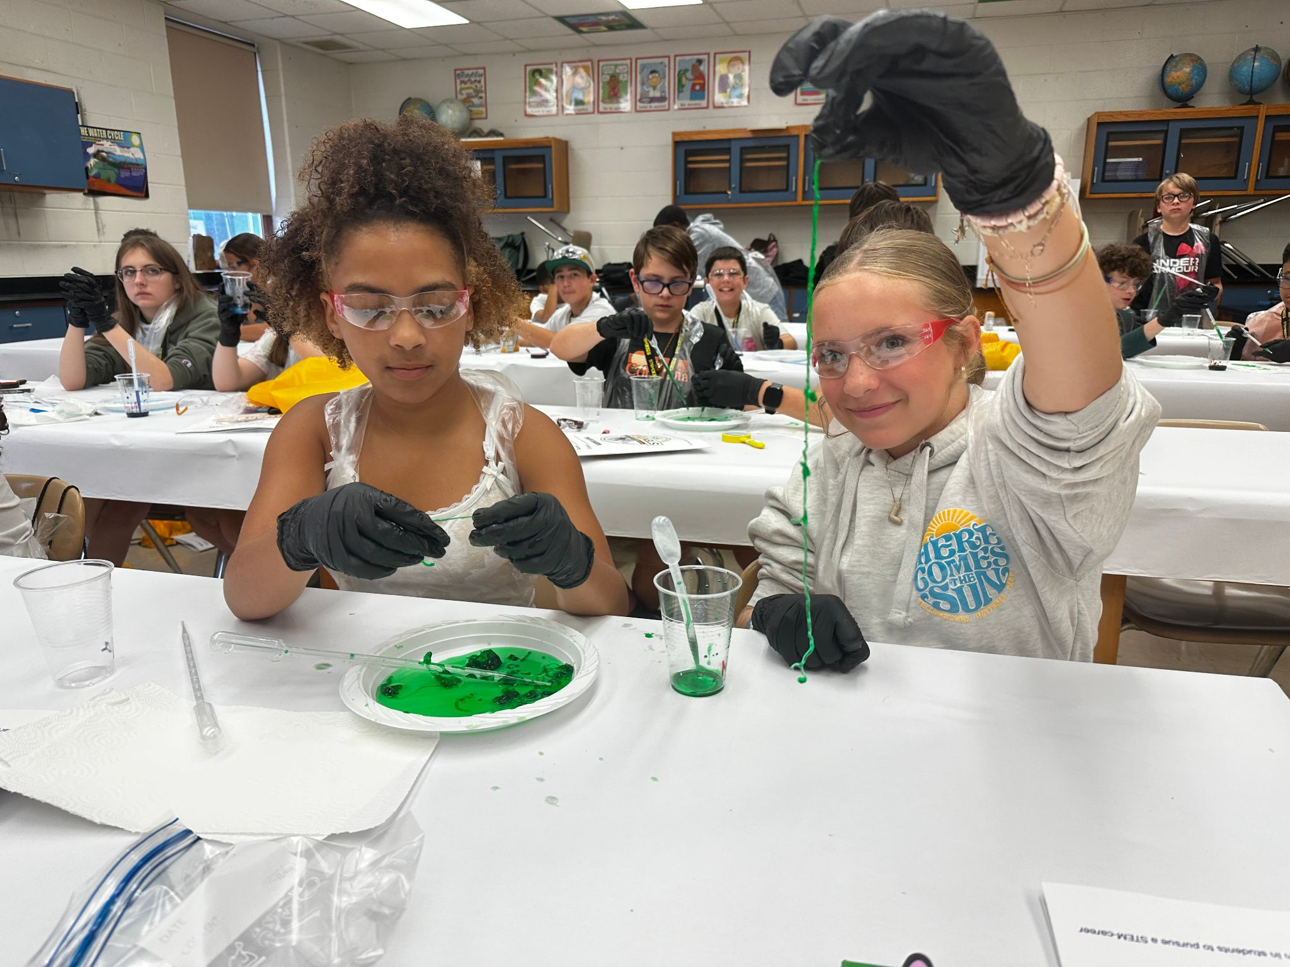
What is STEMKAMP?
DoWSTEM / DSEC Funding
SAME pilot in 2026
Five-day summer camp
New STEM curriculum each year
75-200 3rd-8th grade students/camp
Districts with >10% active military kids
Priority given to military kids
Staffed by licensed teachers
Community partners and organizations participate as volunteers and exhibitors

Slide 3






4,756
students attended
STEMKAMP from 21-25
11
military connected school districts
currently host STEMKAMPs
58%
of students who participated were Kids of Active Military Personnel (KAMPers)
122
teachers received training in STEM methodology each year
96%
of parents said STEMKAMP was a good program for their child and would recommend it to other families
Notes:
0:03
KAMPers - Kids of Active Military Personnel

Slide 4
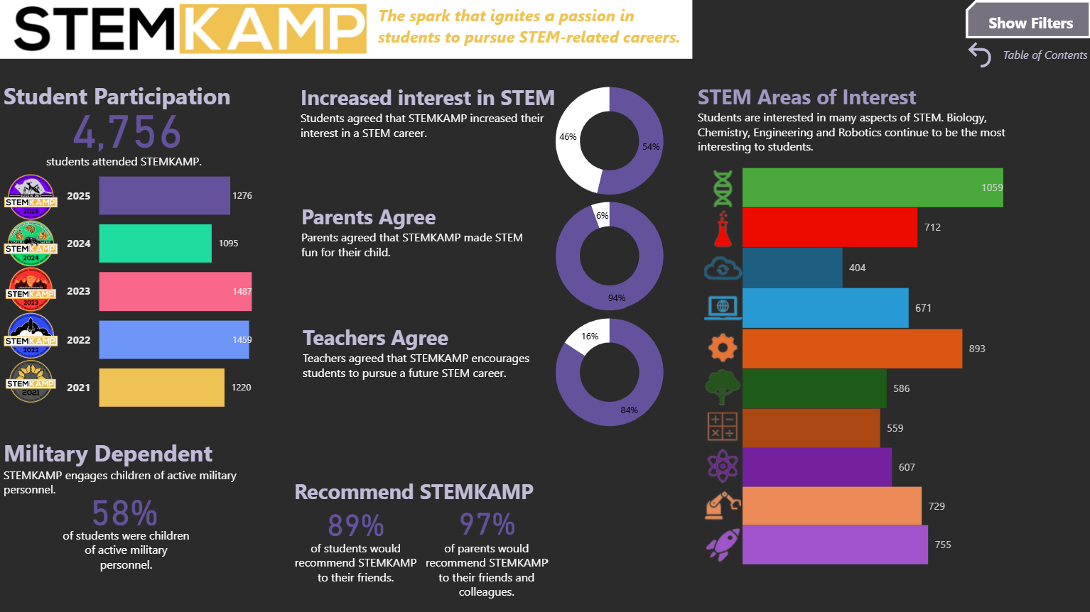
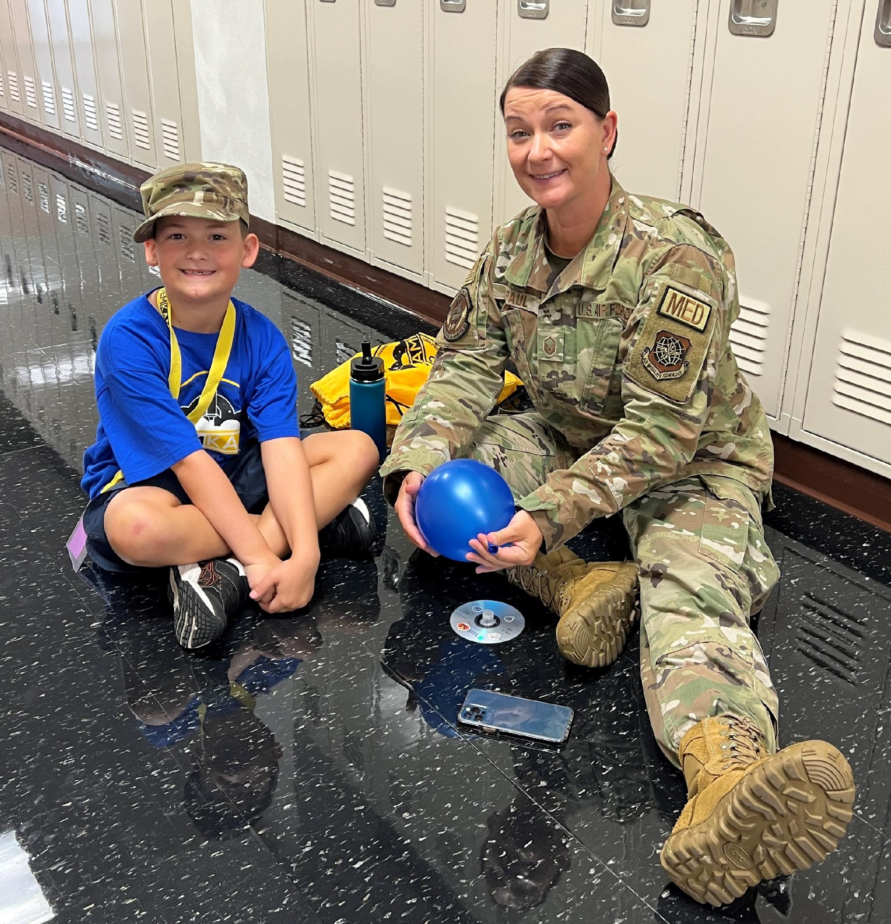
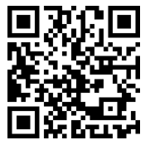
How have we done?
For more data on STEMKAMP, scan here:
Notes:
notes

Slide 5
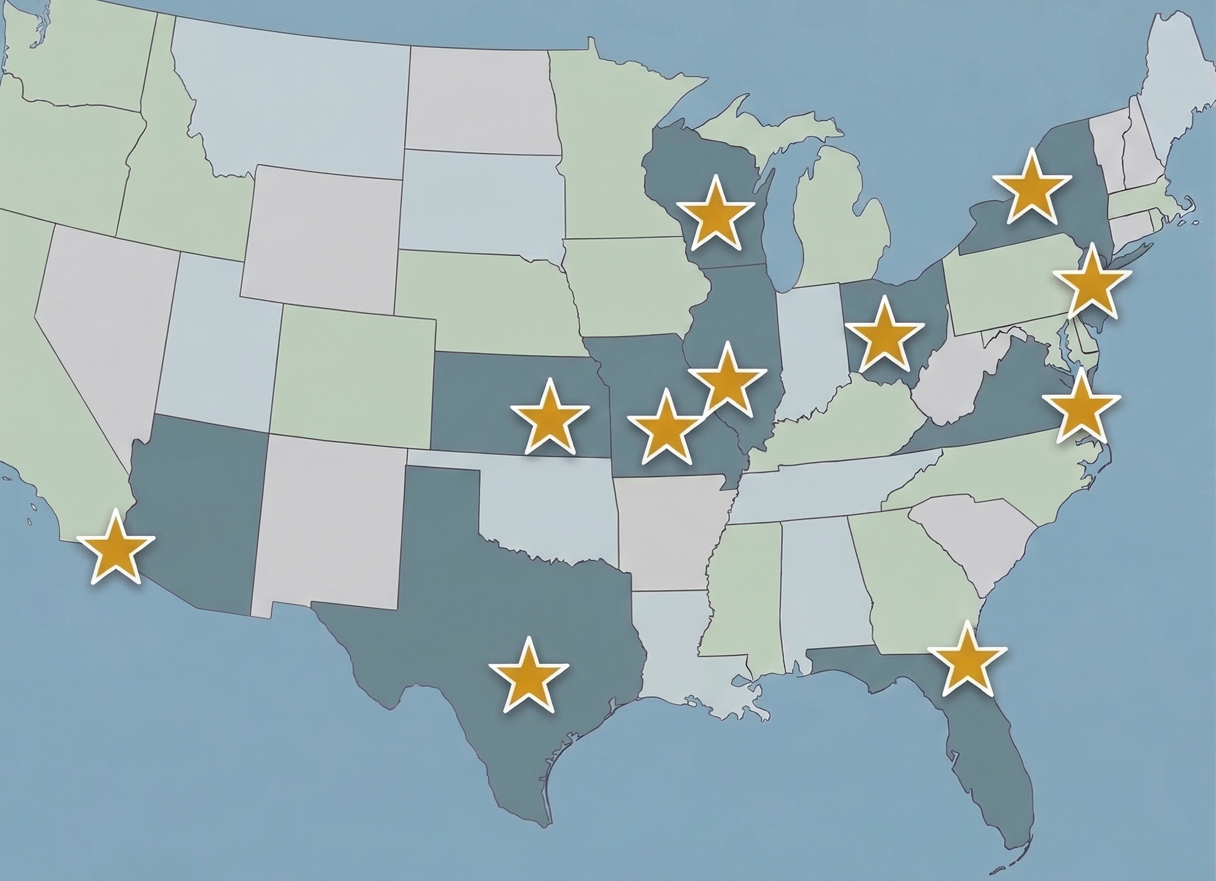
2026 Locations
Chesapeake, Virginia (Navy Station Norfolk)
Dayton, OH (Wright-Patterson AFB)
Derby Public Schools, Kansas (McConnell AFB)
Jacksonville, Florida (Naval Station Jacksonville)
San Antonio, Texas (Joint Base San Antonio)
Sparta, WI (Fort McCoy)
North Hanover, New Jersey
(Joint Base McGuire-Dix-Lakehurst)
Mascoutah, IL (Scott Air Force Base)
Watertown, NY (Fort Drum)
Waynesville, MO (Fort Leonard Wood)
Yuma, Arizona (Marine Corps Air Station)

Slide 6

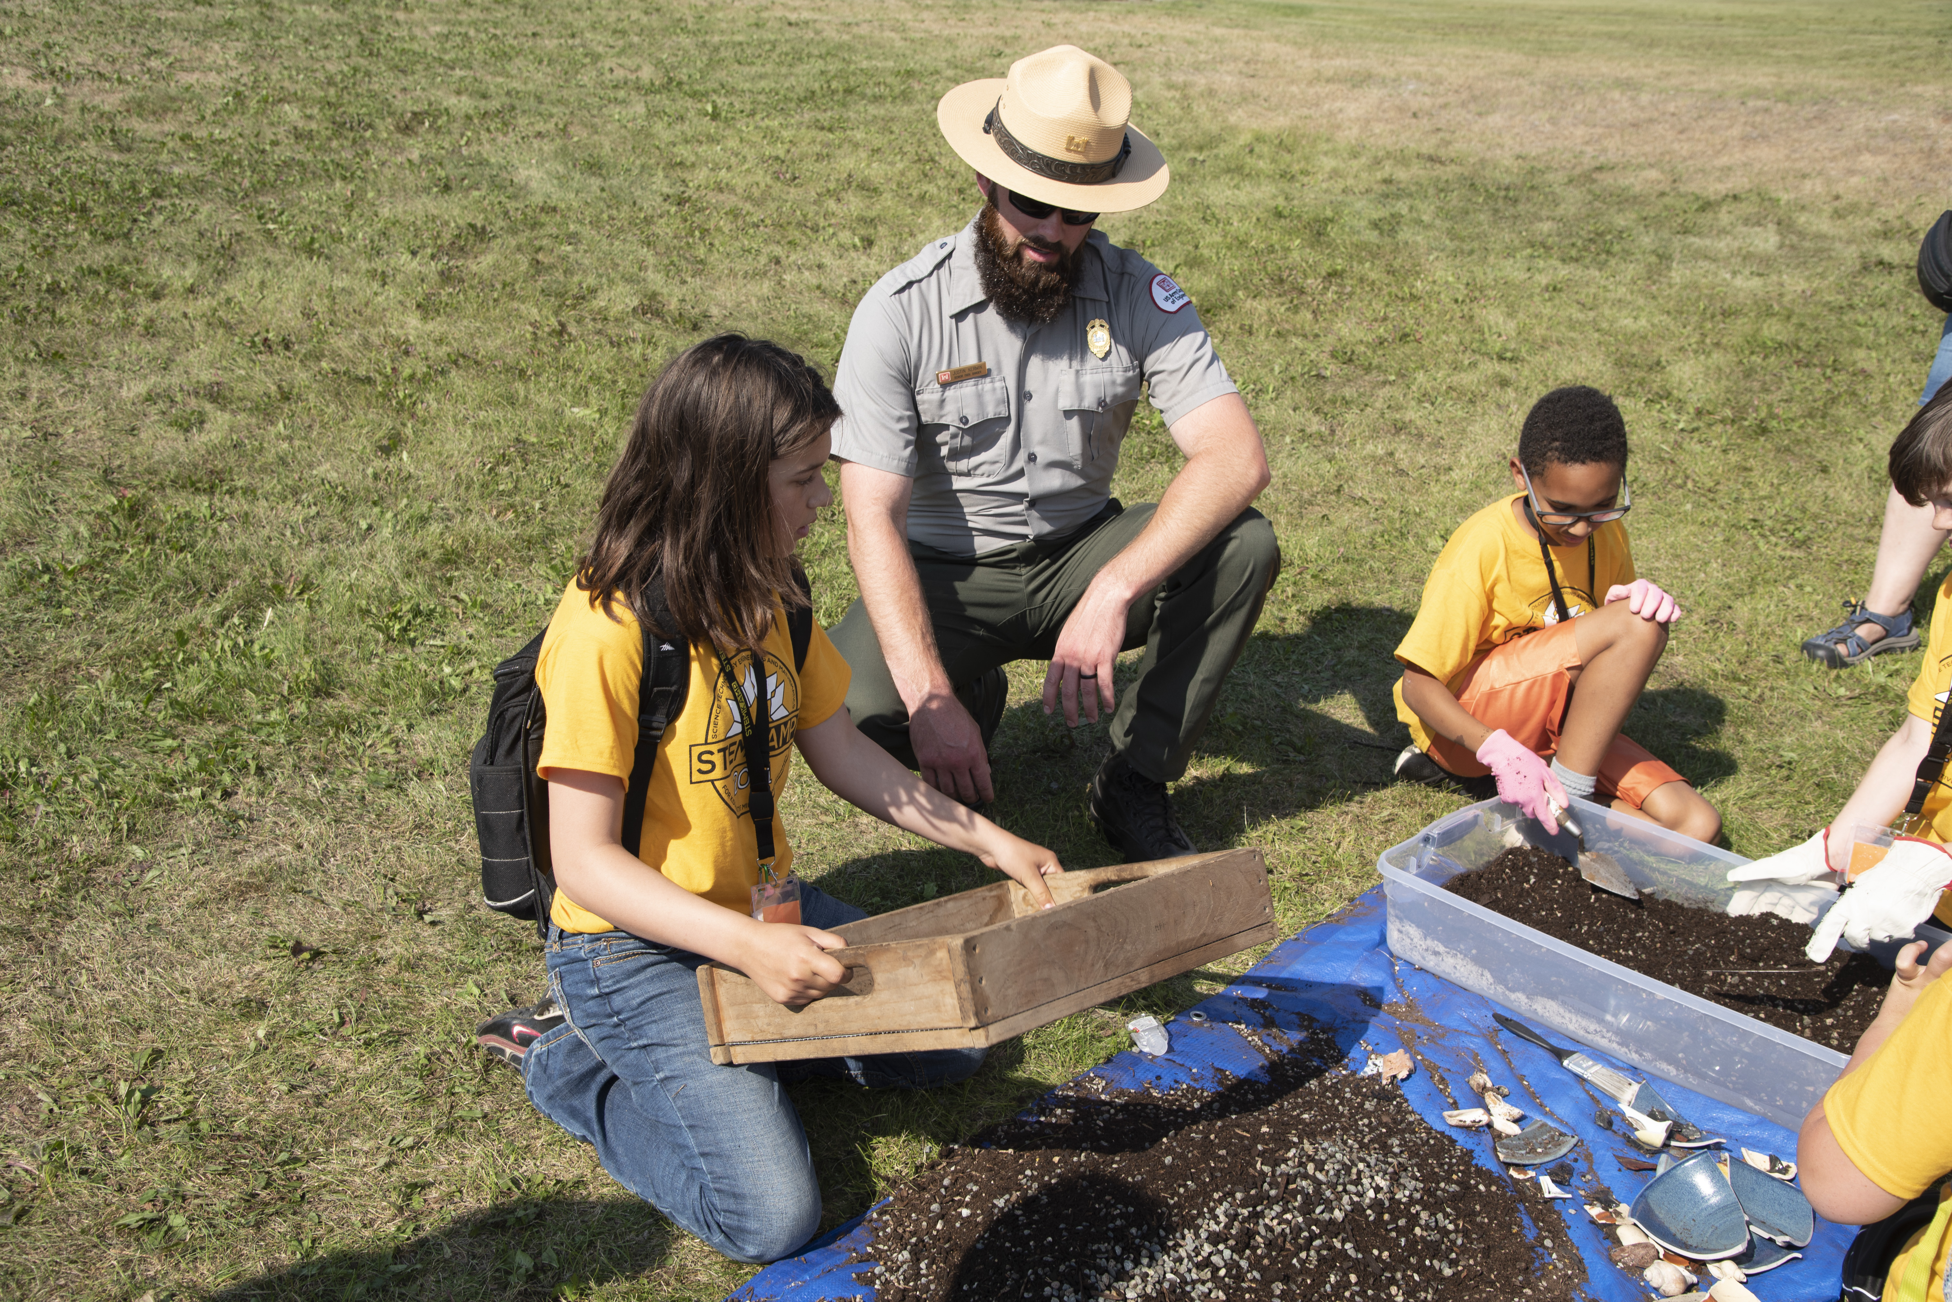
Activity Overview:
Day 1: Designing Sustainable Cities
Day 2: Ecological Restoration Engineering
Day 3: Clean Water Chemistry
Family Day: The "Green Logistics" Drop
Notes:
https://stemkamp.net/storage/flyers/01KKA5BKTB91RPGWAE9AT30RXN.png

Slide 7
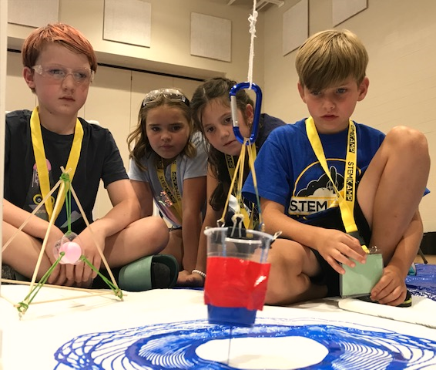
Expansion and Sustainability
SAME Pilot
1 Funded Classroom
Co-located with Mascoutah Camp
Mascoutah Middle School
July 13 – 17
25 KAMPers from Scott Field Community

Slide 8
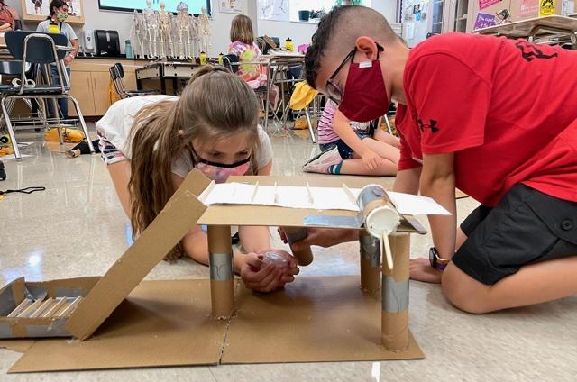
For more information:
www.stemkamp.net
Program Director: Shannon McWhorter, shannon@stemkamp.net
Executive Director: Matt Feldmann, PhD, matt@stemkamp.net

