Slide 1

VA John J Cochran division, st louis, MO
Replace Bed tower, clinical expansion, & parking garages
SAME/SMPS Industry Day
April 2026
BUILDING FOR HEROES
BUILDING FOR HEROES

Slide 2



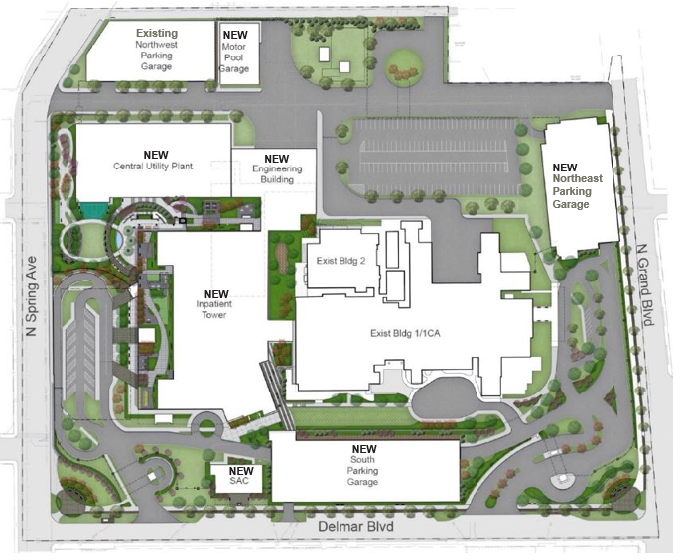
VA JOHN COCHRAN DIVISION, ST. LOUIS, MO
REPLACE BED TOWER, CLINICAL EXPANSION & PARKING GARAGE
VA PROGRAM OVERVIEW
VA St. Louis Health Care System
A full-service health care facility providing inpatient and ambulatory care in medicine, surgery, psychiatry, neurology, and rehabilitation, as well as over 65 subspecialty areas. It is a two-division facility that serves veterans and their families in east central Missouri and southwestern Illinois.
The John Cochran (JC) Division
Located in midtown St. Louis at 915 N Grand Blvd near its affiliated medical schools - St. Louis University and Washington University. It has all of the medical center’s operative surgical capabilities, the ambulatory care unit, and a six-story Clinical Addition that includes surgical facilities, intensive care units, outpatient psychiatry clinics, and expanded laboratory.
DVA Major Project 657-309
Addresses a variety of issues including patient safety and privacy, physical security, mission critical mandates, building seismic deficiencies, facility condition deficiencies, and lack of on-site parking; all working to improve and “right-size” the medical center. Many existing inpatient functions will be relocated into a new seismically designed bed tower. New work includes a Seismically Designed Inpatient Tower, Central Energy Plant, IT/Engineering/Admin Facilities, Substance Abuse Clinic, Elevated Parking, Water Storage (96hr Supply) and Demolition of Aged/Deficient Ancillary Buildings.
PROGRAM PARTNERSHIPS
Department of Veterans Affairs
Office of Construction & Facilities Management
St Louis Health Care System, Major Projects Services
Rogers, Lovelock, & Fritz (RLF)
Architect and Engineering Services – Designer of Record
Jacobs
Government’s Commissioning Agent (CxA)
PROJECT AUTHORIZATION
2010 Requirements Gathering $43M
2022 CA $135M
FY26 Appropriation $1.62B
KEY MILESTONES
Advertise AE SATOC JAN 2026
Award AE SATOC OCT 2027
Advertise IDaC SEP 2026
Award IDaC JAN 2027
FY26 VA Appropriation 2QFY26
FY26 VA Authorization 4QFY26
Design Resumes APR 2027
Schematic Site Plan
JC Division - 915 N Grand Blvd

Slide 3
VA JOHN COCHRAN DIVISION, ST. LOUIS, MO
program Schedule

Slide 4
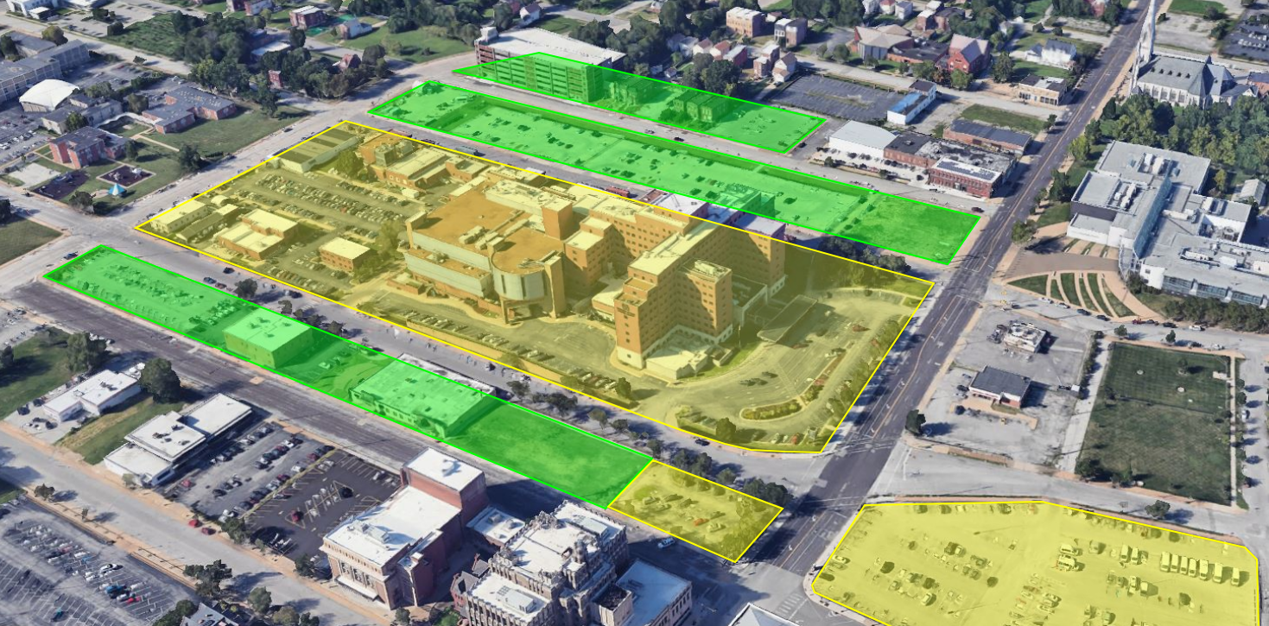
VA JOHN COCHRAN DIVISION, ST. LOUIS, MO program and bed tower scope
Relocates in-patient functions from a seismically deficient building into a new seismically designed bed tower.
Improve inpatient privacy by eliminating existing double and triple occupancy inpatient rooms.
Allows for Primary Care, Women's Health and Outpatient Mental Health Services to be brought back on campus.
Relocates SCI Hub to tertiary care facility from Jefferson Barracks and adds SCI Inpatient Beds
Corrects vertical transport constraint for complex surgical cases
Corrects safety, physical security, and mission critical resiliency deficiencies
Replaces seismically deficient mission critical CUP (Central Utility Plant)
Leading VHA’s HVAC design response to pandemic mode operations
VASTLHCS is a FEMA designated COOP facility
Property acquisition and street vacation
* Overall, the JC Major Project right sizes the Medical Center and builds a new campus to meet current VA Design Criteria.

Slide 5
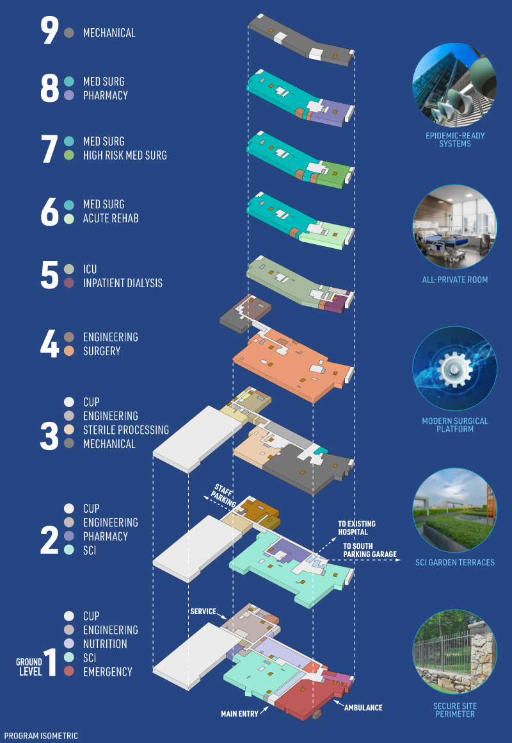
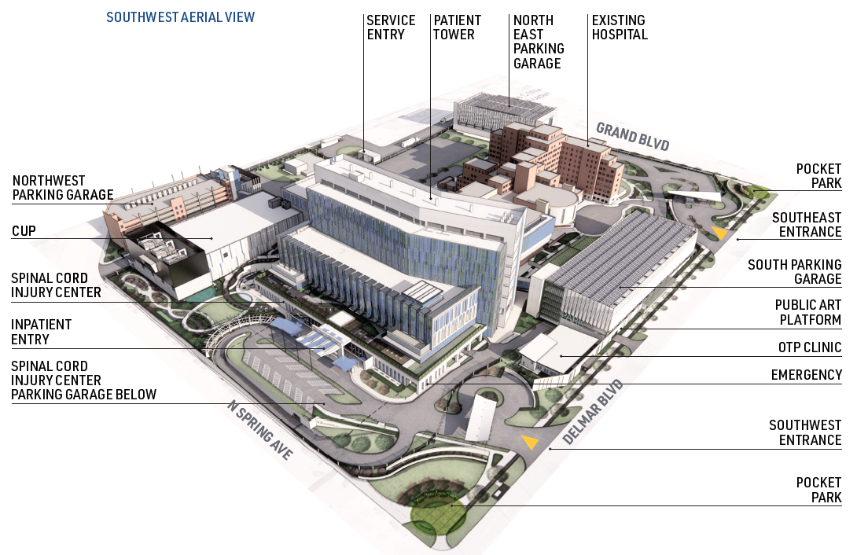
VA JOHN COCHRAN DIVISION, ST. LOUIS, MO program and bed tower scope
New Construction Details
Inpatient Bed Tower 585,000 SF
IRM/Engineering/Warehouse 54,000 SF
Central Utility Plant 94,000 SF
Treatment Clinic 5,100 SF
Additional Parking 1,900 approx. spaces
(3 garages and surface lot)

Slide 6




VA JOHN COCHRAN DIVISION, ST. LOUIS, MO integrated design and construction overview
CONCEPT DESIGN
35% DESIGN
65% DESIGN
95% DESIGN
100% DESIGN
IDaC
A-E
DESIGN
BUILDER
PRECONSTRUCTION SERVICES
CONSTRUCTION
RFP FOR OPTION
CONCEPT DESIGN
35% DESIGN
65% DESIGN
95% DESIGN
100% DESIGN
Project Delivery Method
D-B-B
A-E
DESIGN
BUILDER
CONSTRUCTION
RFP
CONCEPT DESIGN
35% DESIGN
65% DESIGN
95% DESIGN
100% DESIGN
D-B
A-E
DESIGN
BUILDER
RFP
CONSTRUCTION

Slide 7




VA JOHN COCHRAN DIVISION, ST. LOUIS, MO integrated design and construction overview
Integrated Design and Construction Key Objectives
IDAC is D-B-B
Design and construction services are contracted concurrently through two efforts.
        A-E Services for Complete Design
        Pre-Construction Services with Construction Options
Award construction contractor services early in the project's development.
Enables the builder's early engagement with the Designer of Record to provide:
        Constructability
        Cost Input
  End Goal
  Cost-effective design and construction solution
  with better alignment of scope and budget.
STAKEHOLDER
USACE
DOR
CONSULTANTS
BUILDER
SUBCONTRACTOR
COLLABORATION

Slide 8


VA JOHN COCHRAN DIVISION, ST. LOUIS, MO
SENIOR EXECUTIVE BOARD
QUESTIONS & CLOSING REMARKS
Questions on any information in the sources sought?
Questions on milestones or schedule?
Questions on funding?

